Slide 1
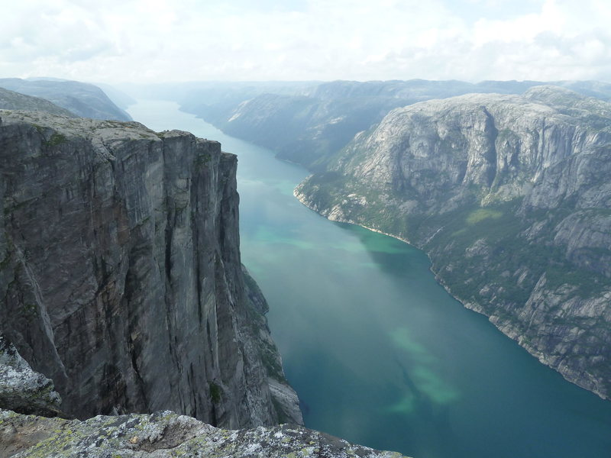
Base-
BASE jumping in Norway
-some aspects for the rescue…
Dan Halvorsen

Slide 2
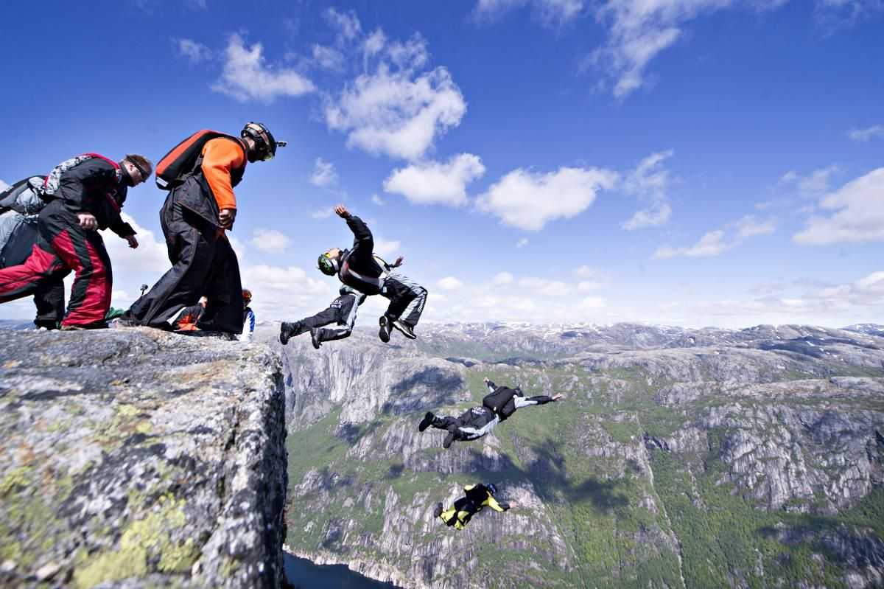
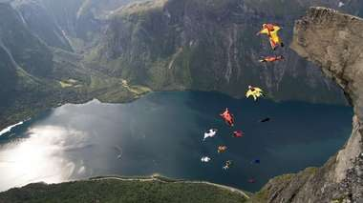
More popular and safer equipment

Slide 3
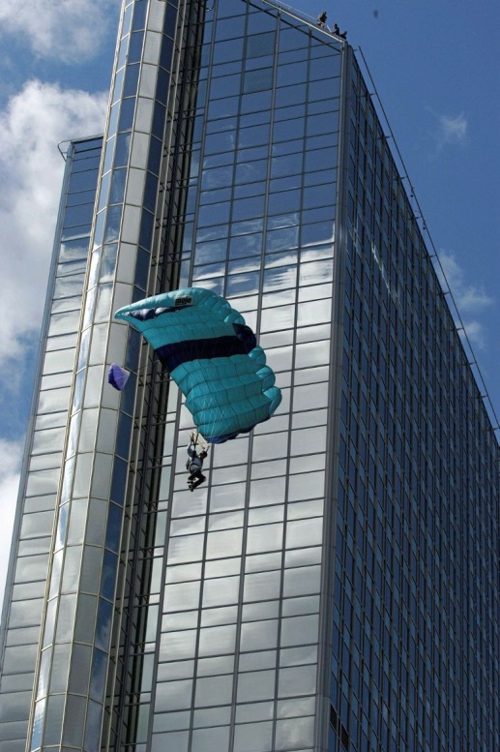
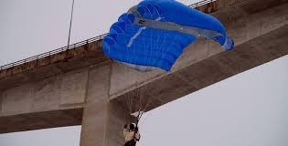
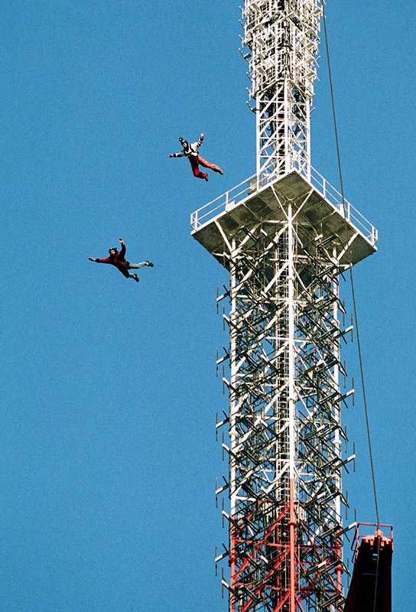
BASE jumping
Building
Antenna
Span (bridge)
Earth (Mountains)

Slide 4
Spectacular Activity:
Filming of the Activity -from day one
High focus in the media
Today:
Go-Pro and You Tube

Slide 5
1978 El Capitan Carl Boenish
1980 Trollveggen, Norway
1984 Carl Boenish dies in Trollveggen
1986 Regulaton in Trollveggen…. «banned jumping..»

Slide 6
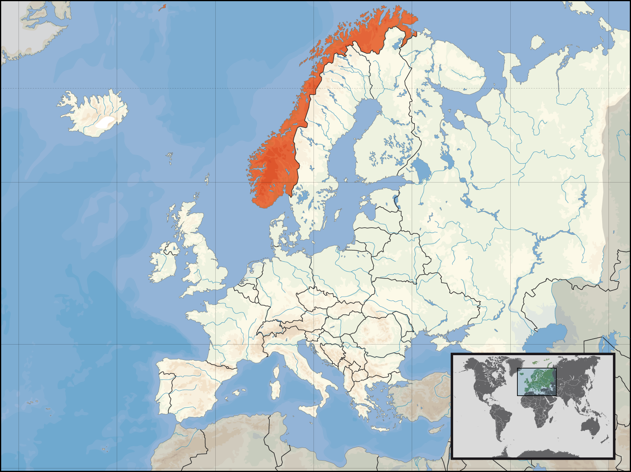
29.000 km coastline

Slide 7
1984- 2012 Nine fatalities in Trollveggen
1996-2012 Ten fatalities in Kjerag
From 1984 – 2017 total 34 fatalities
Risk: 5- 8 times higher than parachuting from plane

Slide 8
Danger for the rescue team
-the victim can be in mountain areas that climbers do not climb
Rock fall during rescue in Trollveggen

Slide 9
Rescue drama in vertical wall
«We don’t dare to fly close to, or above , the patient due to fear of blowing air into the chute again.

Slide 10
Rescue:
Difficult (and dangerous) access to the victim
Is the victim alive or dead ?
-difficult decision from the helicopter window
Some victims (dead)blown away from helicopter downwash

Slide 11
PLAY SLIDE 11 VIDEO HERE

Slide 12
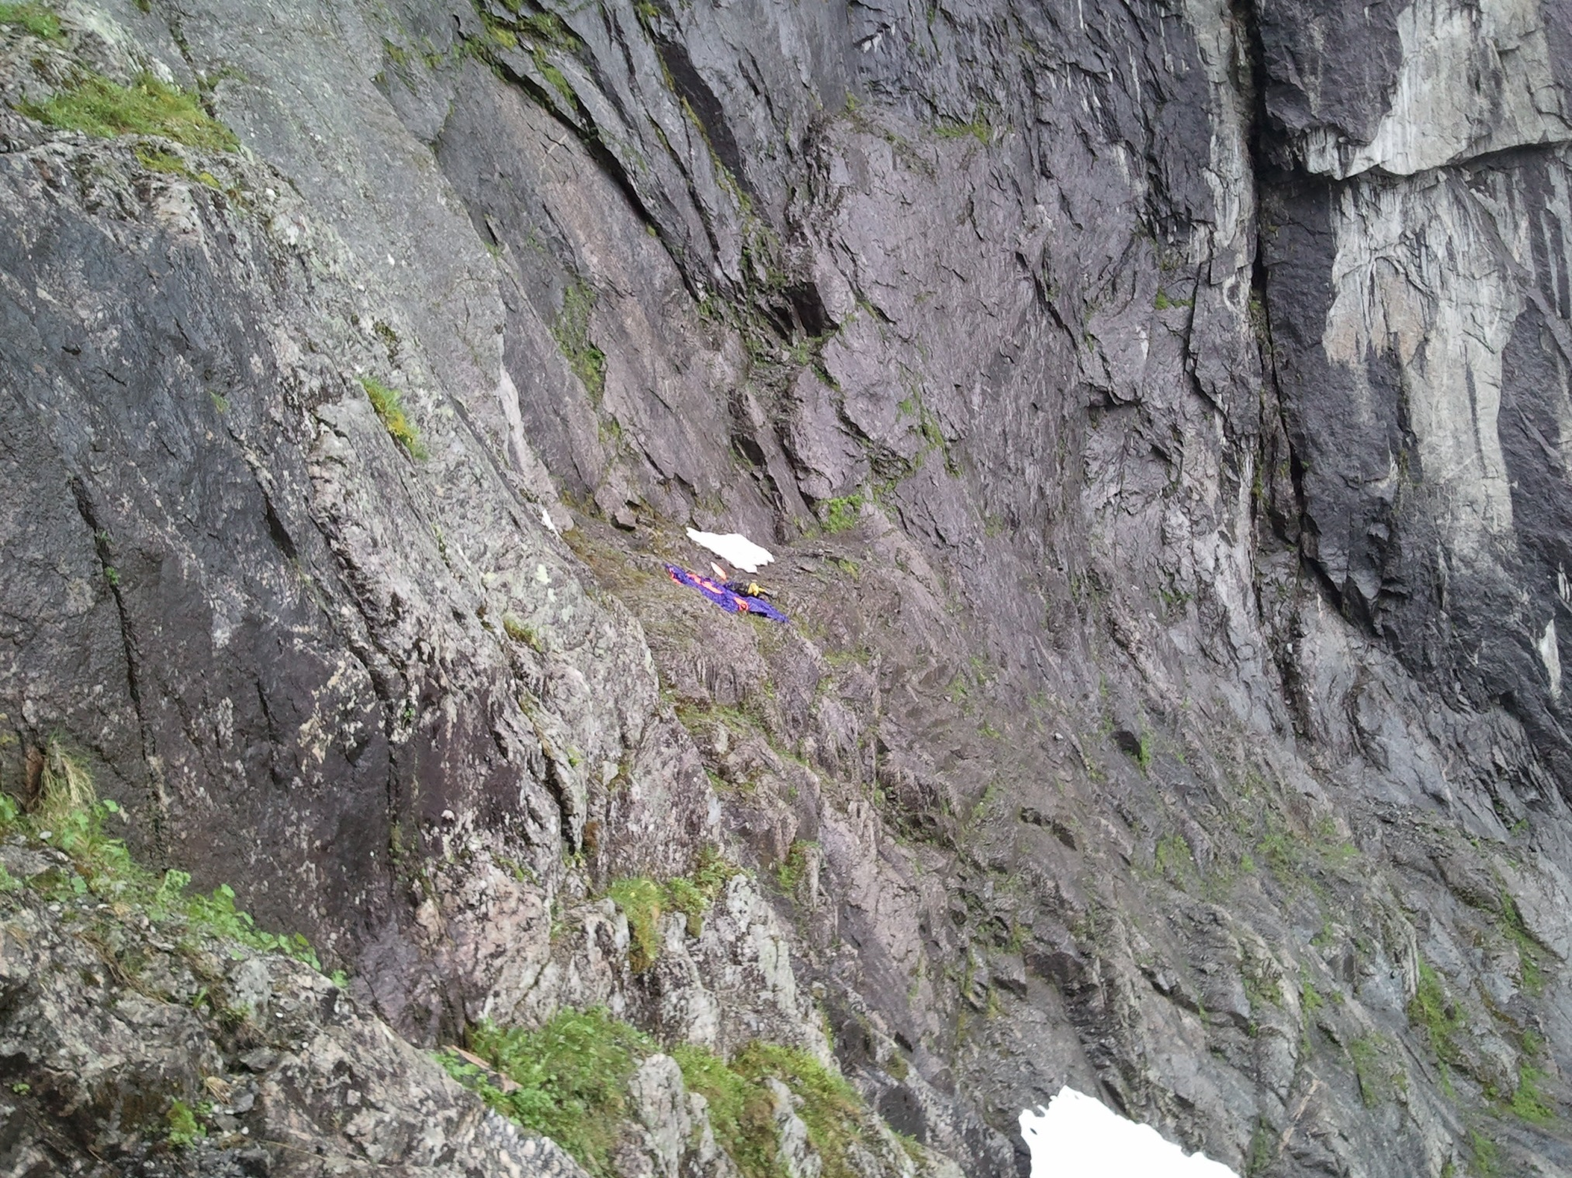
Alive ?
….or not

Slide 13
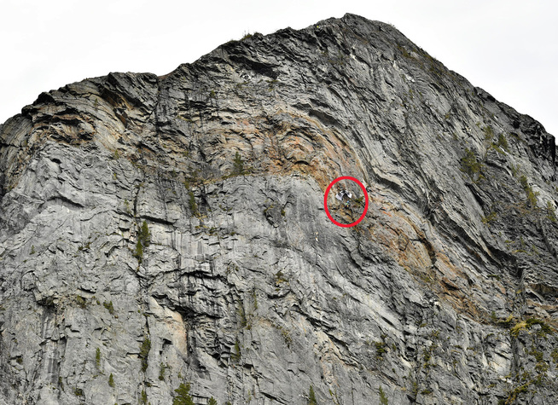
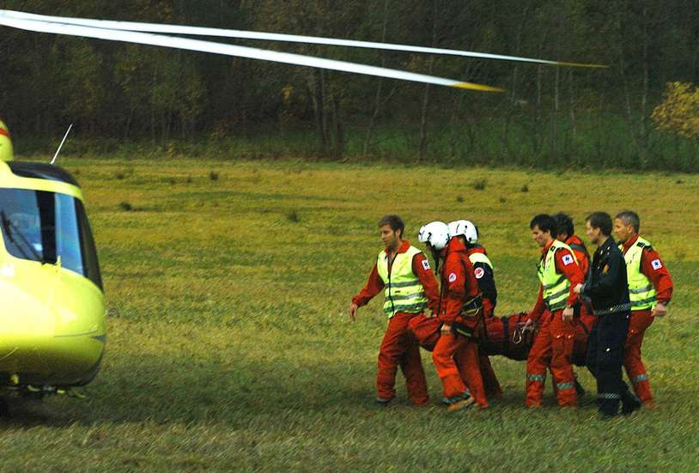

Slide 14
Local demands for a regulation or prohibition of BASE jumping
The local Mayor: « ask for a regulation and to stop BASE jumping…”

Slide 15
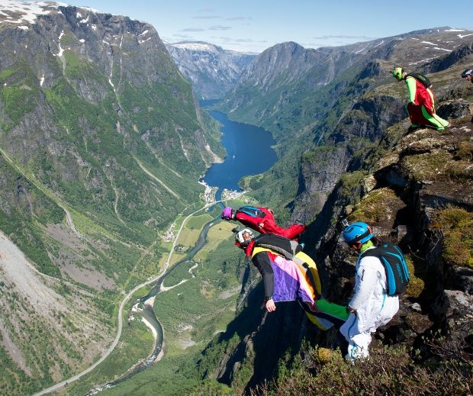
To be discussed:
“guidelines” concerning rescue
of people with a parachute
Do a recon flight (keep distance to the parachute)
Make a plan – helicopter crew, alpine rescue
Secure the victim ( wrap the parachute)
Do the evacuation
SAFETY FIRST !

Slide 16
dh@luftambulansetjenesten.no
Thanks to Bjarte Bø

