Slide 1


CROATIAN MOUNTAIN RESCUE SERVICE
SAR and Avalanche Committee
PRESENTATION BY:
Andrea Pintar
HGSS SAR Dog instructor

Slide 2

IKAR doghandler meeting 2009
11. - 14. June 2009 Baške Oštarije, Mnt. Velebit, Croatia
Topic:
Summer search

Slide 3

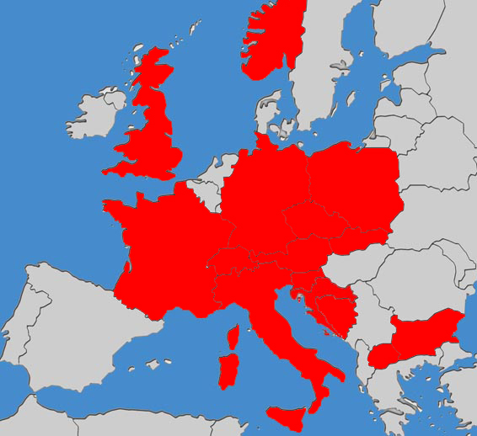
IKAR doghandler meeting 2009
15 countries
Italy
Switzerland
Great Britain
Slovenia
France
Czech Republic
Slovakia
Poland
Bulgaria
Norway
Macedonia
Bosnia and Herzegovina
Germany
Croatia
Austria

Slide 4
IKAR doghandler meeting 2009
48
participants
+ 15 HGSS stuff

Slide 5
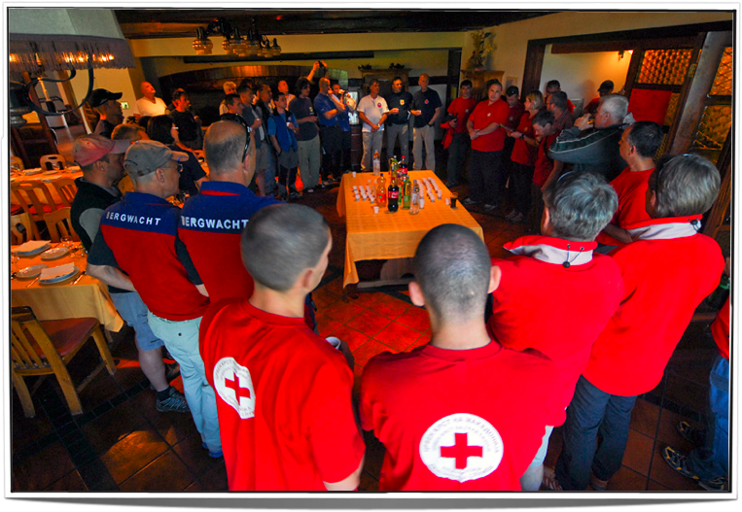
IKAR doghandler meeting 2009

Slide 6
IKAR doghandler meeting 2009
20
organizations

Slide 7
IKAR doghandler meeting 2009
30
dogs

Slide 8
IKAR doghandler meeting 2009
12 presentations

Slide 9
IKAR doghandler meeting 2009
Presentations
by theme:
Organization / Testing
Methods
Education

Slide 10
IKAR doghandler meeting 2009
Presentations
Organization / Testing
HGSS
SAR dogs testing
Norwegische Rettungshunde
Organization of the SAR in Norway
Bavarian mountain rescue service
Hypothermia

Slide 11
IKAR doghandler meeting 2009
Presentations
Methods
Bergretunsdienst im Alpenverein Sudtirol
How does Bloodhound work?
Horska zachrana sluzba Slovakia
Avalanche search with SAR dogs
Global Rescue Service (GRS) Wales
Cadaver dogs
Search for the drowned victims
SARDA Lakes
Barking and recall alerts

Slide 12
IKAR doghandler meeting 2009
Presentations
Education
Gorska Reševalna Sveza Slovenije
Psychology - how do dogs learn
Bergretunsdienst im Alpenverein Sudtirol
Recall method - how to train the dog
KOSSP - Croatia
Problems with naturale barriers in SAR dog working
Alpine Rettungs Schweiz
Bringsel method teaching technics

Slide 13
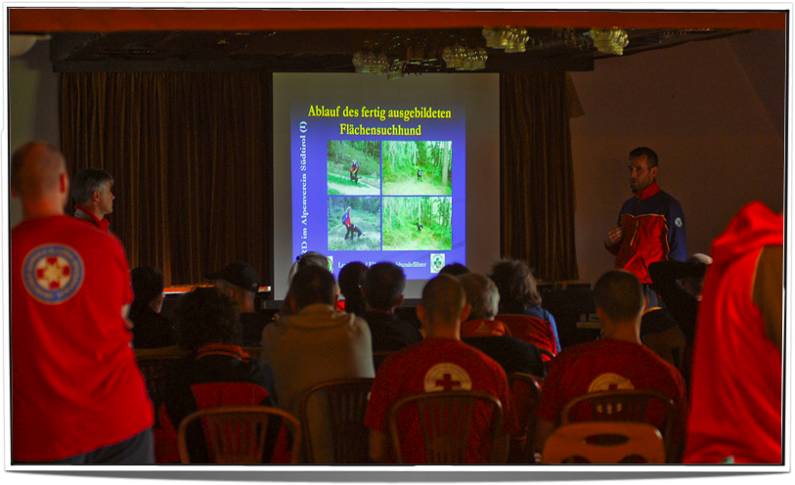
IKAR doghandler meeting 2009
Presentations

Slide 14
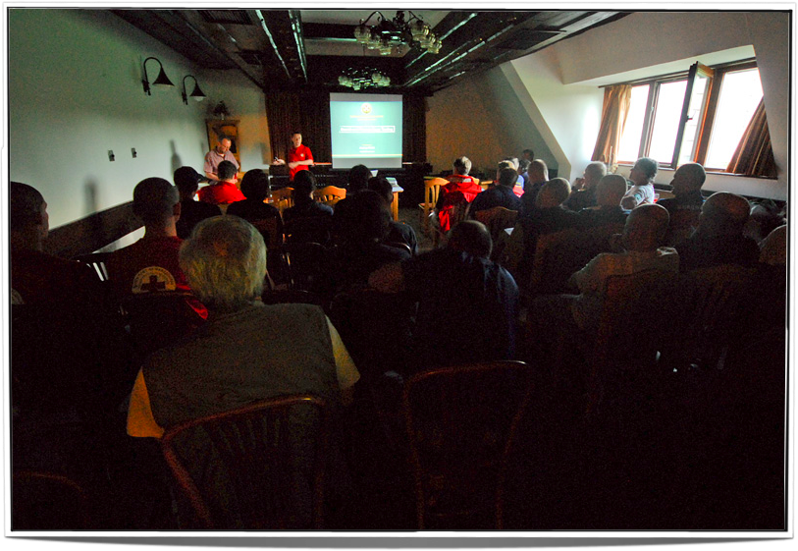
IKAR doghandler meeting 2009
Presentations

Slide 15
IKAR doghandler meeting 2009
10 practical presentations

Slide 16
IKAR doghandler meeting 2009
Practical Presentations
Gorska Reševalne Sveze Slovenije
Sector search, searching in erows
Bergretunsdienst im Alpenverein Sudtirol
Recall method - how to train the dog
GOPR Poland
Use of the remote dog rewarding machine
Difficult area search
TOPR Poland
Difficult area serach

Slide 17
IKAR doghandler meeting 2009
Practical Presentations
Bergretunsdienst im Alpenverein Sudtirol
How does Bloodhound work?
Bavarian mountain rescue service
Marking the victim with barking method
Marking the victim with bringsel method
HGSS
Presentation of the SAR command vehicle

Slide 18
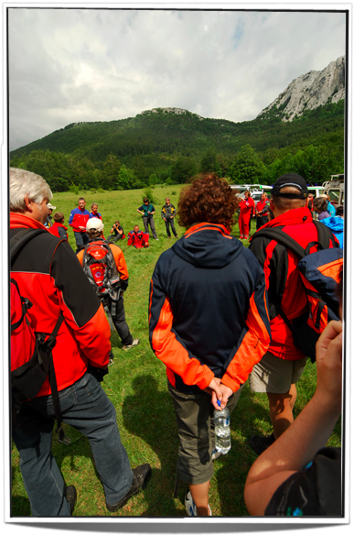
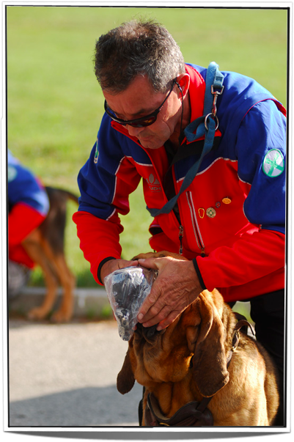
IKAR doghandler meeting 2009
Practical Presentations

Slide 19
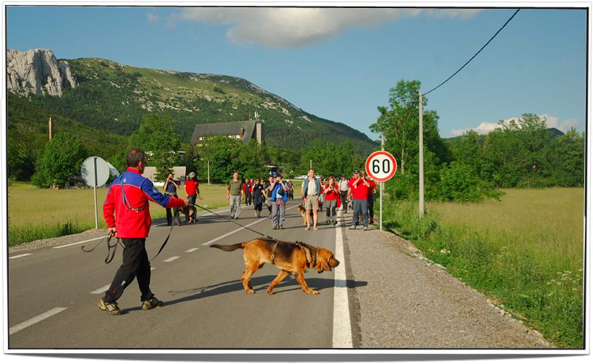
IKAR doghandler meeting 2009
Practical Presentations

Slide 20
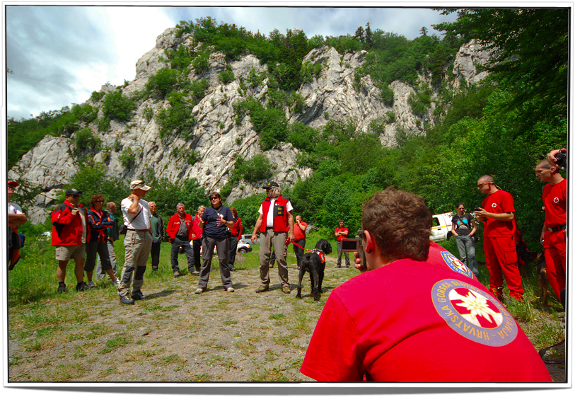
IKAR doghandler meeting 2009
Practical Presentations

Slide 21
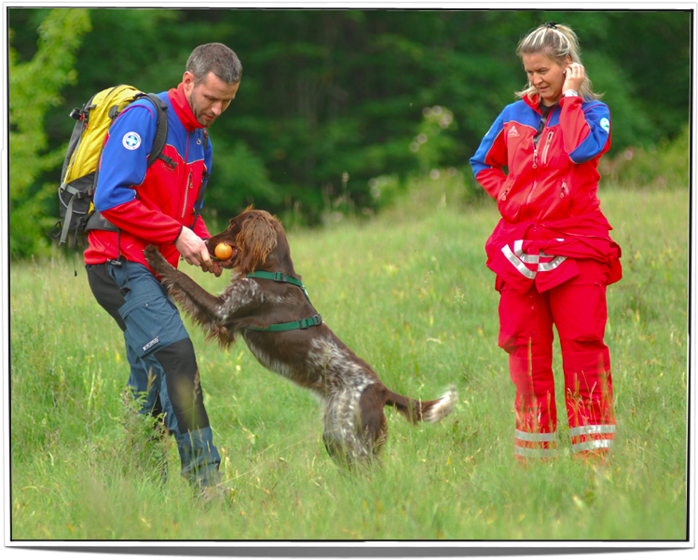
IKAR doghandler meeting 2009
Practical Presentations

Slide 22
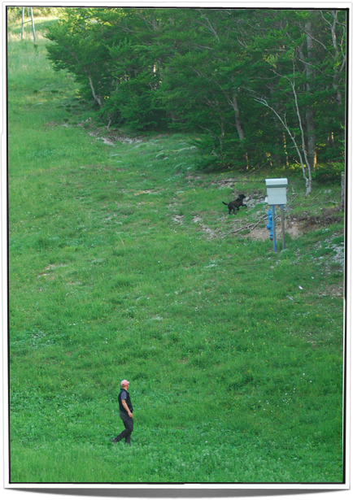
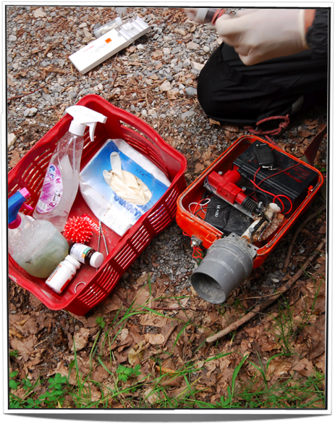
IKAR doghandler meeting 2009
Practical Presentations

Slide 23
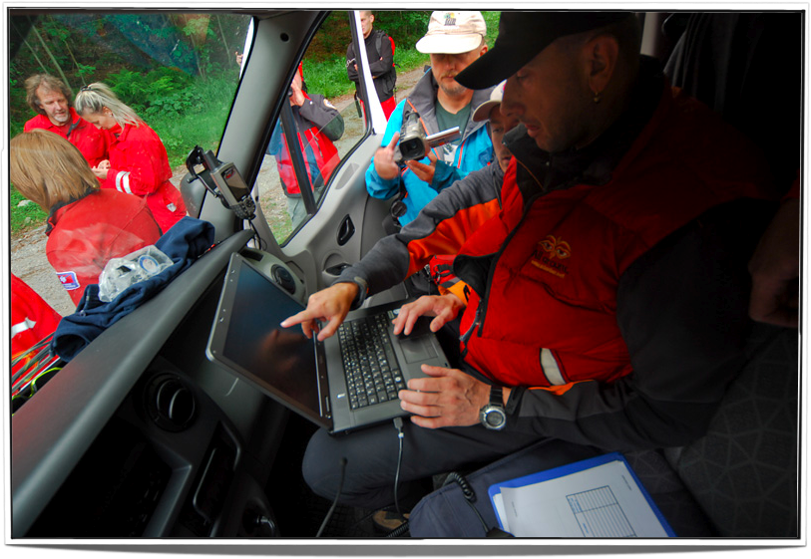
IKAR doghandler meeting 2009
Practical Presentations

Slide 24
IKAR doghandler meeting 2009
Final exercise
Involved: all participants (SAR dog teams, search management, victims)
Terrain: steep sided, difficult, 10 Ha
All teams were lead by HGSS search management team
All teams used GPS
All teams were given communication set to stay in touch with command vehicle
8 live victims and 2 death victims
All teams found their victims

Slide 25
IKAR doghandler meeting 2009
Conclusion

Slide 26
IKAR doghandler meeting 2009
Conclusion
When you get together SAR dog teams from whatever country who were trainted to work on any awayleble method, and they never worked together before, as long as you have unique search manegamant, yout can use all of them in SAR mission.
All of the SAR temas will have same responsability for the zone they were in.
If dog knows what to do and how to do it, if handler knows how to read the dog’s body language, it really does matter which handler will take which dog and make a sucesfull SAR team

Slide 27
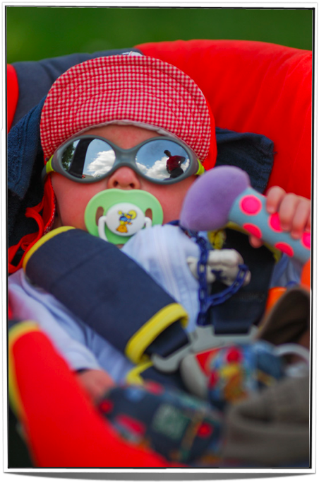
So, anybody... ?
Questions?
Drinks?
The End

