Slide 1
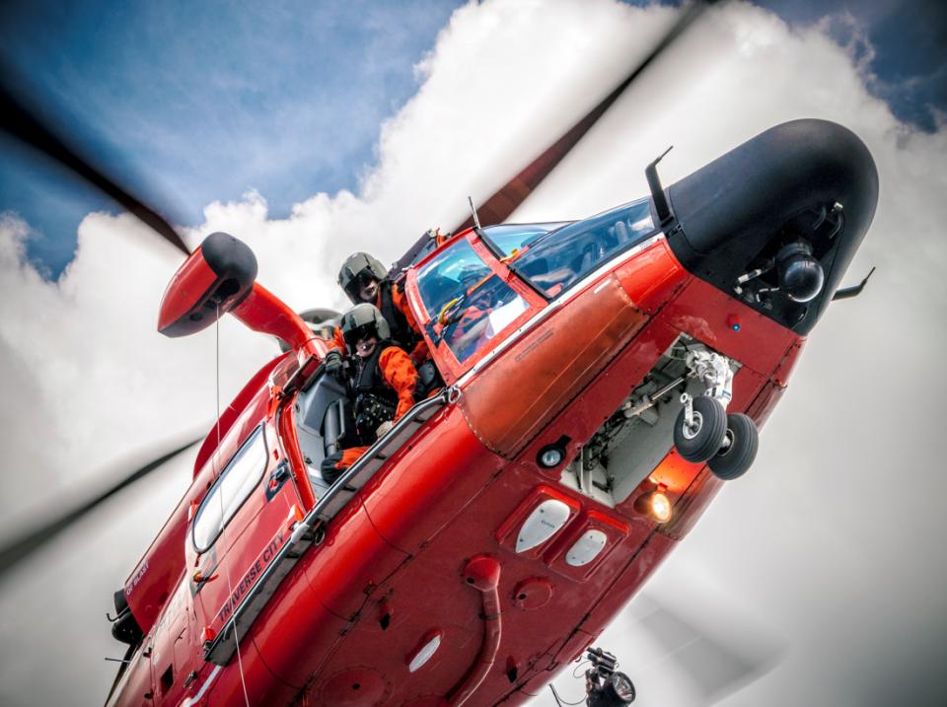

U.S. AIR RESCUE REPORT
Charley Shimanski; U.S. Delegate
October 19-21, 2017 – Soldeu, Andorra
Photo: Brian Edwards

Slide 2
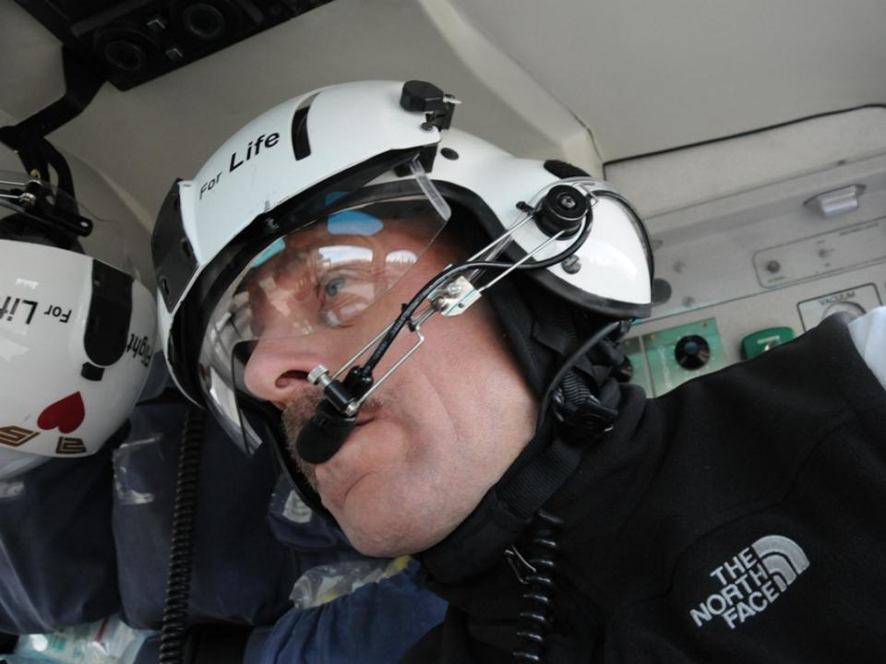
U.S. Air Rescue Commission - ICAR
Mountain Rescue Coordinator; Flight For Life
Alpine Rescue Team
Charley Shimanski; U.S. Delegate

Slide 3
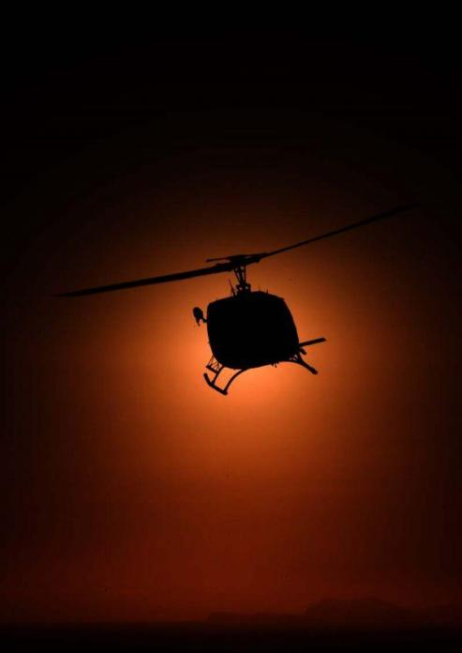
2017 USA
AIR RESCUE REPORT
PART 1
Accidents - USA
PART 2
Accidents - other
PART 3
Risks/Trends

Slide 4
2017 USA
AIR RESCUE REPORT
PART 1
Accidents - USA
PART 2
Accidents - other
PART 3
Risks/Trends

Slide 5
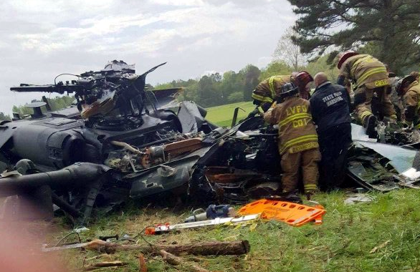
2015 Incident Follow-up
Fort Hood Blackhawk Crash
Review indicates delays in SAR response
November 23, 2015
Unrelated photo: TheBayNet.com

Slide 6
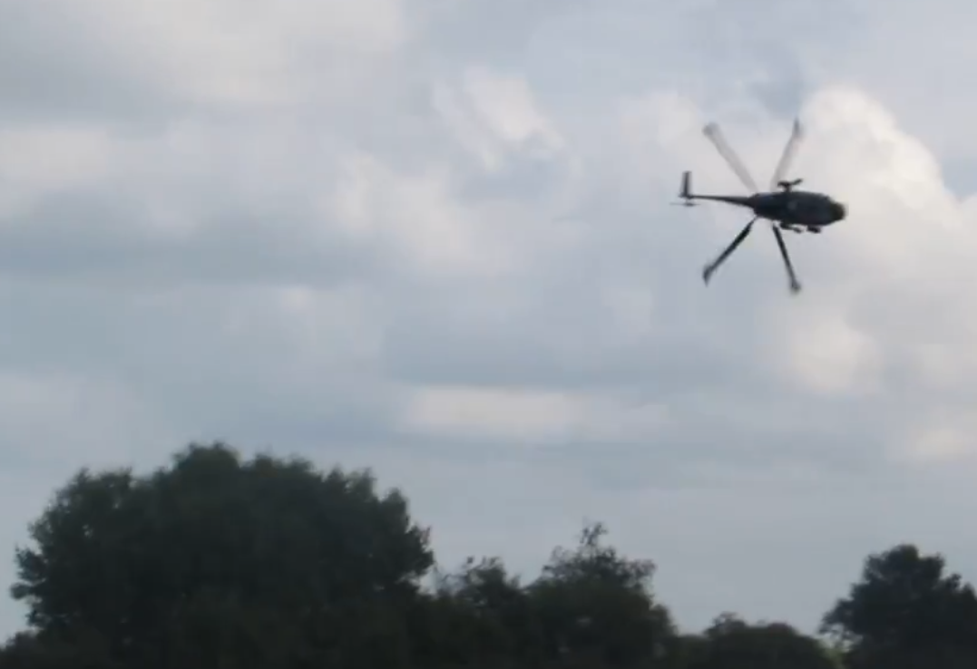
Pilot initiated a "break turn"
138 miles per hour
300 feet agl
Angle of 70 degrees
  10 degrees higher than regs
Caused a stall he couldn't recover from.
The helicopter crashed into trees, killing the two pilots
and two aircrew inside
Unrelated photo: MelanGressive YouTube

Slide 7
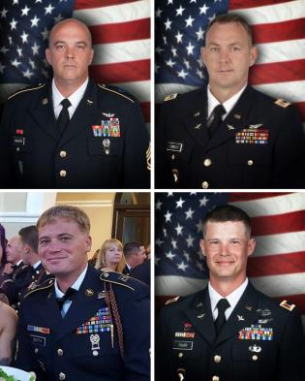
Killed in the crash were
Sgt. 1st Class Toby Childers
Chief Warrant Officer 3 Stephen Cooley
Sgt. 1st Class Jason Smith
CW3 Michael Tharp

Slide 8
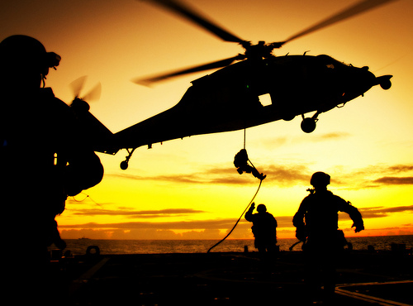
An Army investigation blamed
pilot error, but investigators discovered a glaring problem with Fort Hood's search and rescue system in the process.
Photo: coastguarddodlive.mil

Slide 9
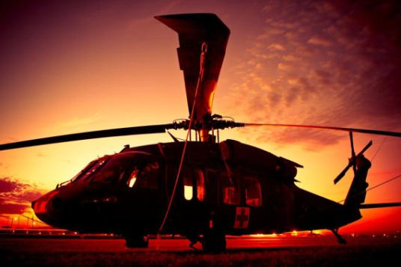
The Black Hawk last checked in at 1719 hrs
At 1749 hrs, the post's air traffic control (ATC) center should have declared the aircraft overdue and initiated SAR.
Photo: Old81tudiosart.com

Slide 10
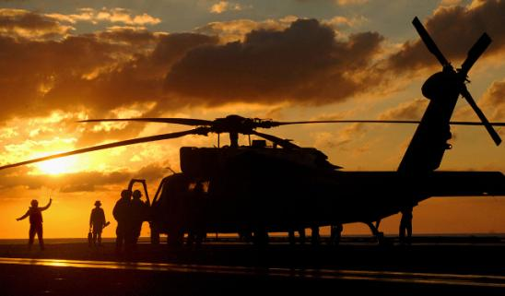
Instead:
  At 1800 hrs, ATC notified base operations (“Gray Ops”)
  Gray Ops spent an hour trying to call the unit's flight operations center
  Gray Ops called one of the pilots’ cell phone, but could not get through
  Gray Ops sent an AH-64 Apache that was already in the air to do a search.
Wikimedia Commons

Slide 11
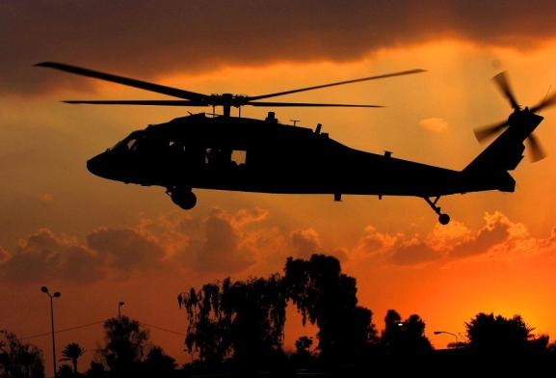
Photo: Sofrep.com
At 1940 hrs Gray Ops reported the helicopter missing
and requested SAR response.
The Last check-in was at 1719 hrs.

Slide 12
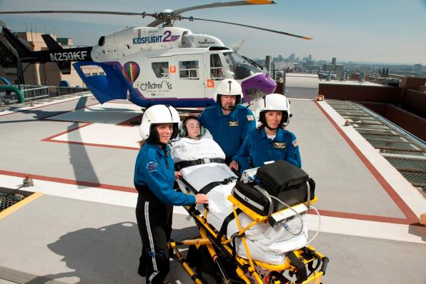
Incident Report
St. Louis Children’s Hospital
“Kids Flight”
July 1, 2017 – Perryville, Missouri

Slide 13
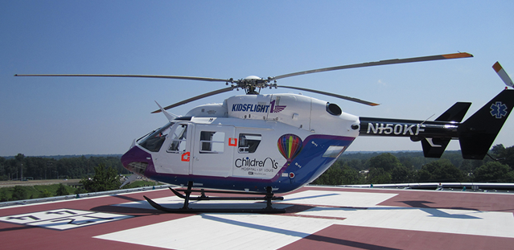
The inter-hospital flight with this aircraft (BK117 B-1) took off at 2019 hrs for
St. Louis (MO) Children's Hospital

Slide 14
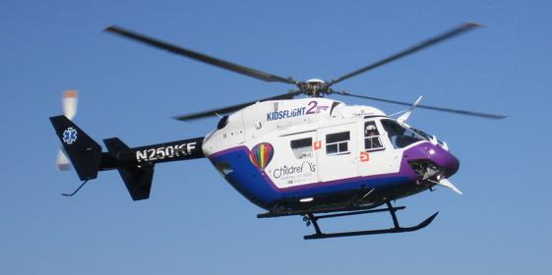
The pilot reported that the helicopter "experienced a sharp change in attitude yawing to the left with a hard-upward bump," followed by a change in the engine noise.
The No. 1 engine low warning light, the No. 1 generator light, and the battery discharge warning lights were illuminated.

Slide 15
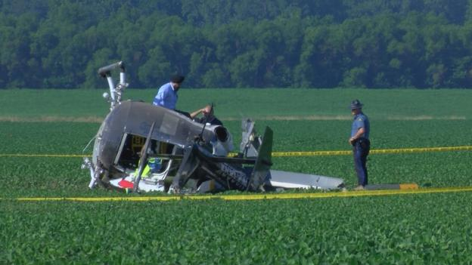
He stated, "Suddenly the aircraft pitched nose up and rolled to the right. I could hear the rotor begin to deteriorate."
He entered an autorotation by applying right forward cyclic and lowering the collective to full down.
Kathrynsreport.com

Slide 16
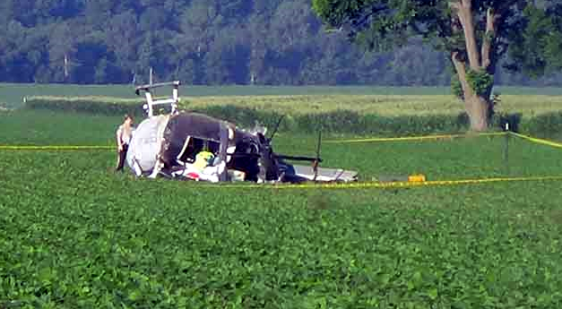
The pilot flared the helicopter about 100 ft agl and the rotor rpm began to decay rapidly. The helicopter landed right skid low and skidded for about 100 ft. The main rotor blades hit the ground as the helicopter rolled onto its right side.
Fox2Now.com

Slide 17
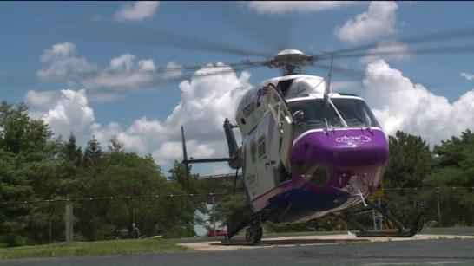
The pilot and flight crew, with the patient on a stretcher, egressed the helicopter with minimal injuries.
The pilot observed fuel draining. He re-entered the cockpit and turned off all electrical and fuel switches to minimize the risk of fire.

Slide 18
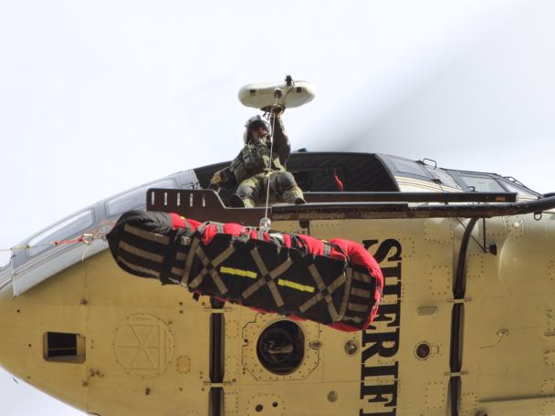
Incident Report
Hoist Weight Falls During Rescue
Snohomish (WA) County Sheriff’s Office
August 21, 2017
Snohomish County Sheriff’s Office

Slide 19
While sitting inside the cabin doorway, the hoist operator inverted the hoist hook and attached the hook weight using the swivel snap hook.
He then released the weight and allowed the hook to right itself.

Slide 20
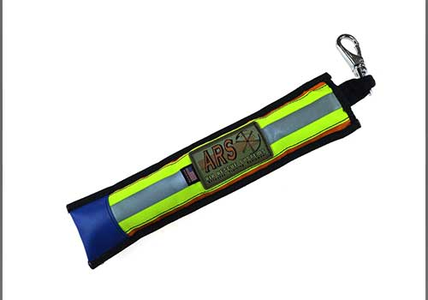
As soon as the weighted hook righted and was released from the operator’s hand, the ARS Hoist Hook Weight fell from the aircraft and into the trees, without incident.
AirRescueSystems.com

Slide 21
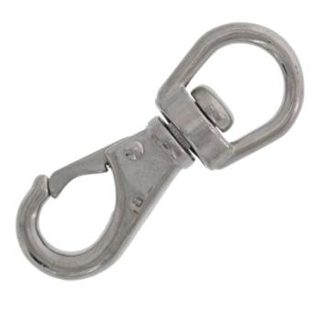
The program has determined that the ARS Hoist Hook Weight became disengaged from the hoist hook in a “forced roll-out”
situation.
Not the actual product

Slide 22
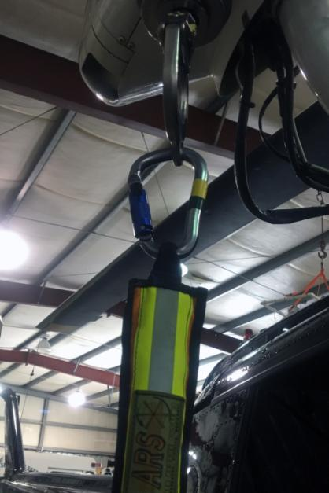
They have replaced the swivel snap hook with a locking carabineer
(as shown).
Snohomish County HRT

Slide 23
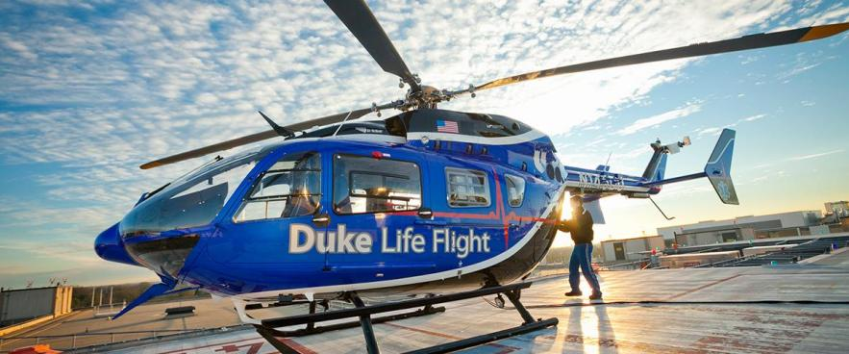
Incident Report
Duke University
“Life Flight”
September 8, 2017 – Perquimans Cty., North Carolina

Slide 24
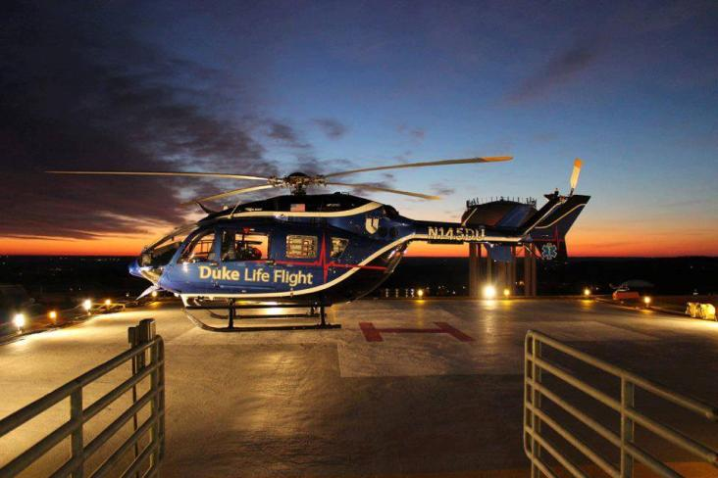
The MBB BK117-C2 helicopter, N146DU, was en route to Duke University Hospital from Sentara Albemarle Medical Center.

Slide 25
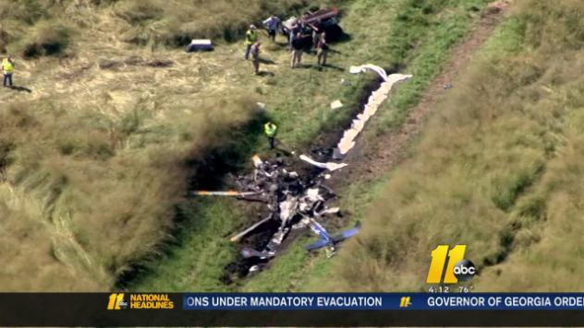
Several witnesses reported observing "heavy/dark" smoke trailing behind the helicopter, also a "popping noise,"
They then watched it turn twice and descend before it disappeared from sight.

Slide 26
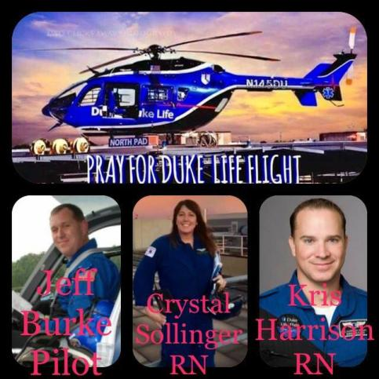
Jeff Burke; pilot
Kristopher Harrison; flight nurse
Crystal Sollinger; flight nurse
Mary Bartlett; patient

Slide 27
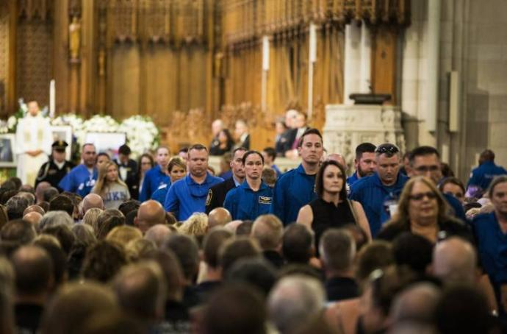
Duke Today
One of two engines showed signs of
“overheating and lack of lubrication,”
per the NTSB.

Slide 28
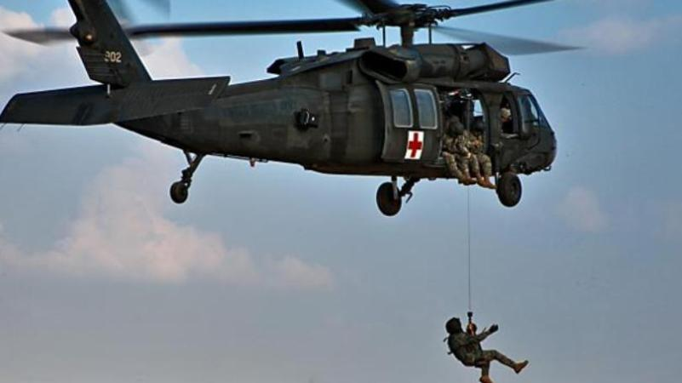
Incident Report
Rescuer Falls from Hoist
Medical Evacuation Hoist Training
September 12, 2017 – Fort Hood, Texas
Unrelated photo by Sgt. Travis Zielinski

Slide 29
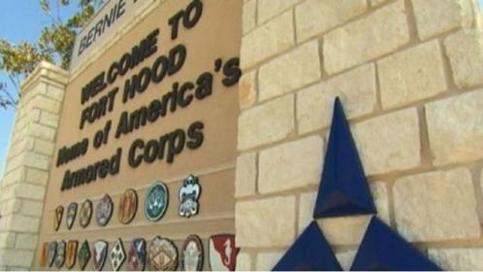
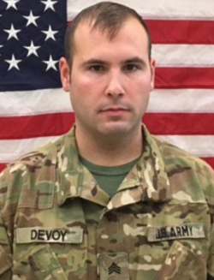
Staff Sgt. Sean Devoy died after falling during hoist training with an HH-60M Black Hawk medical evacuation helicopter.
The incident occurred at 2030 hrs

Slide 30
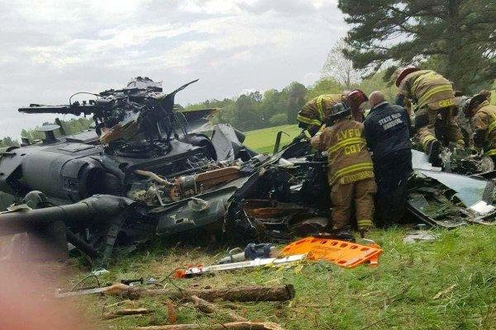
Unrelated photo by BayNet.com
There has been growing trend of training accidents, capturing the attention of military leaders, who have been warning for years of the consequences of budget cuts.

Slide 31
2017 USA
AIR RESCUE REPORT
PART 1
Accidents - USA
PART 2
Accidents - other
PART 3
Risks/Trends

Slide 32
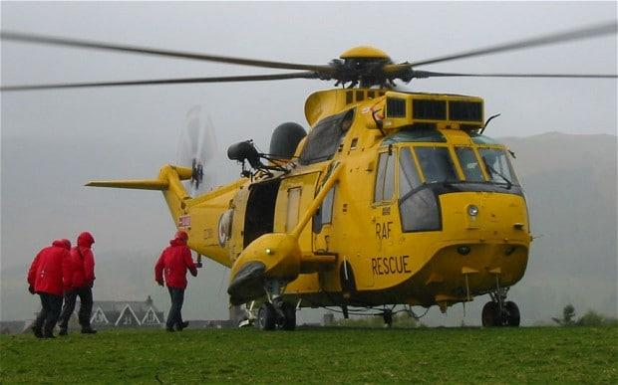
2013 Foreign Incident Update
Rescuer Cuts the Wrong Rope
Climber Dies from Subsequent Fall
February 13, 2013 – Ben Nevis, Scotland
The Telegraph
A long-overdue Service Inquiry Report was released
by the UK government January 2017.

Slide 33
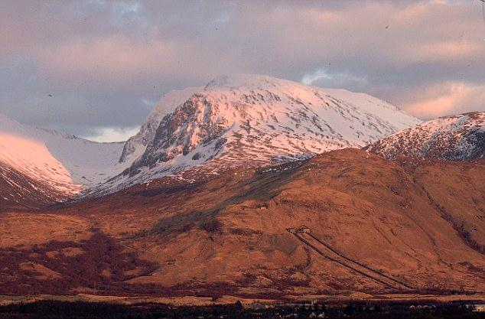
The Daily Mail
The incident involved a RAF Sea King that was dispatched to rescue a fallen climber on Ben Nevis in Scotland following an ice climbing fall on lead.

Slide 34
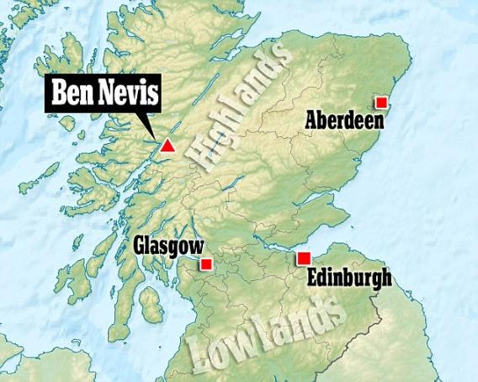
The Daily Mail
Mark Phillips, 51, was climbing with a friend when he fell 160 ft on the north face of the 4,406 ft peak,
suffering serious head injuries.

Slide 35
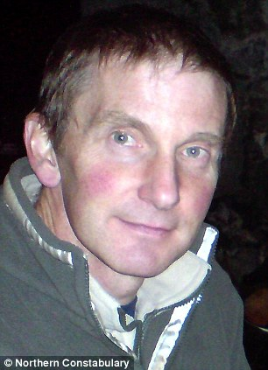
A rescue helicopter from RAF Lossiemouth was trying to get him on board when the safety rope was severed before he had been secured
The victim fell hundreds of feet to his death.

Slide 36
“The Press and Journal newspaper reported that there were ‘tense radio exchanges’ between the groups involved in the rescue in the moments before and after Mr. Phillips fell, followed by an order for radio silence.” (The Telegraph)

Slide 37
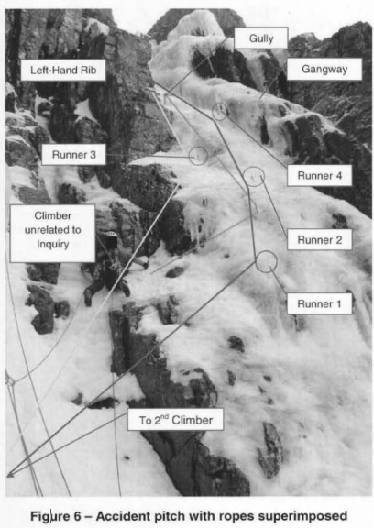
Contributing Cause Summary*:
The winchman (hoist rescuer) verbally "expressed concern at the complexity of the rescue" to the flight crew raising the option of involving the ground rescue team.
Complexity of the rope system encountered by the winchman upon reaching the accident scene.
*Courtesy Ken Phillips; former MRA ICAR Air Rescue Commission delegate

Slide 38
Contributing
Cause Summary*:
Investigative conclusion of winchman feeling a "perceived pressure to perform"
Failure to follow pre-existing established procedural sequence of
  Strop (placed on casualty)
  Connect (strop to hoist hook)
  Cut (ropes attached to casualty)"
*Courtesy Ken Phillips; former MRA ICAR Air Rescue Commission delegate

Slide 39
Contributing Cause Summary:
The Winchman reached down and took out his J-knife. He took hold of the yellow rope at the Casualty's shoulders and looking at the 2nd Climber, mimed the action of cutting the rope while shouting to ask permission to cut.
Unable to hear the W2, W4 Winchman due to the noise of the helicopter the 2nd Climber assumed that he was being asked to confirm that he was secure before any ropes were cut. Accordingly, he gave a thumbs-up to indicate that he was safe; a response the Winchman did not recall seeing.

Slide 40
Twice before he left the helicopter, the Winchman stated that his intention was to place the strops on the Casualty connect the strops to the winch hook and then cut the ropes. This was not the sequence that he followed.
Having received what he considered to be a nod of approval he believed he had been given clearance to cut the yellow rope by the 2nd Climber, which he proceed to do. The tension went immediately from the yellow rope and the Casualty fell. The Winchman attempted to grab tl1e strop but was unable to; the Casualty slid down the snow pack, over several ledges and came to rest several hundred feet below.

Slide 41
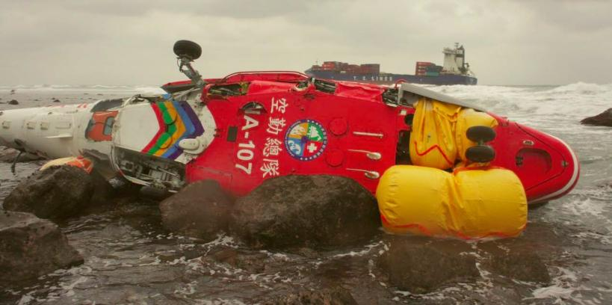
2016 Foreign Incident Update
Rescuer Impacted by Main Rotor
Hoist Rescue from Grounded Cargo Ship
March 11, 2016 – Taipai, Taiwan
Taiwan Aviation Safety Council

Slide 42

Taiwan Aviation Safety Council
The Aviation Safety Council (ASC) of Taiwan has issued its investigation report (in Chinese apart from an Executive Summary) into a fatal Survivable Water Impact (SWI) accident on 11 March 2016 involving National Airborne Service Corps (NASC) Airbus Helicopters AS365N3 Dauphin NA-107 during a transport hoist mission.

Slide 43
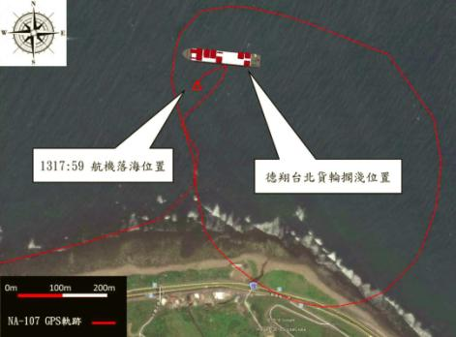
On board were two pilots, one crew chief and two Coast Guard Administration (‘CGA-SSC’) personnel. After arriving above the grounded cargo ship, the aircraft circled in clockwise direction…and began to approach the deck of the ship.

Slide 44
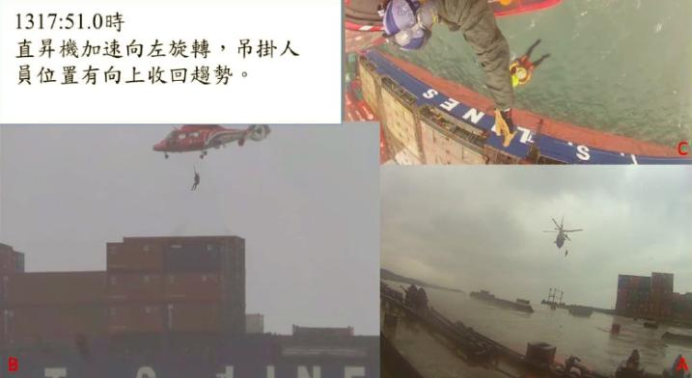
The aircraft began yawing towards the left. Four seconds later, the aircraft began to turn drastically. The copilot reported that the aircraft was shaking in all directions as the aircraft drastically spun towards the left.

Slide 45
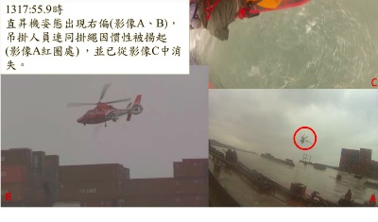
As the spinning accelerated, the member being hoisted was thrown upward by centrifugal force,
and impacted the main rotor.
The aircraft plummeted into the sea.

Slide 46
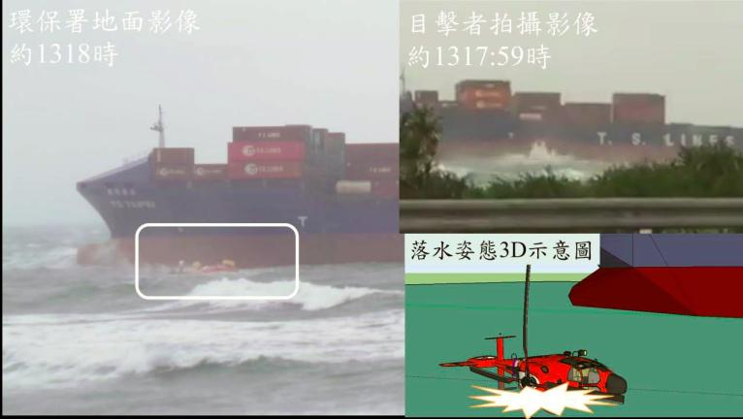
The helicopter was destroyed when it hit to the left of the cargo ship with a right roll in an easterly direction..

Slide 47
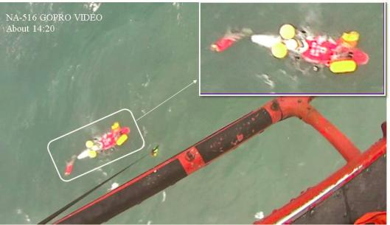
The aircraft commander’s cause of death was abdominal bleeding and drowning and the hoist passenger were killed upon after the main rotor blade strike. The other occupants sustained serious injuries.

Slide 48
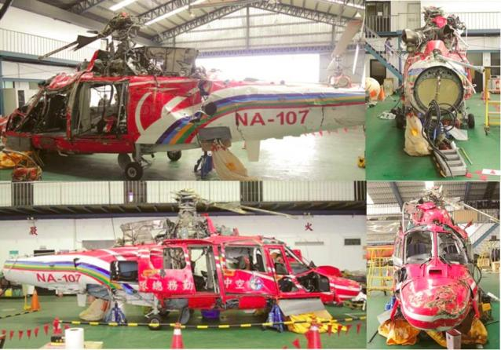

Slide 49
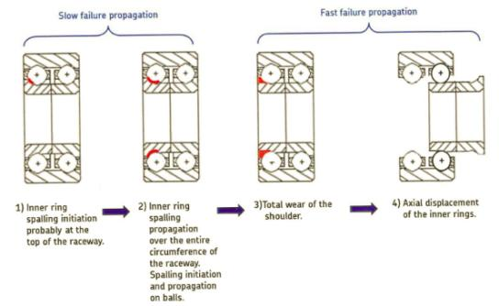
Wear of the Tail Rotor Pitch Change Bearing led to a loss of tail rotor pitch control after the inner race retaining shoulder rapidly deteriorated.
Five of the twelve ball bearings on one side had been released (all were undersized due to wear).

Slide 50
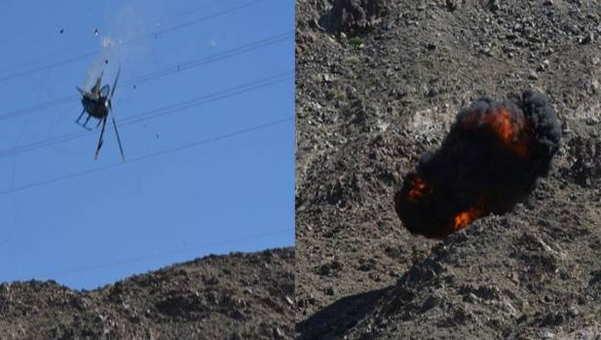
Foreign Incident Report
4 Die During Body Recovery
March 14, 2017 – Mexicali, Mexico

Slide 51
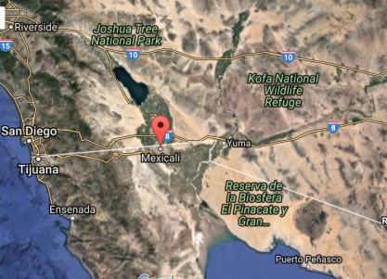
Hughes MD 530 - El Centinela hills in Mexicali,
A hiker had died from injuries sustained when she fell into a gorge.
The government says the crew had found the woman's body and was bringing back rescue workers when the helicopter hit an electrical power cable.

Slide 52

Four rescue workers took to the air in the black helicopter as they set out to retrieve the body of a mountain climber who had died after falling 300 metres from a cliff edge.

Slide 53

All four people on aircraft died after helicopter got tangled in power linesThey were trying to retrieve the body of mountaineer Violeta Ruiz SanchezA part of the aircraft was seen falling off before it hurtled to the ground
The aircraft got tangled in high tension power lines, hurtling to the ground and exploding in a tragedy which claimed the lives of all those on board.

Slide 54
2017 USA
AIR RESCUE REPORT
PART 1
Accidents - USA
PART 2
Accidents - other
PART 3
Risks/Trends

Slide 55
Risks/Trends
NEW: Mechanical failure
CONTINUES: Hoist-related Accidents
DECREASING: Inadvertent VFR Flight into Instrument Meteorological Conditions (IMC)

Slide 56
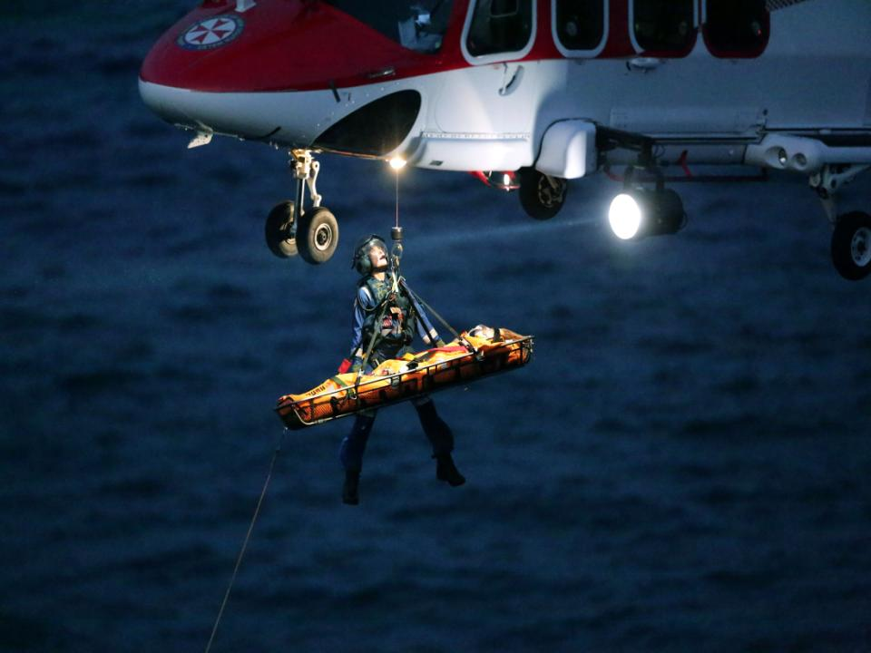
Thank
You!
Charley Shimanski
charley.shimanski@gmail.com

