Slide 1
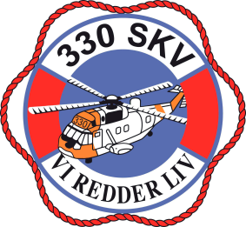
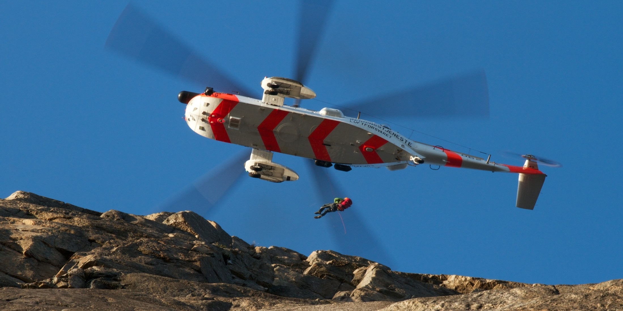
Norwegian Alpine Rescue Groups and 330 Sqn
Big wall rescue procedures with helicopter

Slide 2
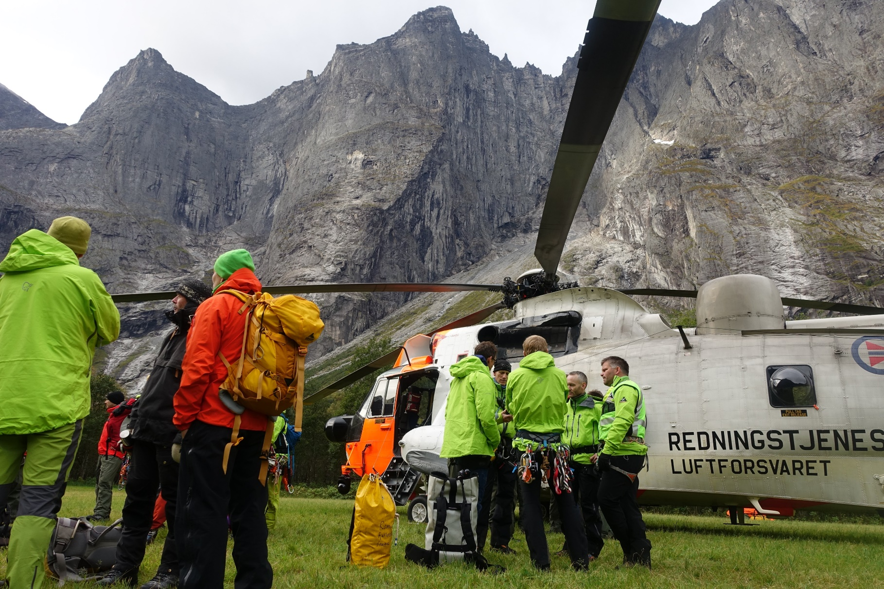

Slide 3
Big wall rescue
Stetind, Norwegian national mountain

Slide 4
PLAY SLIDE 04 VIDEO here

Slide 5
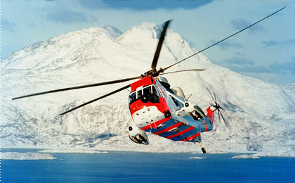
Sea King rescue helicopter
AUW 21400lbs/9600kg
Crew of 6, including doctor (Anesthesiologist)
Dual hoist (hydraulic)
Hoist cable length 245 feet
Coms
EO/IR camera

Slide 6
Considerations
Procedure development
Mountaineous hoisting
Wind
Turbulence
Settlig with power/vortex ring state
Big wall proximity (stress)
Workload
Safety (escape)

Slide 8
Longline
Is an extension to the hoist cable
Helicopter has to descend along the wall – risk of settling with power
Longline is used as a long guideline to pull the hoist cable to the extraction point
Longline is used to control the load during hoisting

Slide 9
Superlongline
Is an extension to the hoist cable
Helicopter does not have to descend along the wall
Reduces hover time near the wall
This procedure accepts very long ropes, in needed numbers. (superlong line).
Rope and load can be hoisted into the helicopter

Slide 10
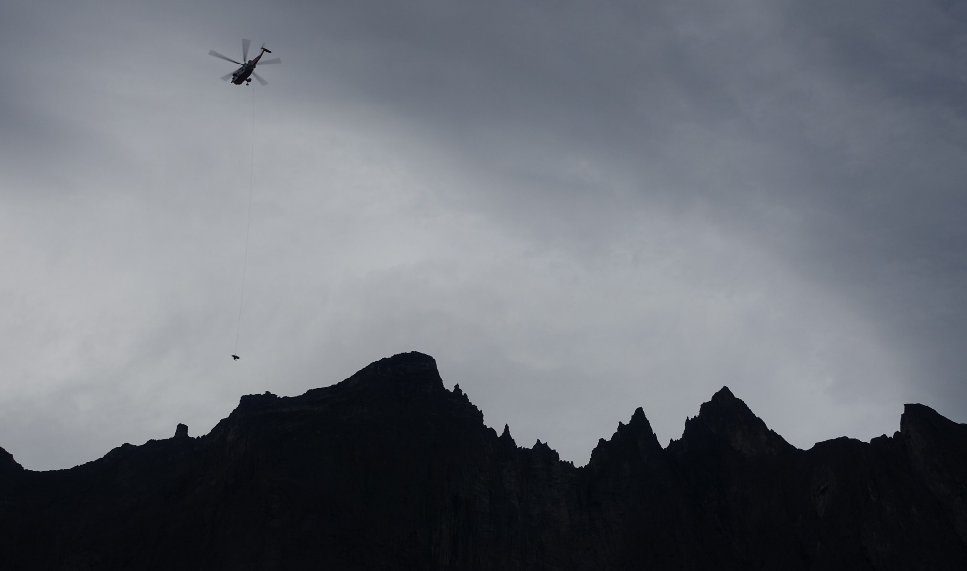
Superlongline vs. Longline
Superlongline
Helicopter does not have to descend along the wall
Helicopter can hover above deep ravines/gullies
Helicopter can hover above difficult wind conditions
Less downwash on accident site
Less rockfall hazard
Facilitates rescues in very steep or narrow places
Longline
Helicopter has to descend along the wall
Helicopter has to hover in an offset position
Facilitates extraction of a larger number of casualties or rescuers

Slide 11
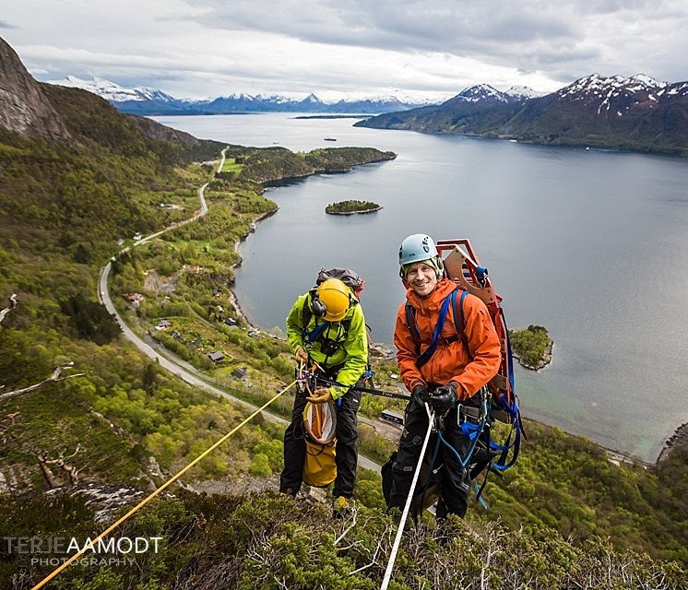
Access to the victim
Mountain rescuers will gain access to the casualty by lowering or by rappel
A third, untensioned rope will be layed out between the upper belay and the accident site
This rope will be used as a «superlongline»

Slide 12
The procedure:

Slide 13
Longline

Slide 14
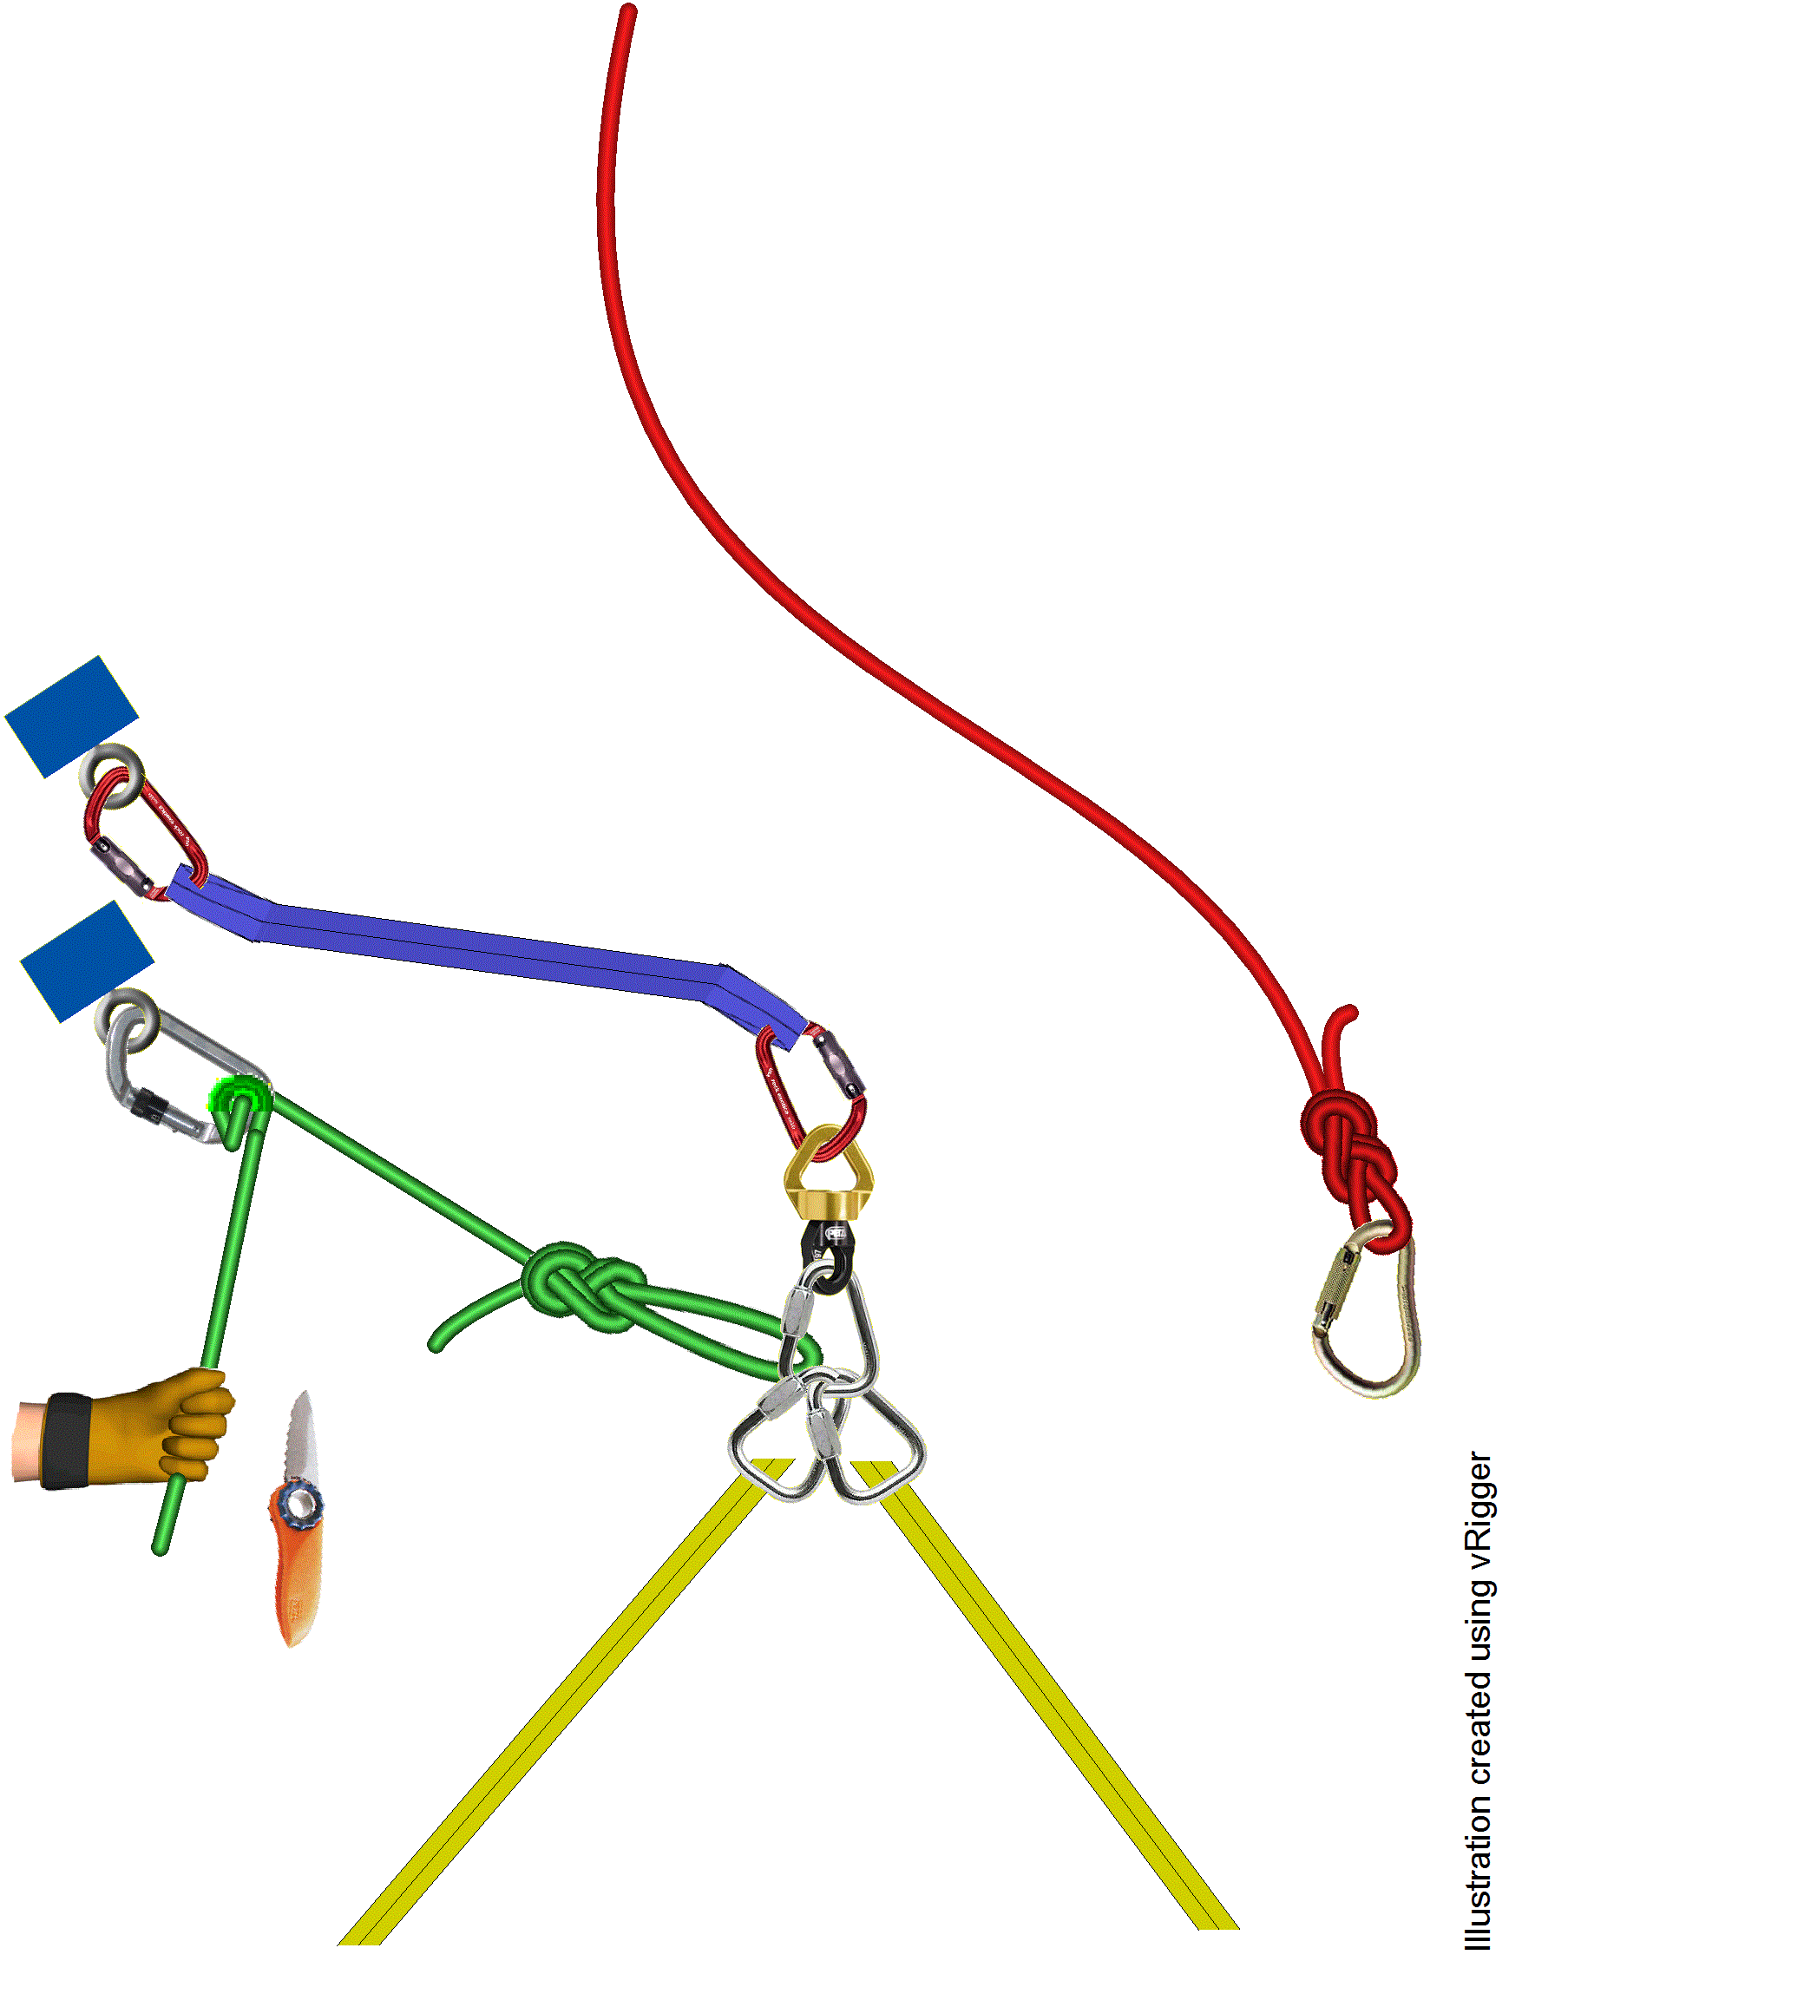
Superlongline ready for pick up
Upper belay point
Extraction point

Slide 15
Superlongline pick up on upper belay point

Slide 16
Connection of superlongline in the helicopter

Slide 17
Releasing stretcher from wall

Slide 18
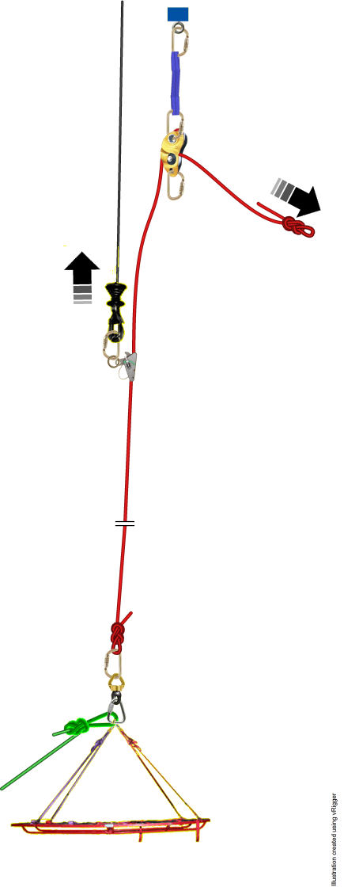
Hoisting the superlongline

Slide 20
PLAY SLIDE 20 Video here

Slide 21
Thank you !
Stein Falsen Møller, NARG,
Fredrik Jomaas Major, CO, 330Sqn

