Slide 1
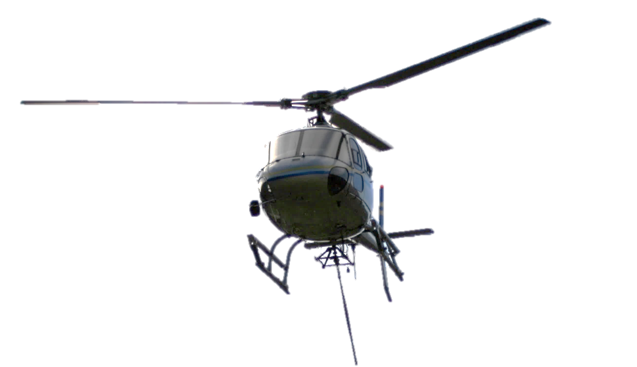



Slide 2


Slide 3
Thought by Pilots

Slide 4
Fitted for Helicopters

Slide 5
Developed by TEXBOR

Slide 6

INTRODUCTION AND BACKGROUND

Slide 7


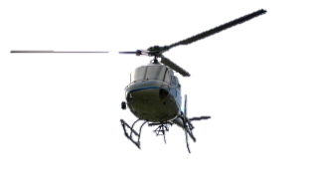
INTRODUCTION AND BACKGROUND
Texbor is a company with more than 100 years
Manufacturing Load Slings since 1970
Applying load slings to the helicopter operations since 2004
Key personnel
  Texbor expertise – Engineers and Manufacturers
  Feedback from Helicopter Companies
    Helitrans Pyrinees
    Heliand

Slide 8
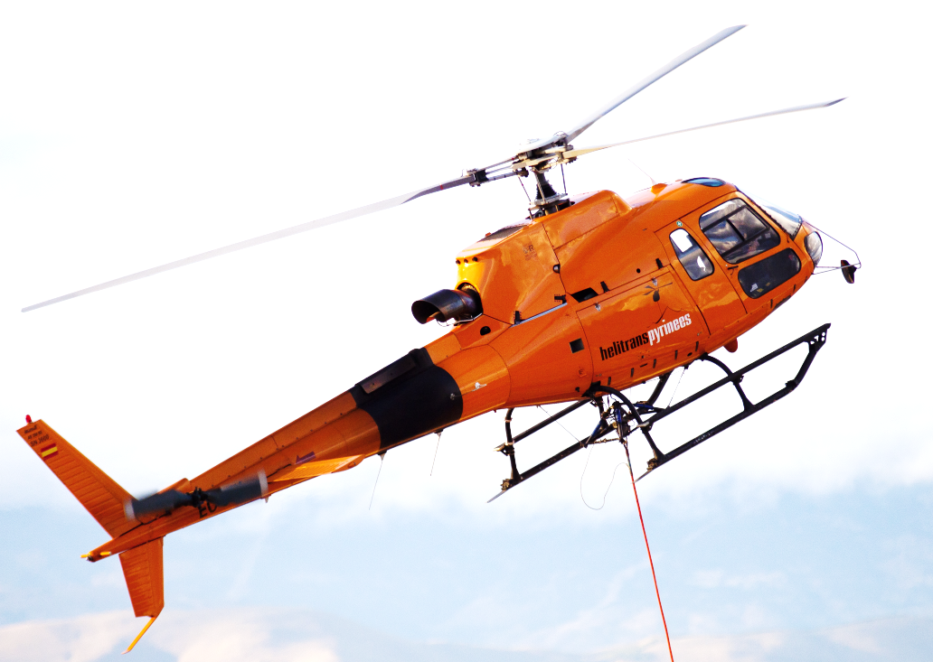
USES OF THE LONGLINES IN THE HELICOPTER OPERATIONS

Slide 9
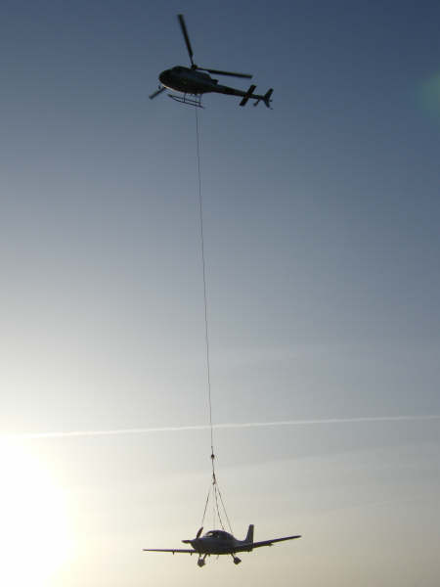
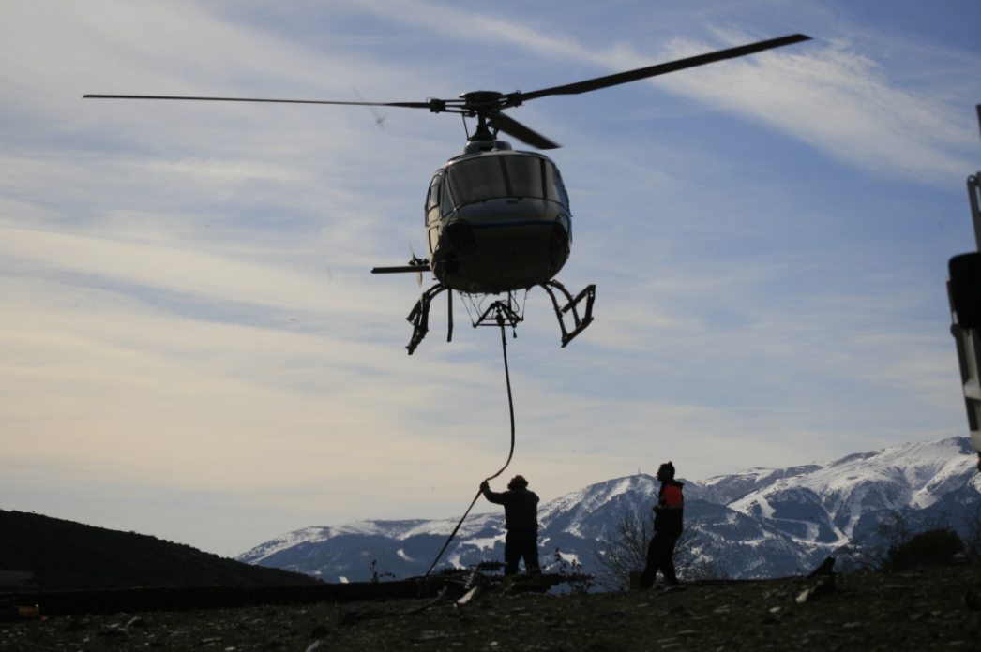
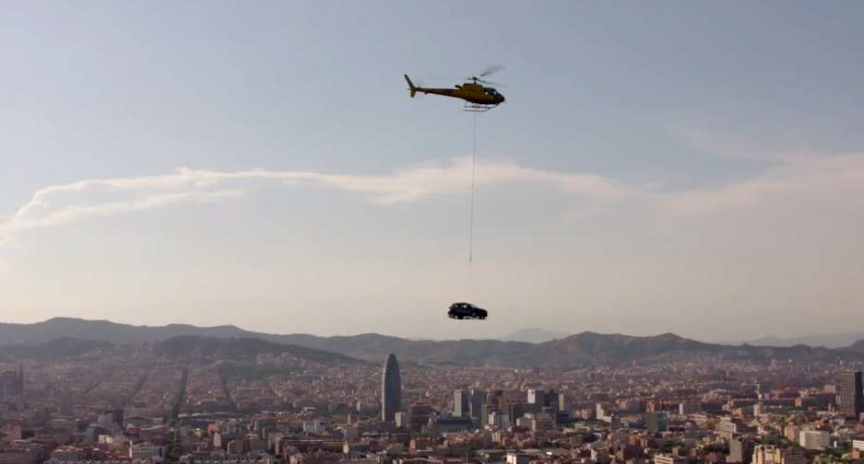
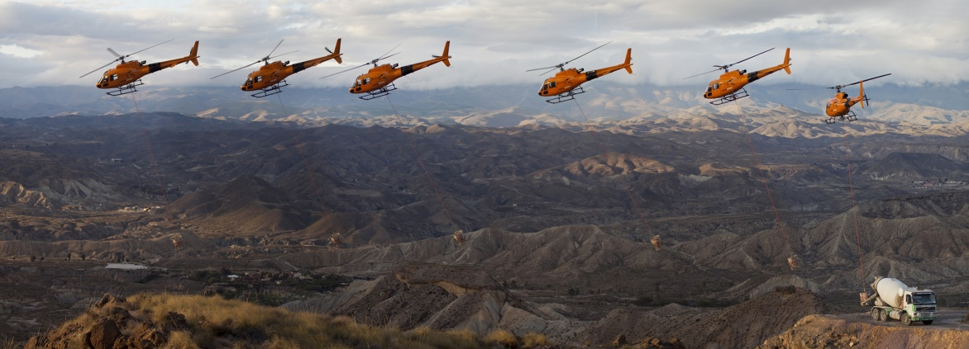

USES OF THE LONGLINES IN THE HELICOPTER OPERATIONS
HESLO
Property
Rescue
Concrete / Construction
Load lifting
Advertising

Slide 10
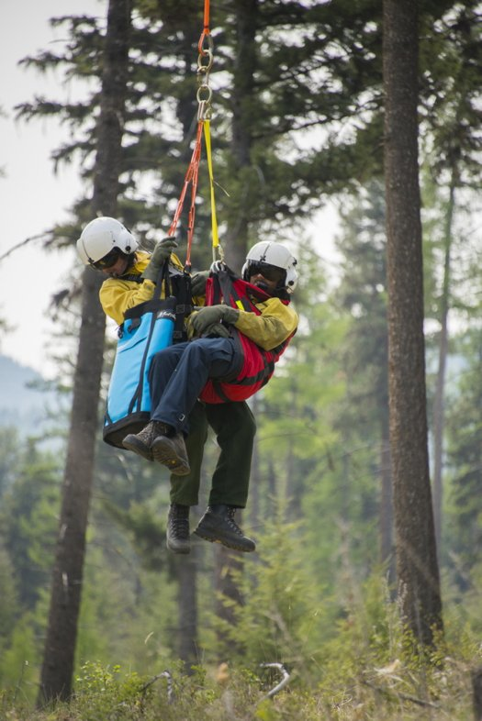
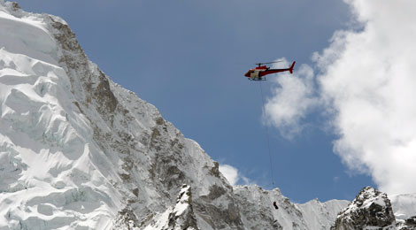
USES OF THE LONGLINES IN THE HELICOPTER OPERATIONS
HEC
Mountain Rescue
FireFighting

Slide 11
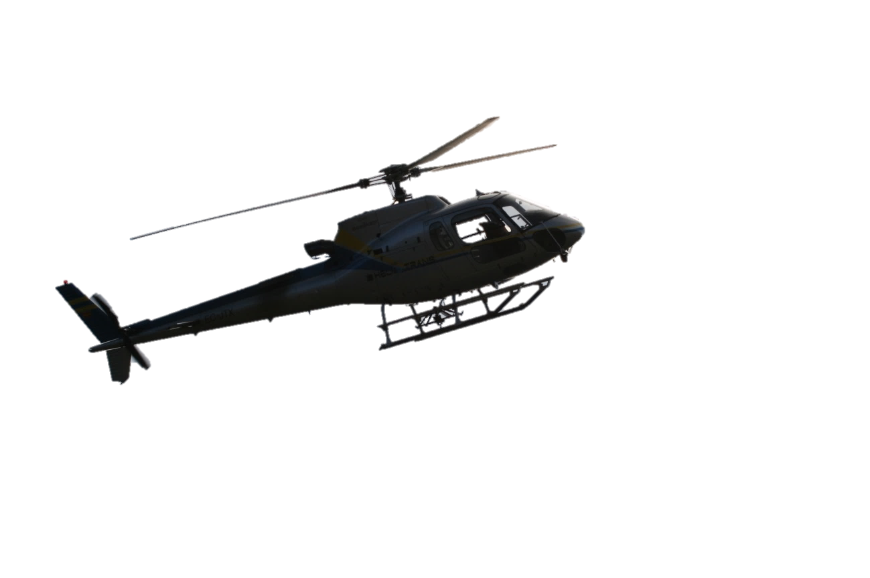
KEY FEATURES OF THE LONGLINES
FOR THE HELICOPTER OPERATIONS PROVED OVER THE YEARS OF EXPERIENCE

Slide 12
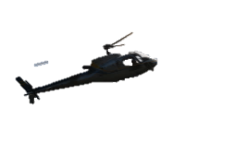
KEY FEATURES OF THE LONGLINES
FOR THE HELICOPTER OPERATIONS PROVED OVER THE YEARS OF EXPERIENCE
STRENGTH
Enough to bear the loads applied, Both STATIC and DYNAMIC
Safety factor
Elasticity and Plasticity: Stress vs Strain diagram
Fracture mode

Slide 13
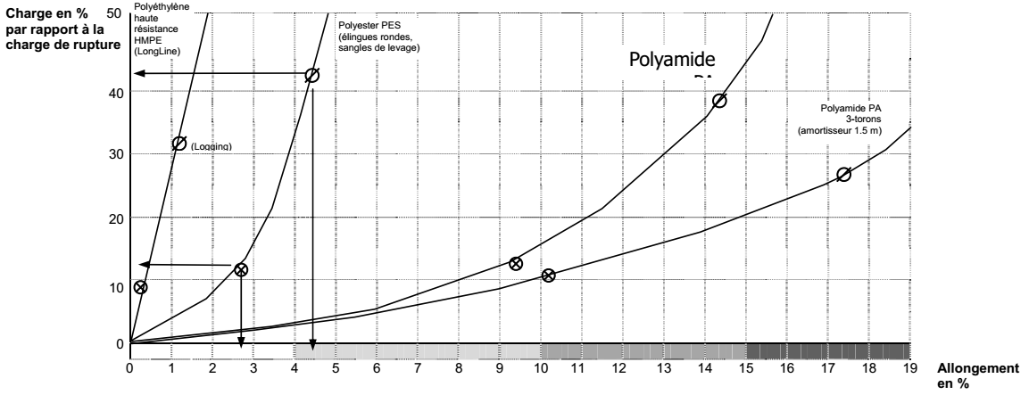
KEY FEATURES OF THE LONGLINES
FOR THE HELICOPTER OPERATIONS PROVED OVER THE YEARS OF EXPERIENCE
STRENGTH

Slide 14
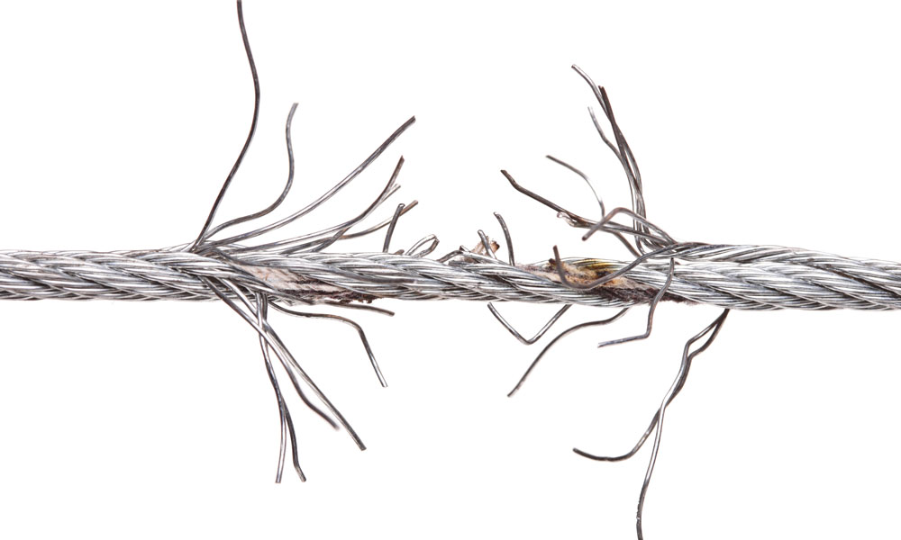
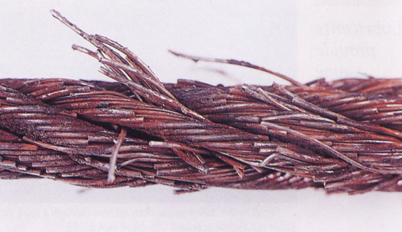
KEY FEATURES OF THE LONGLINES
FOR THE HELICOPTER OPERATIONS PROVED OVER THE YEARS OF EXPERIENCE
STRENGTH

Slide 15
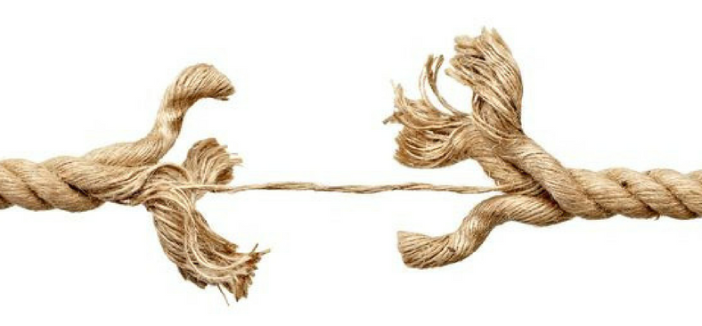
KEY FEATURES OF THE LONGLINES
FOR THE HELICOPTER OPERATIONS PROVED OVER THE YEARS OF EXPERIENCE
STRENGTH

Slide 16
KEY FEATURES OF THE LONGLINES
FOR THE HELICOPTER OPERATIONS PROVED OVER THE YEARS OF EXPERIENCE
BEHAVIOUR
Elasticity → protection of the helicopter
Elasticity → Spring Effect, bouncing back
Vibration and harmonics
Flying behaviour
  Low drag – good air penetration
  Minimize the tendency to bend towards the tail
  Prevent in-flight oscillations

Slide 17

KEY FEATURES OF THE LONGLINES
FOR THE HELICOPTER OPERATIONS PROVED OVER THE YEARS OF EXPERIENCE
BEHAVIOUR

Slide 18
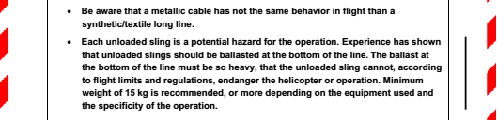
KEY FEATURES OF THE LONGLINES
FOR THE HELICOPTER OPERATIONS PROVED OVER THE YEARS OF EXPERIENCE
BEHAVIOUR

Slide 19
KEY FEATURES OF THE LONGLINES
FOR THE HELICOPTER OPERATIONS PROVED OVER THE YEARS OF EXPERIENCE
HANDY
High visibility
Wear and abrasion resistant
Protected Core
Easy to handle
Able to adapt:
  Ends
  Wiring

Slide 20
KEY FEATURES OF THE LONGLINES
FOR THE HELICOPTER OPERATIONS PROVED OVER THE YEARS OF EXPERIENCE
HARDWEARING
Shelf life time well above the intended use. SAFE LIFE CONCEPT

Slide 21

APPLICABLE REGULATIONS

Slide 22

APPLICABLE REGULATIONS
INDUSTRIAL
2 approaches
EC Machinery Directive 2006/42/EC
Applicable Materials regulations
  i.e. EN 1492,2 Textile Slings, round s
  Etc...
AERONAUTICAL
Certification Specifications
  EASA CS 27,865/ 29,865
    HESLO 2,5 load factor
    HEC 3,5 load factor
  FAA, CAA, etc… equivalent reg.

Slide 23
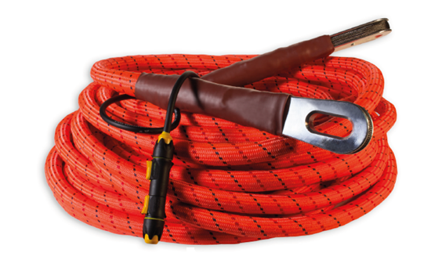
INTRODUCTION TO TEXBOR SMART-SLING

Slide 24
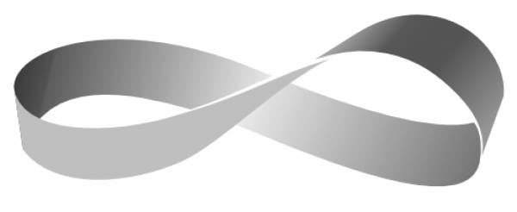

INTRODUCTION TO TEXBOR SMART-SLING
STRONG
PES-HT
High Tenacity Polyester
No continuity solution
14.000 kg
Minimum Breaking Strength
7:1 S.F.
For a Design Load of 2.000 Kg

Slide 25
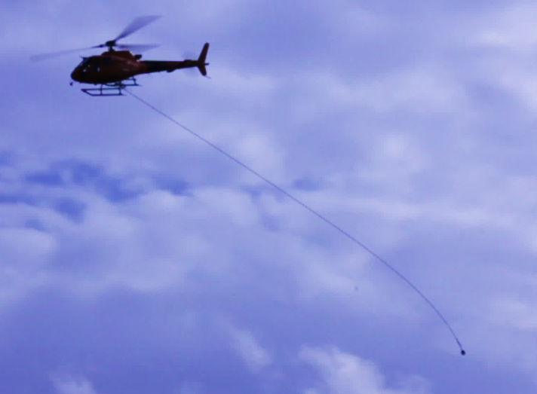
INTRODUCTION TO TEXBOR SMART-SLING
Excellent flying behaviour
ROUND
Very Low Drag coefficient
Minimize oscillations
Minimize bending towards tail

Slide 26

INTRODUCTION TO TEXBOR SMART-SLING
No spring effect
FLEXIBLE / RIGID
No rebound
Aircraft Protection
Controlled max. elasticity 2-3%

Slide 27
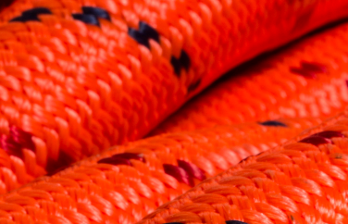
INTRODUCTION TO TEXBOR SMART-SLING
PES-HT
HIGH VISIBILITY
CORE PROTECTION
Soft
Uniform external texture
Hardwearing
Resistant to wear, tear,
abrasion and corrosion

Slide 28
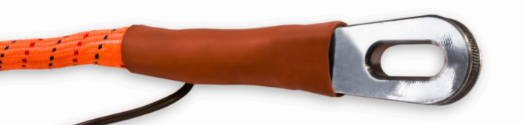
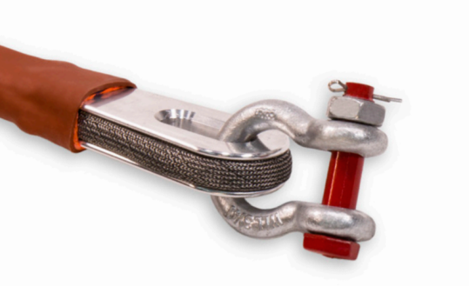
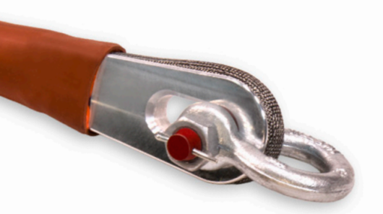
INTRODUCTION TO TEXBOR SMART-SLING
Thimbles
HANDY
HIGHLY COMPATIBLE
Aeronautical Duraluminium End Thimbles
Shackles
Thimble to pin
Thimble to bow

Slide 29
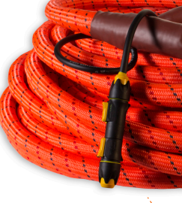
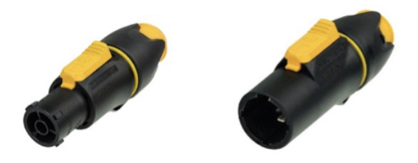
INTRODUCTION TO TEXBOR SMART-SLING
Wiring
Low resistivity embedded wire
HANDY
HIGHLY COMPATIBLE
with robust connectors

Slide 30

OTHER TEXBOR ACCESSORIES

Slide 31
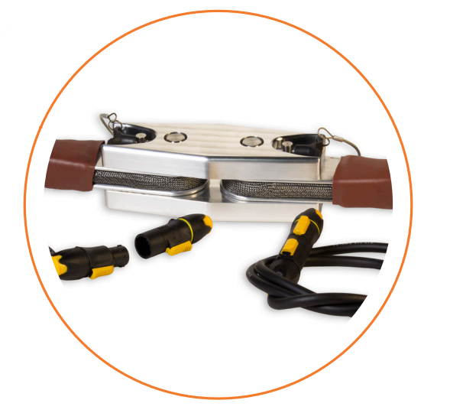
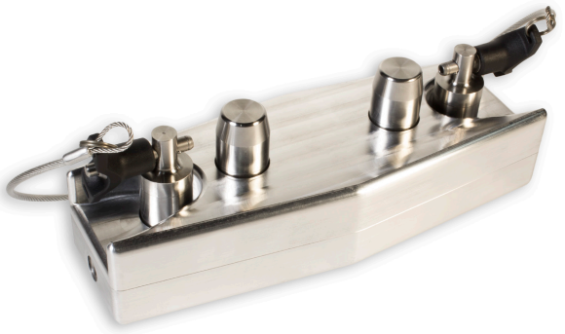
OTHER TEXBOR ACCESSORIES
SLING TO SLING
CONNECTOR

Slide 32
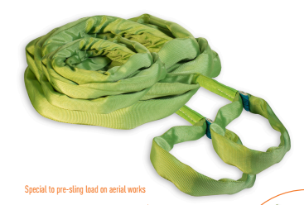
OTHER TEXBOR ACCESSORIES
LOAD RIGGING
ROUND SLINGS

Slide 33
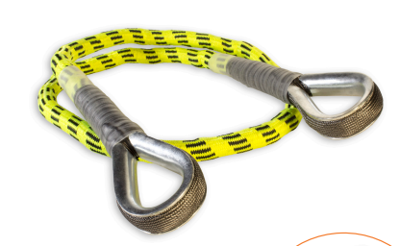
OTHER TEXBOR ACCESSORIES
LOAD RIGGING
SLINGS

Slide 34
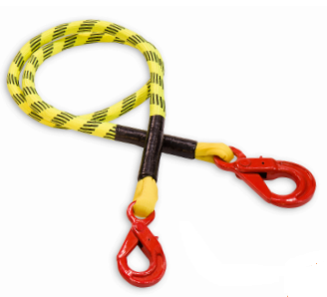
OTHER TEXBOR ACCESSORIES
LOAD RIGGING
SLINGS

Slide 35
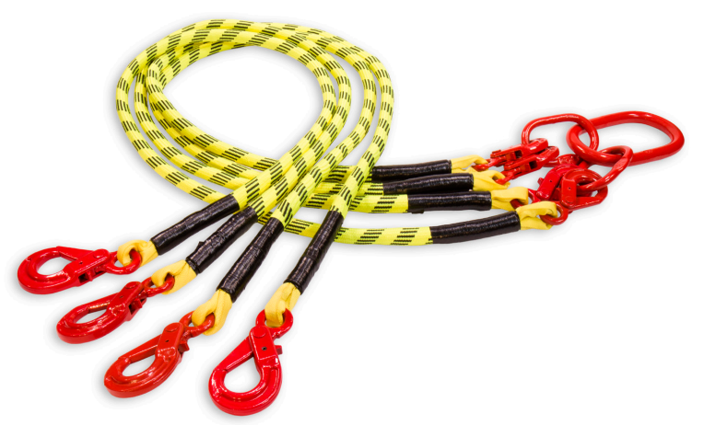
OTHER TEXBOR ACCESSORIES
LOAD RIGGING
SLINGS

Slide 36
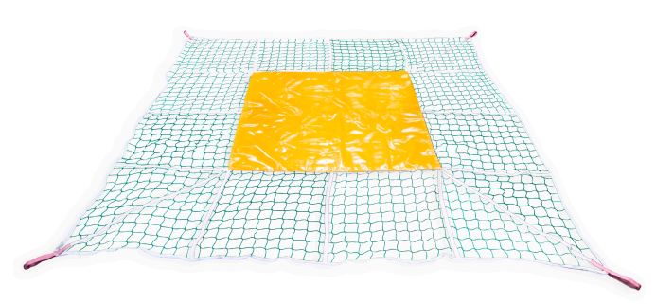
OTHER TEXBOR ACCESSORIES
LOAD NETS

Slide 37
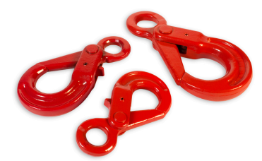
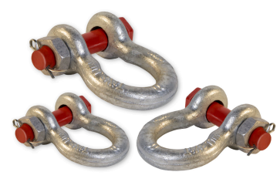
OTHER TEXBOR ACCESSORIES
HOOKS
SHACKLES

Slide 38
THANK YOU !

