Slide 1
Corpo Nazionale Soccorso
Alpino e Speleologico
ANTI ROTATIONS SYSTEMS
FOR HELICOPTER WINCH RECOVERY
S.Na.Te. Scuola Nazionale Tecnici
Italian National Mountain Rescue School

Slide 2
27 HELICOPTER RESCUE BASES HEMS SAR
350 HELICOPTER RESCUE TECHNICIAN

Slide 4
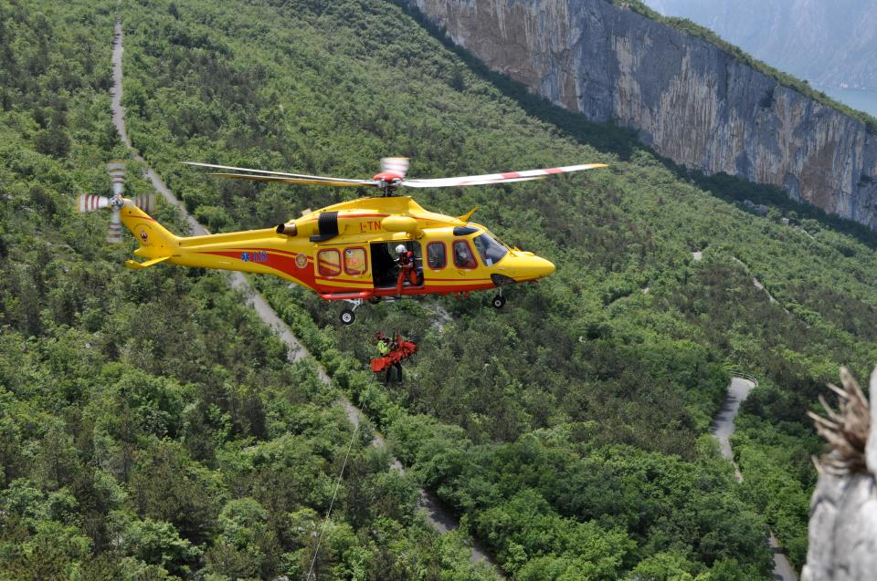
TRADITIONAL TECNIQUE WITH TAG LINE

Slide 5
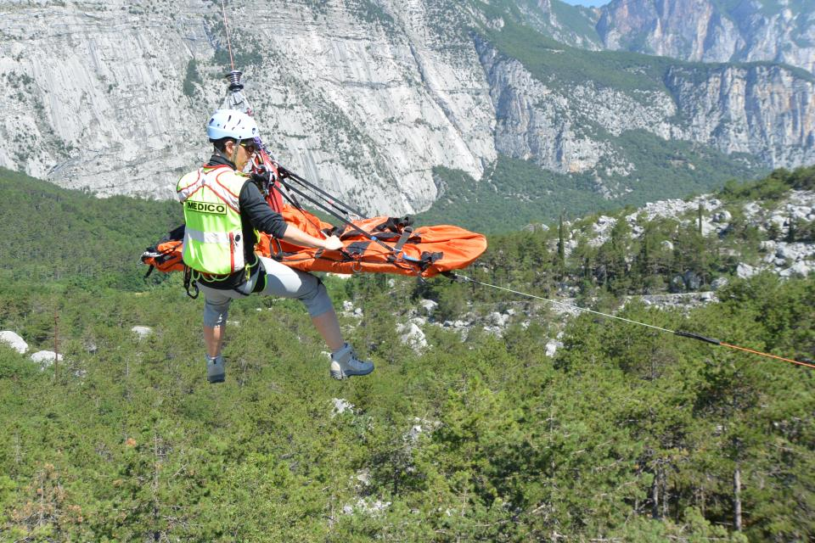
NEW HANDS FREE SYSTEMS

Slide 6
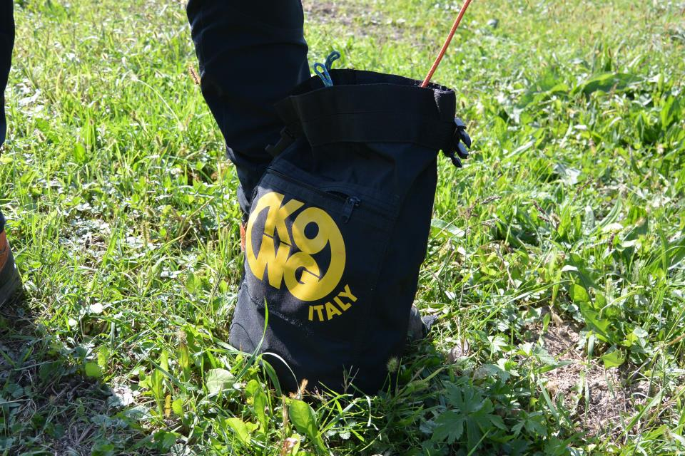
A.R.K. SYSTEM KONG

Slide 7
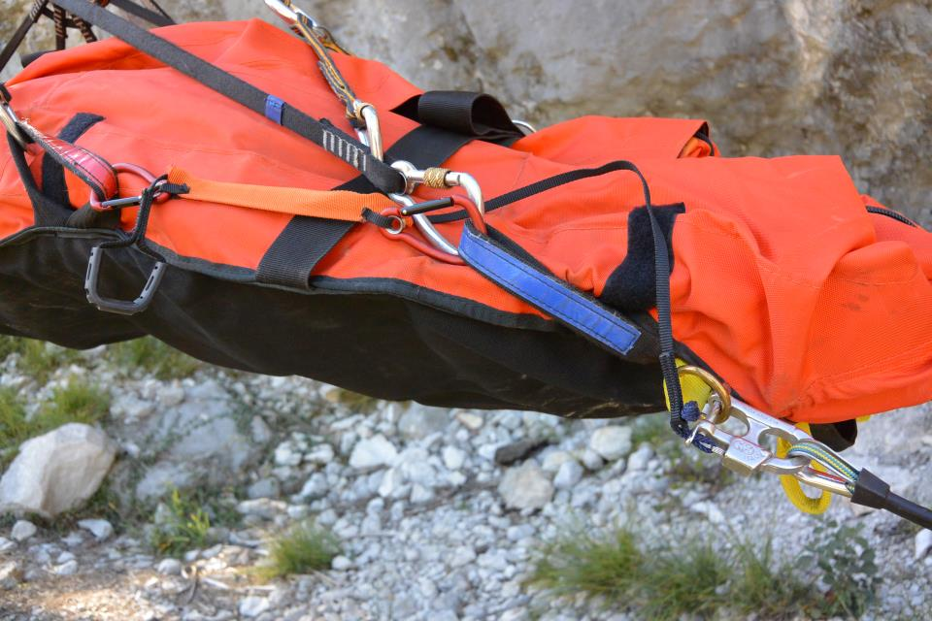
ANCHORAGE TO THE STRETCHER

Slide 8
THE LANYARD ATTACHING

Slide 9
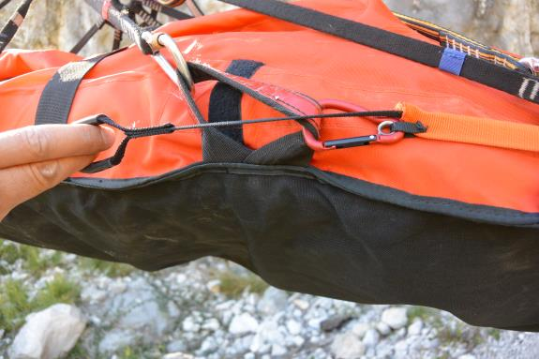
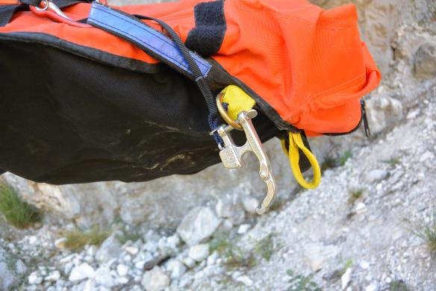
CARABINER OPEN
MANUAL RELEASE

Slide 10
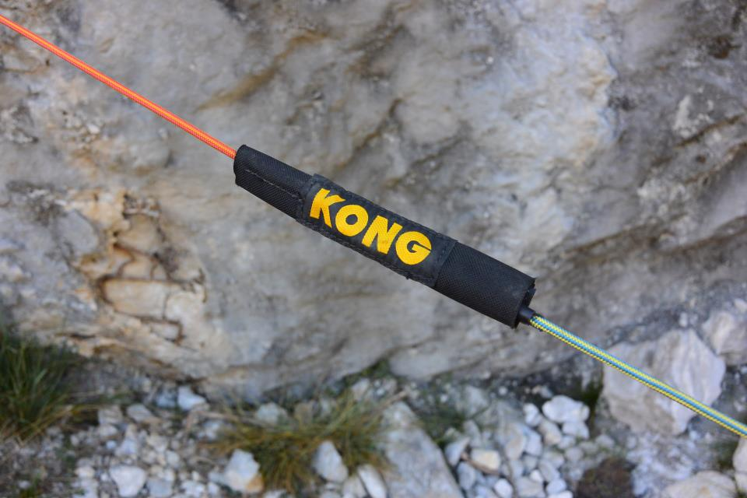
FUSE

Slide 11
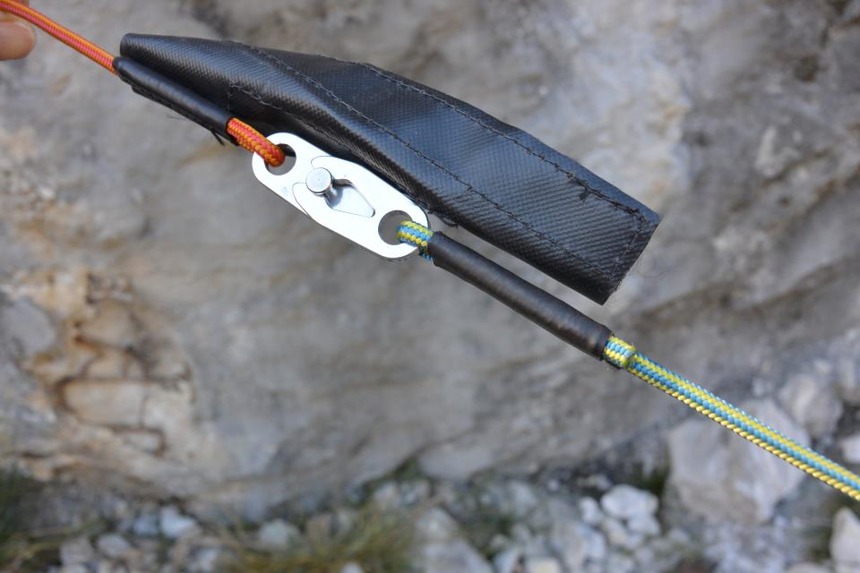
SET AT 45 Kg + - 5 Kg

Slide 12
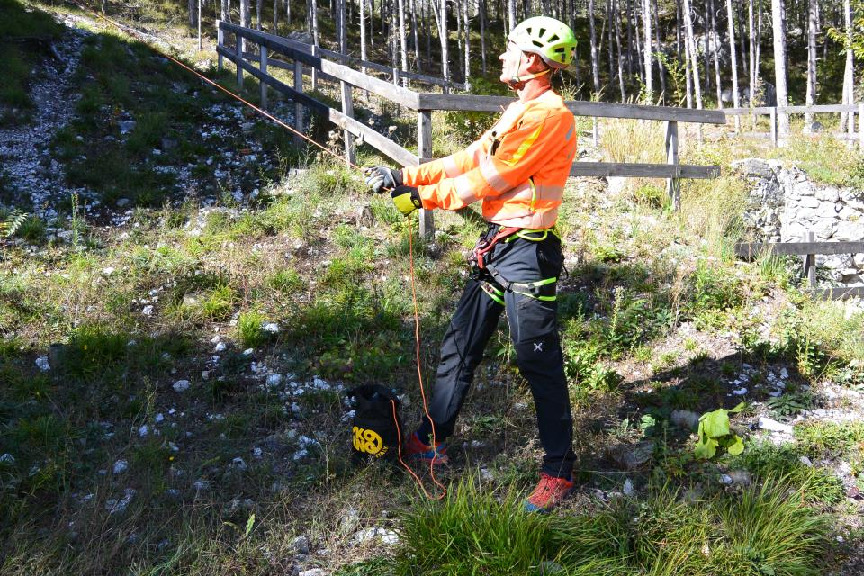
OFFSET RESCUER

Slide 13
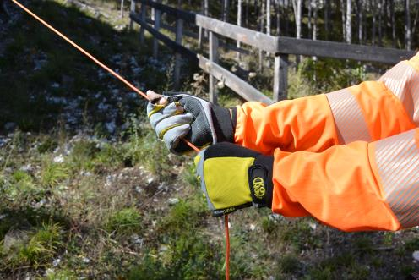
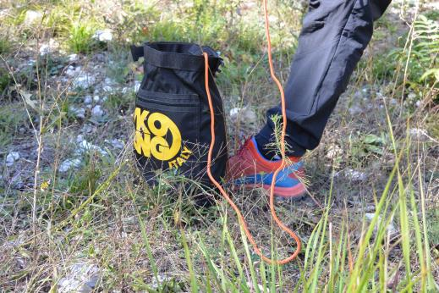
USE OF THE BAG
HANDS GLOVES

Slide 14
USE OF THE BAG

Slide 17
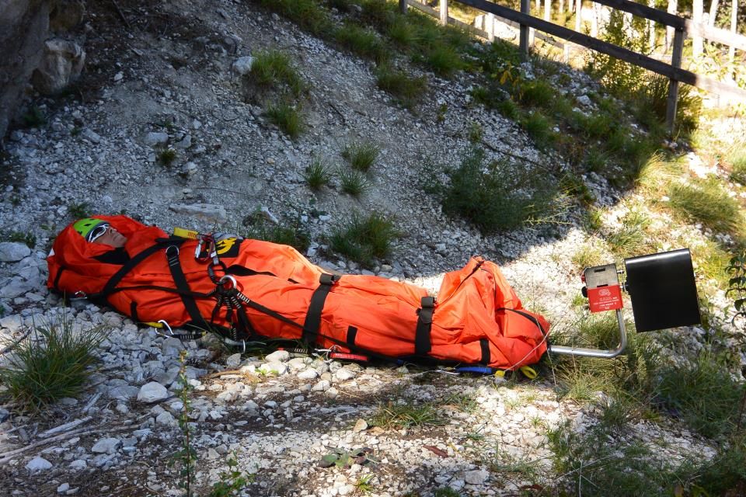
Kong Anti Rotation Sistem

Slide 18
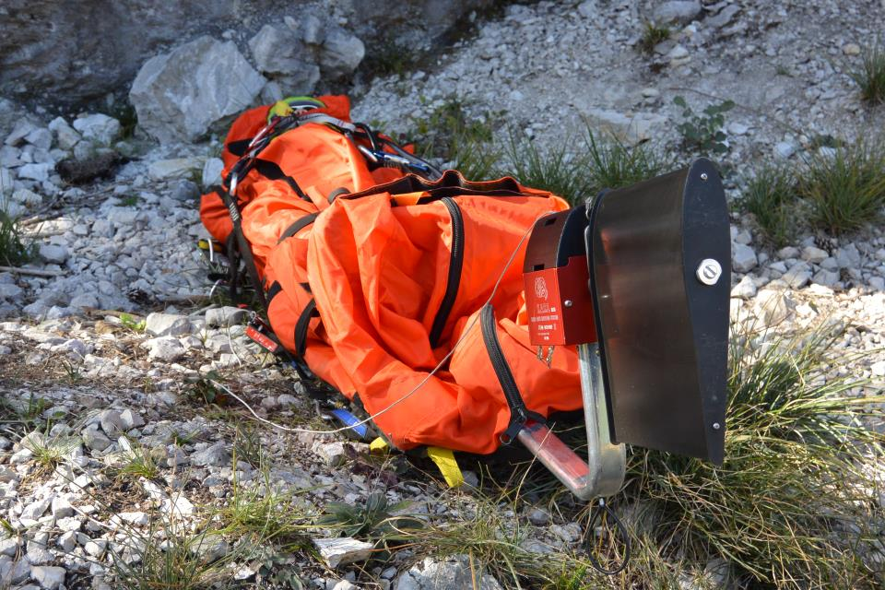

Slide 19
SWITCH ON AND TEST

Slide 20
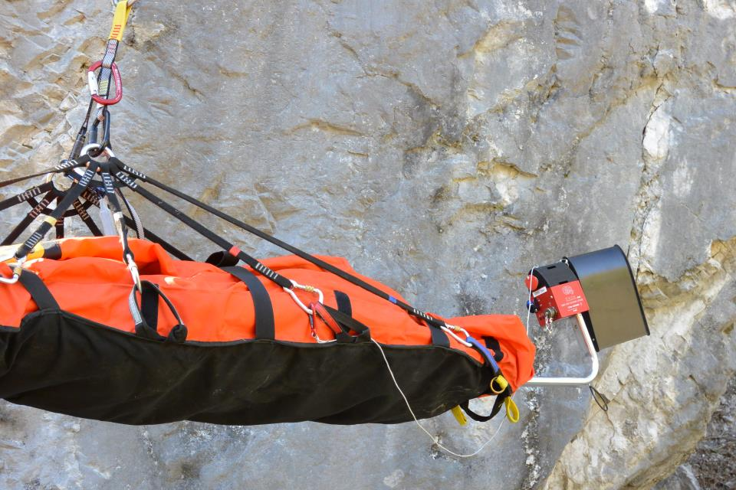

Slide 21
SWITCHING EMERGENCY RELEASE

Slide 23
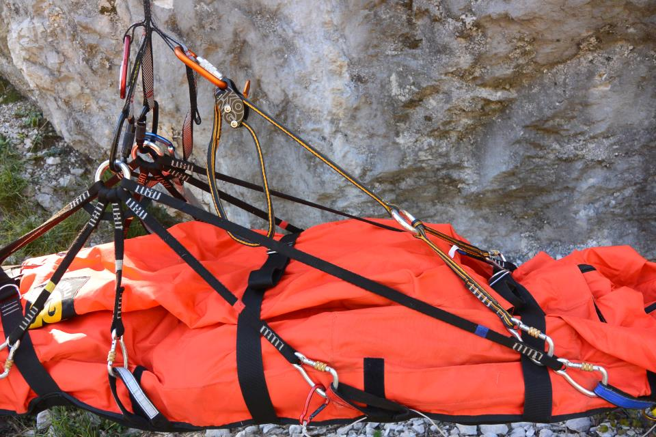
ADJUSTING DEVICE “ELI TRIMMER”

Slide 24
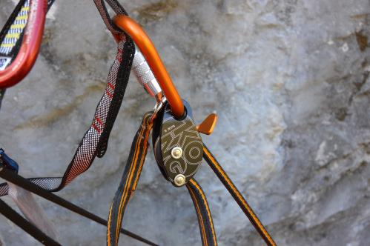
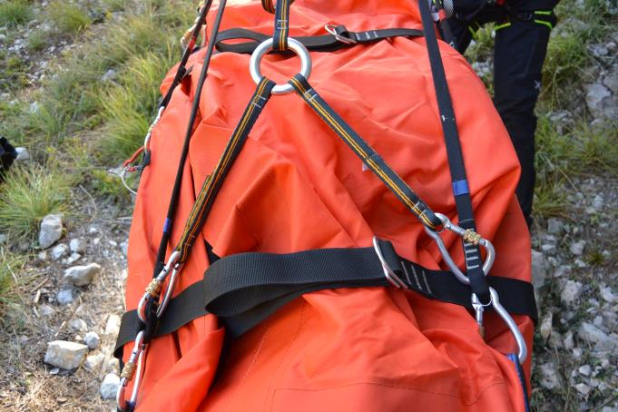
FASTENING
ADJUSTING DEVICE

Slide 25
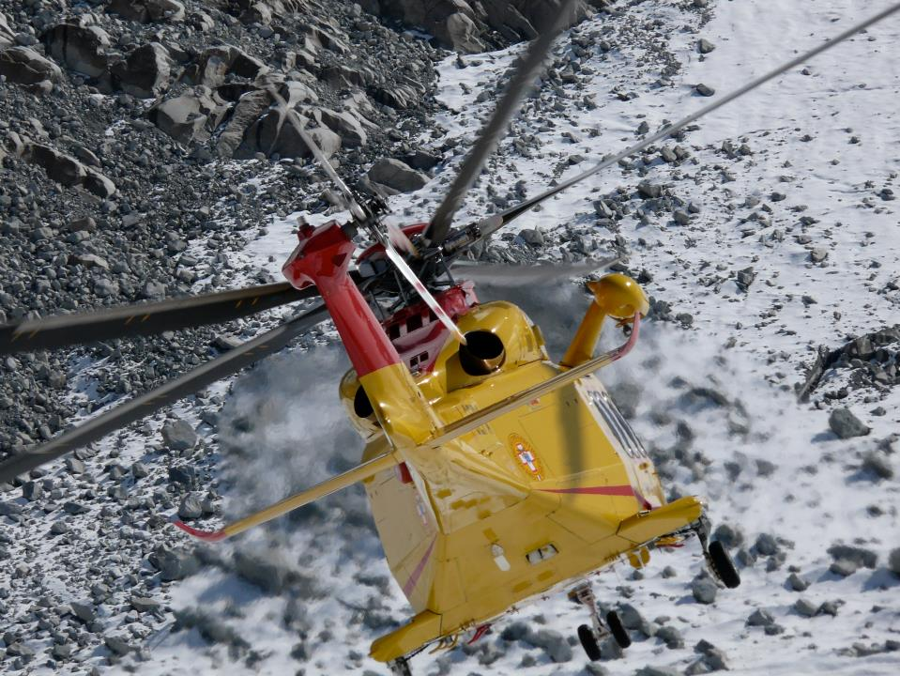
Corpo Nazionale Soccorso
Alpino e Speleologico
THANKS FOR THE ATTENTION

