Slide 1
Bark-back
ICAR 2022 Montreux

Slide 2
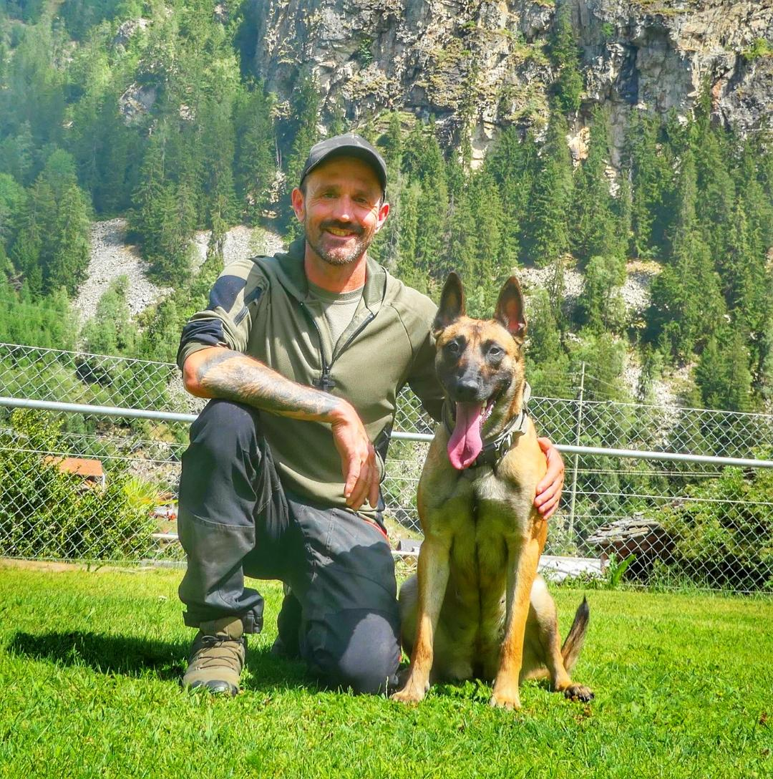
Imboden Philipp Switzerland/KWRO
Professional Dog Trainer
Instructor for:
Avalanche-dogs
Area-search-dogs
Mantrailing

Slide 3
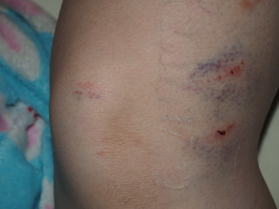
Wy barking back «to» the doghandler?
Pushy dogs
To offensive to the victim
Long distance to the handler
Inpatient dogs

Slide 4
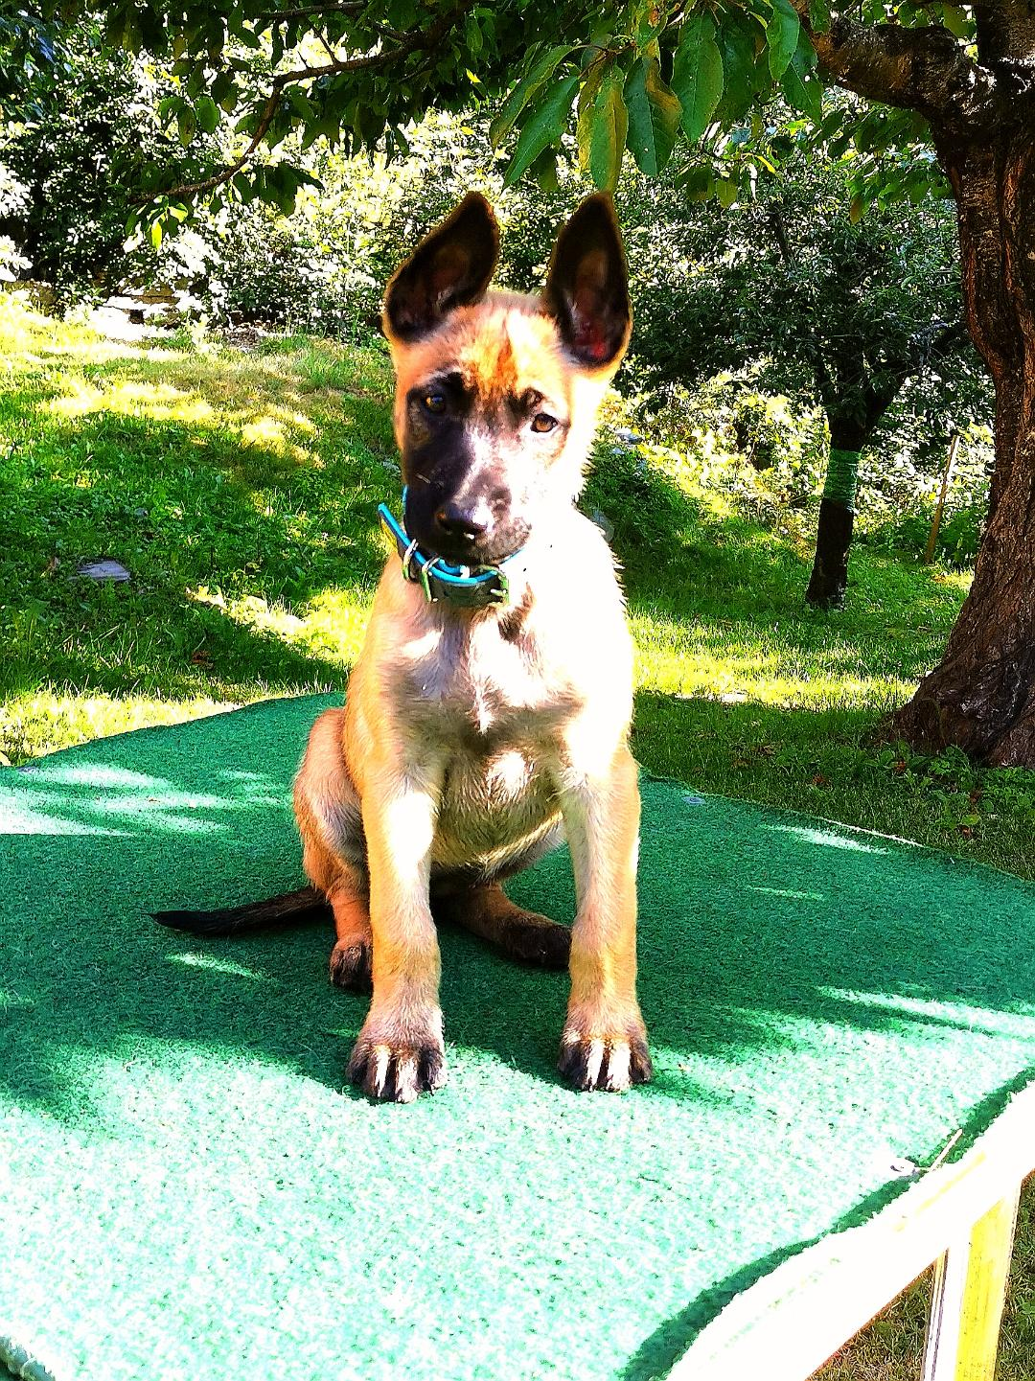
«Back chaining system.»
Table work, face to face
(blanket)
Step 1:
Bark on command, up to 1 min.
Later, more time on the bark.

Slide 5
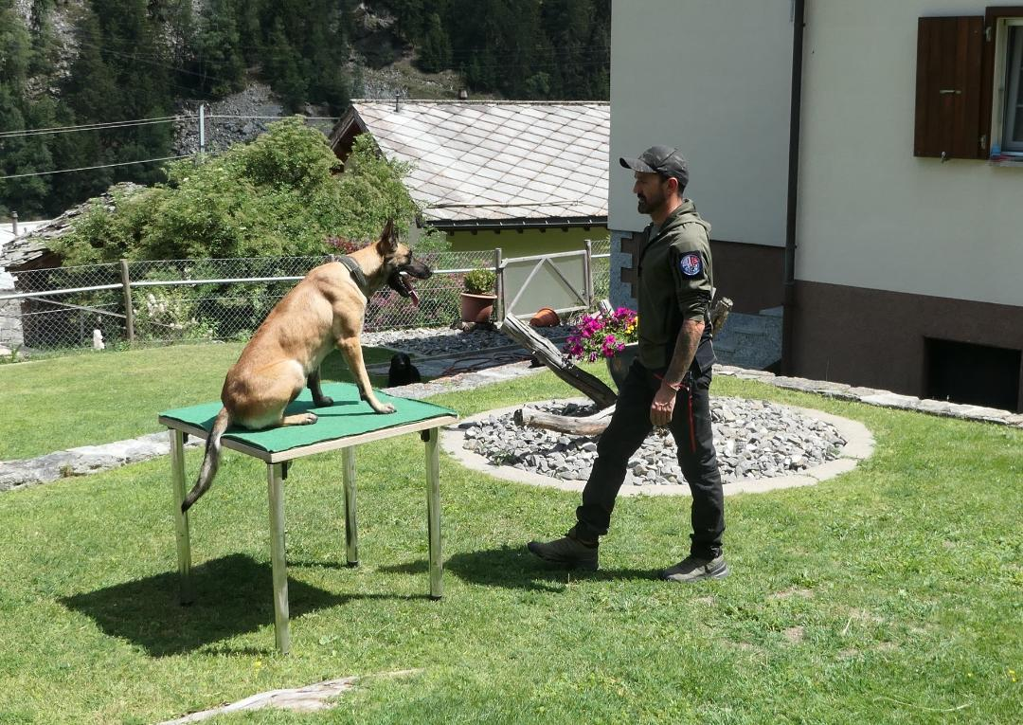
Back chaining system.
Step 2
Step away from the table. Short distance.
«Bark»- move to the dog and reward. Stop barking, stop moving.

Slide 6
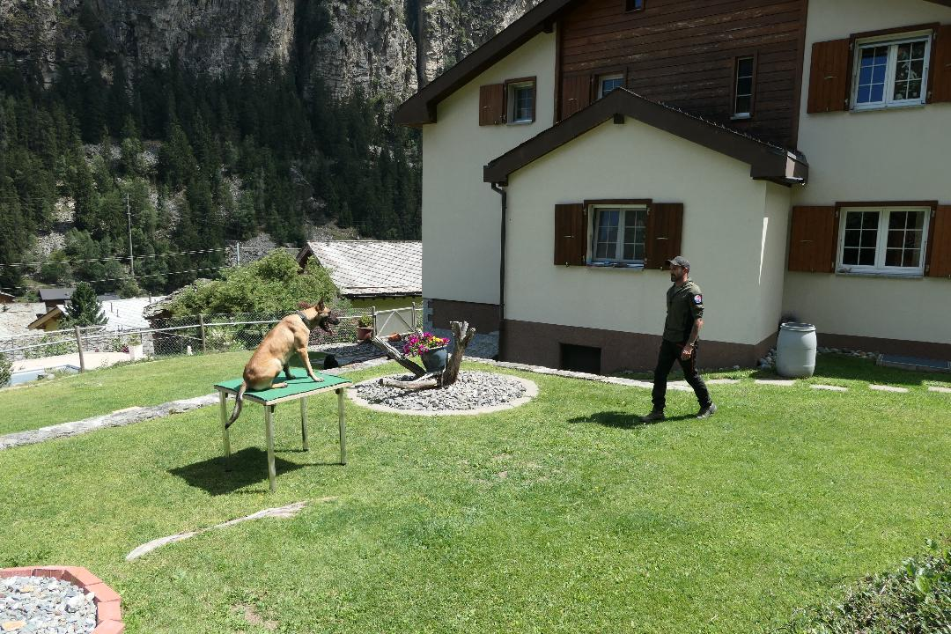
Back chaining system.
Step 3
Longer distance, presistent barking.
Revard, like step 2.
Final step, distance at 100m goal.

Slide 7
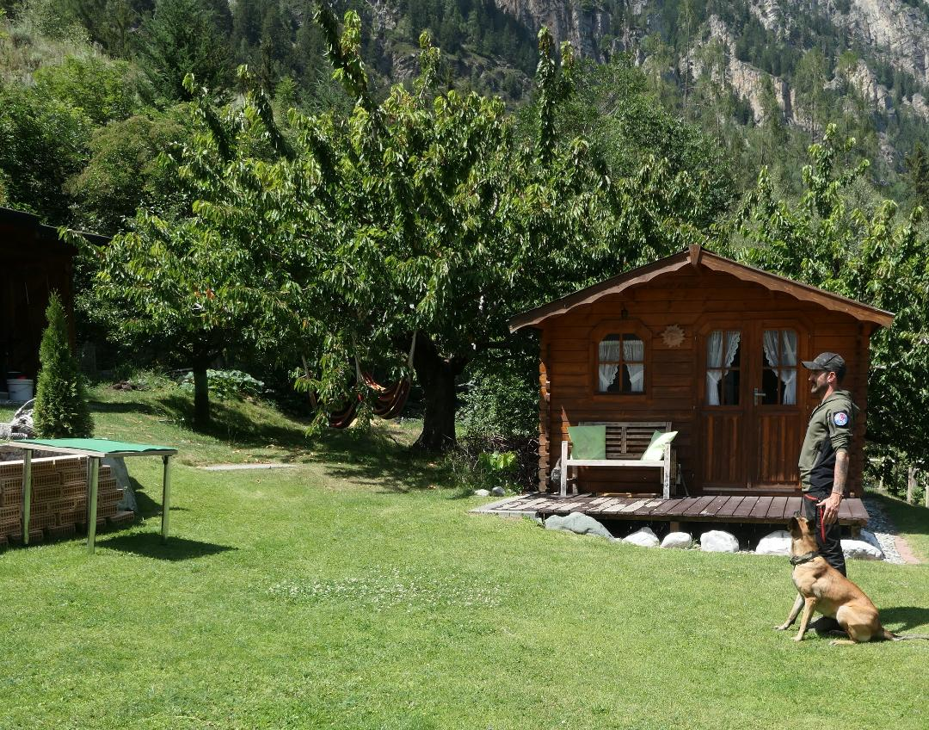
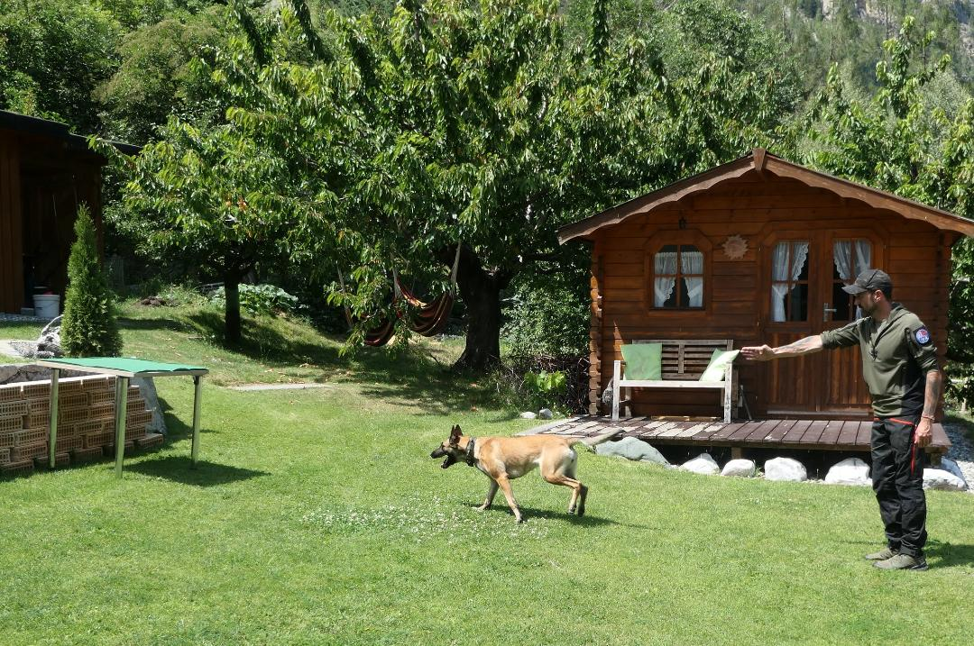
Back chaining system.
Step 4
Send the dog on the table, short distance.
Folow the first 3 steps of barking and reward.
Goal: 80m distance to the table. Presistent barking up to 5min.

Slide 8
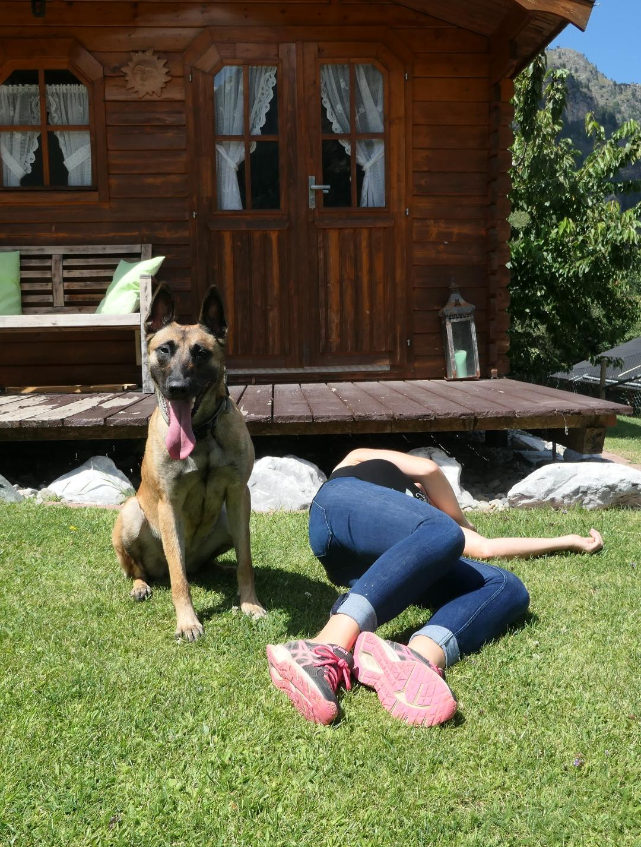
Final Steps
Step 5
Blanket next to the victim.
Send the dog to the victim, short distance. Barking-reward….
What, if the dog move?

Slide 9
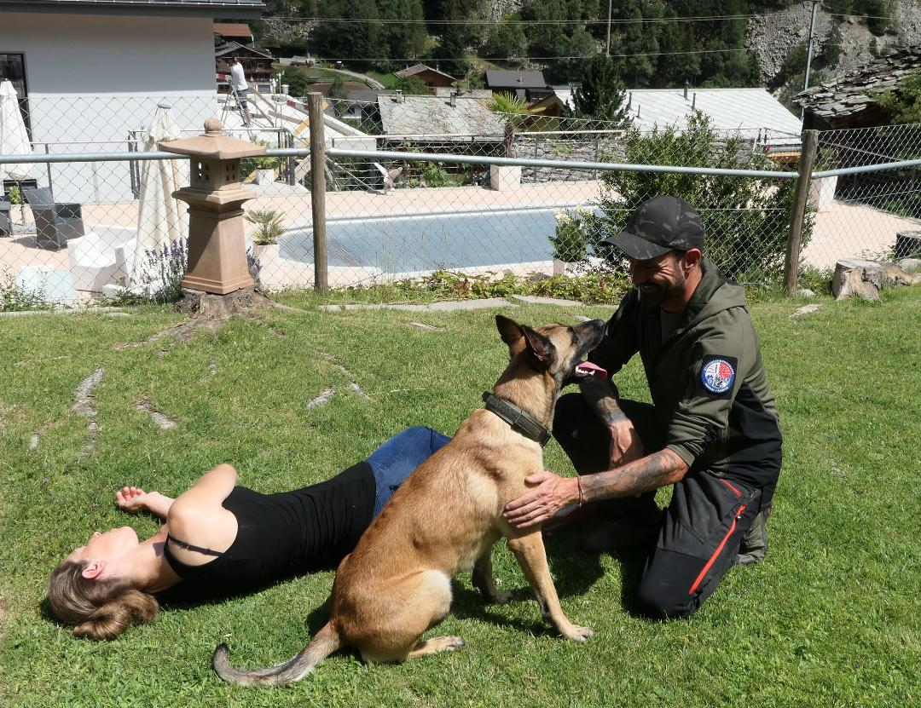
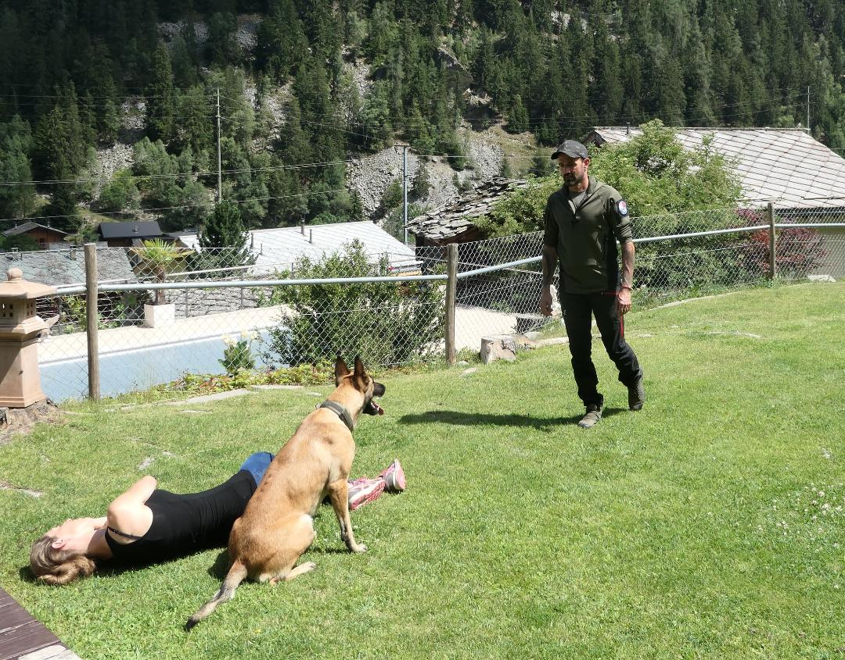
Final Steps
Bark and reward, same like the table work. Remove the blanket.
Goal: Distence 100m, dog cant see the doghandler.

Slide 10
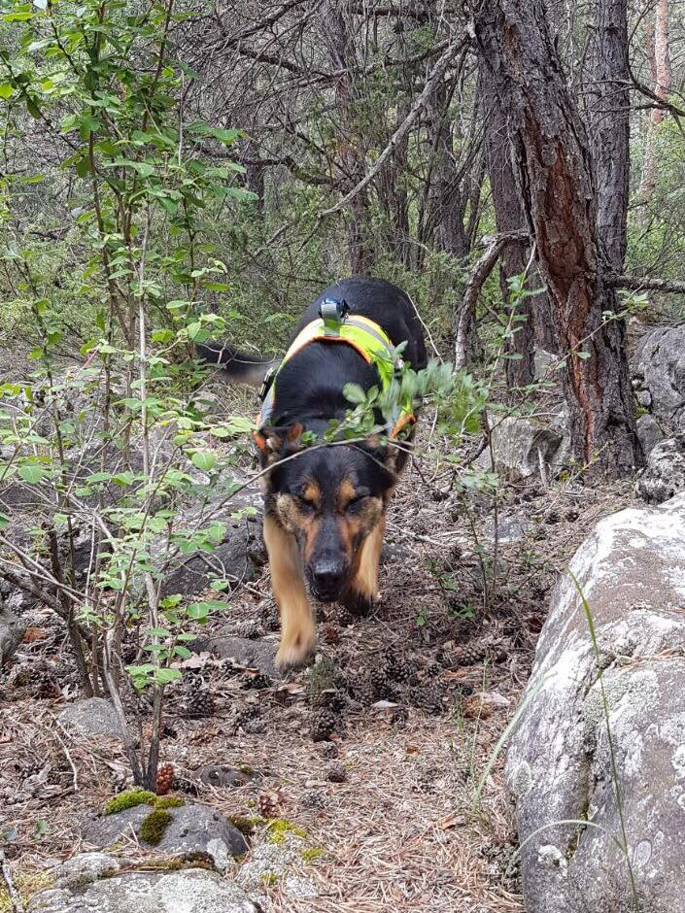
Options
Noise, Water, Street, deep forest,cropped terrain etc.
Recall the dog, barking in front of the doghandler, send the dog again to the victim. Recall the dog again…..etc.
Endurance barking, training options.

Slide 11
Questions

