Slide 1
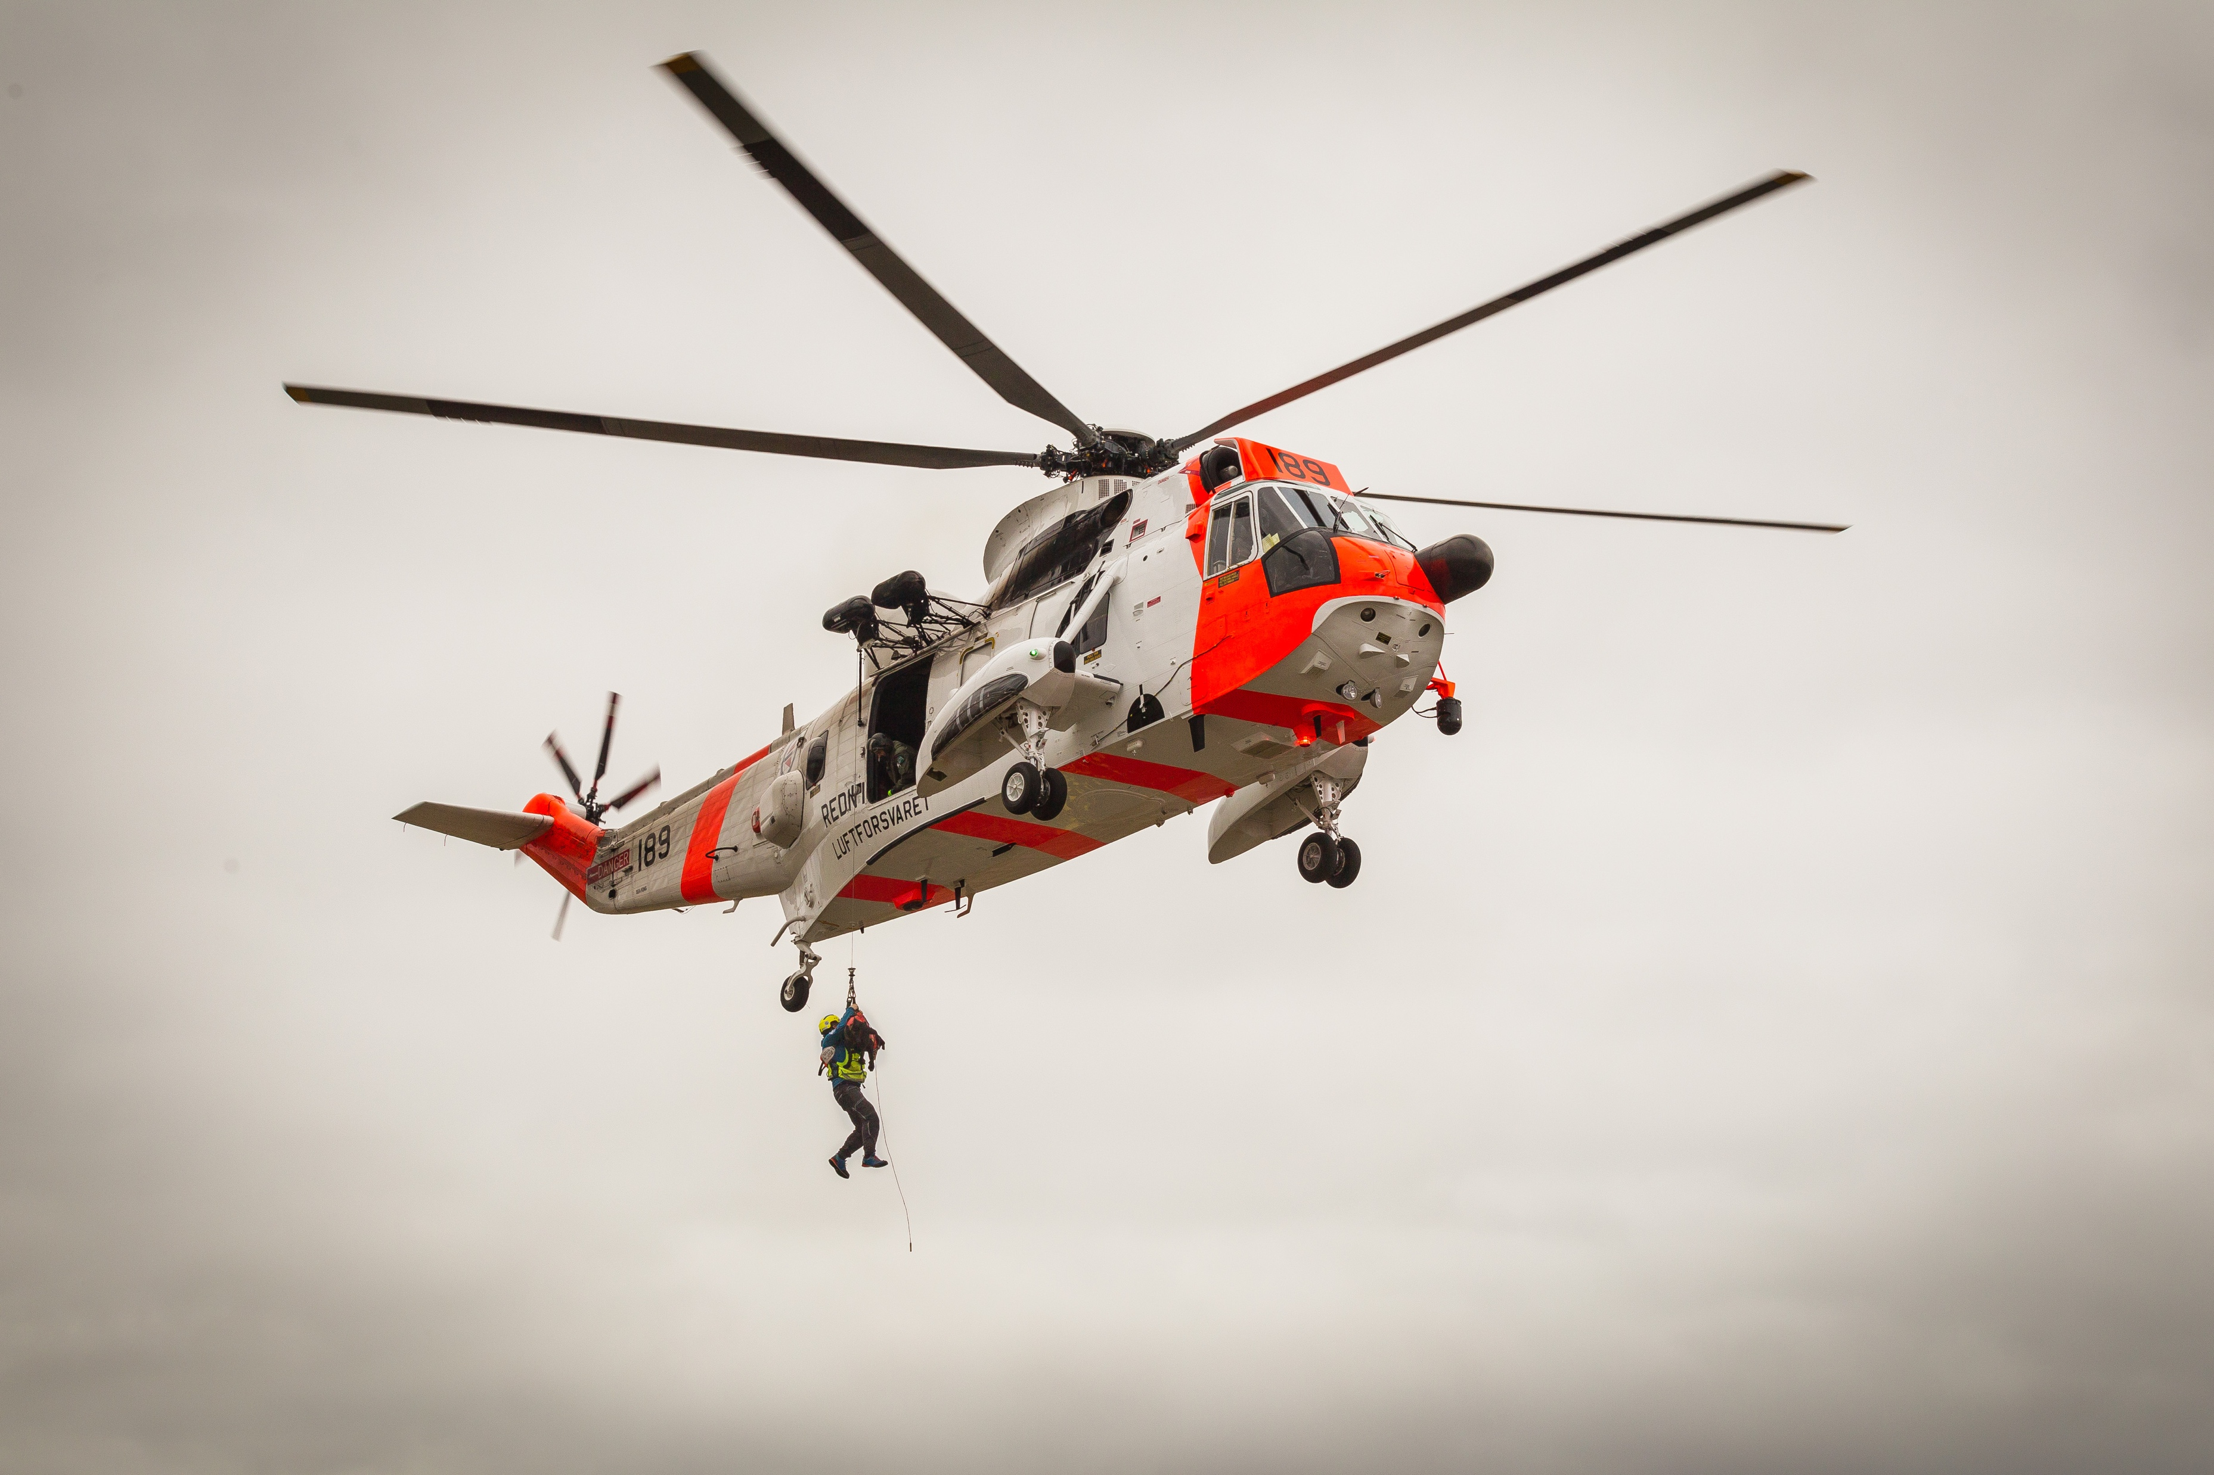

Norwegian search and rescue dogs
SEARCH + RESCUE

Slide 2
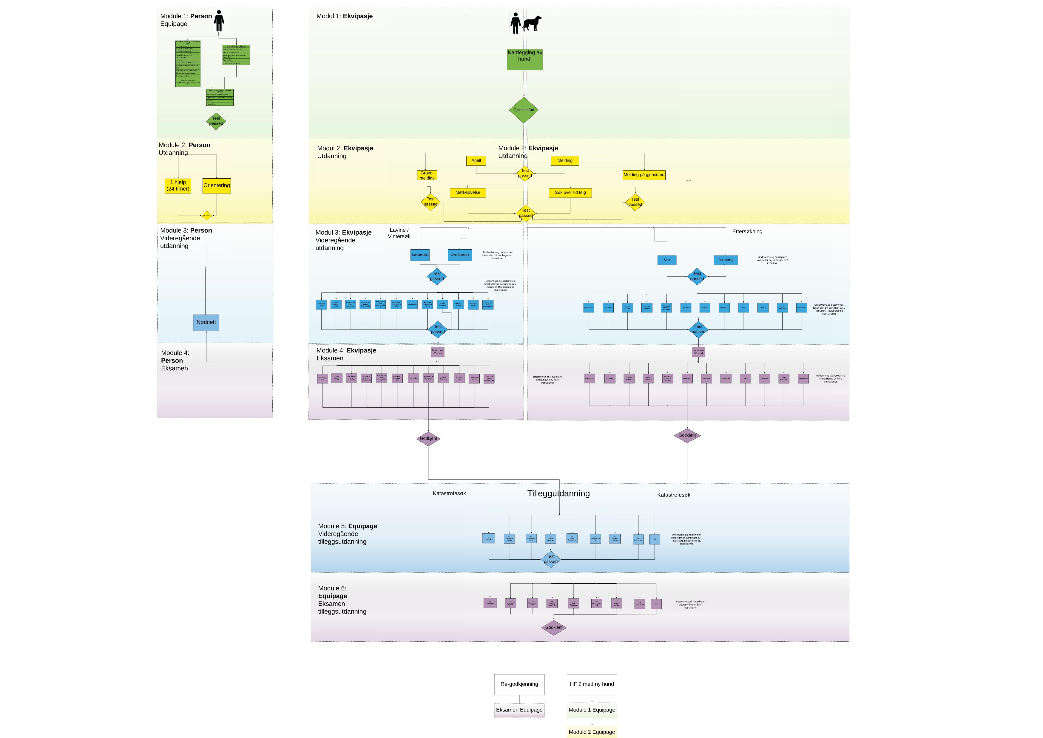
New program from 2021?

Slide 3
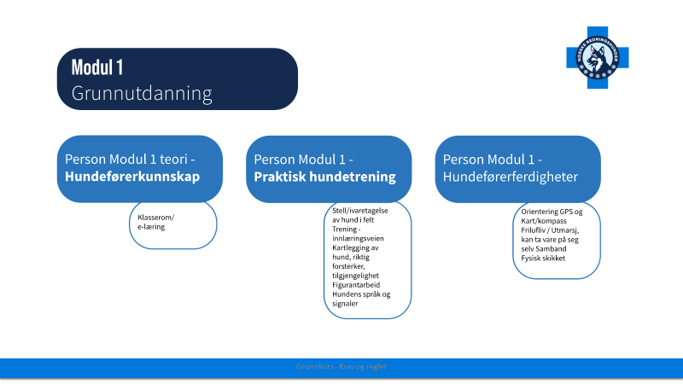

Slide 4
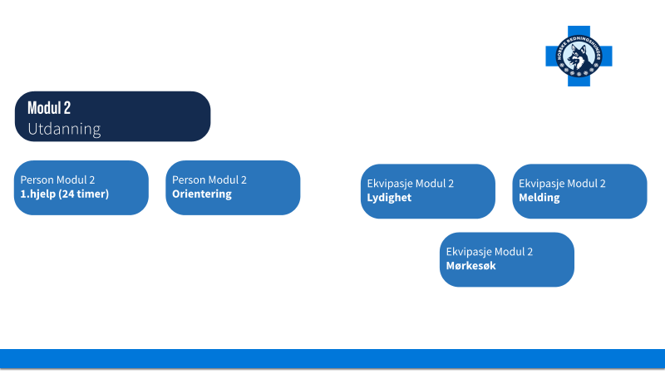

Slide 5
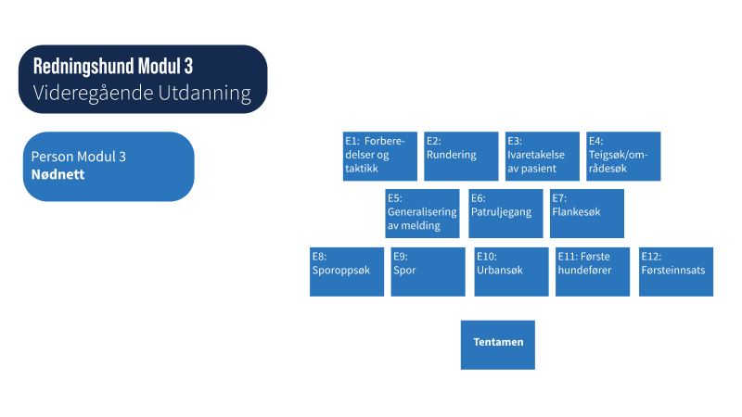

Slide 6
4 National Graduation courses, terrestrial search
Week 28 Middle
Week 31 South
Week 32 North
Week 32 West
Each course has their own theme/courses for approved dog handlers who want to improve their skills in different areas (Urban search, tracking, alpine search etc.)
Special course in tracking in urban (trafficated) areas, with focus on dogs to handle hard surfaces and doghandlers to find startingpoint of the track (from cars, houses, hospital etc.)

Slide 7
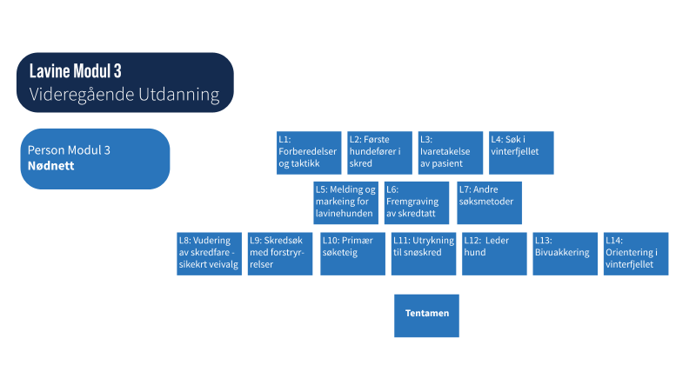

Slide 8
2 national graduation courses, avalanche
Week 13 South (22 March)
Week 12 (15 March) North
Each course has their own theme/courses for approved dog handlers who want to improve their skills in different areas.
Special course in high mountain search where the dog handler will get extra expertise in air scenting search (by ski and skidoo), rope, safety, evaluating risk of avalanche, emergency bivouac, etc.

