Slide 1
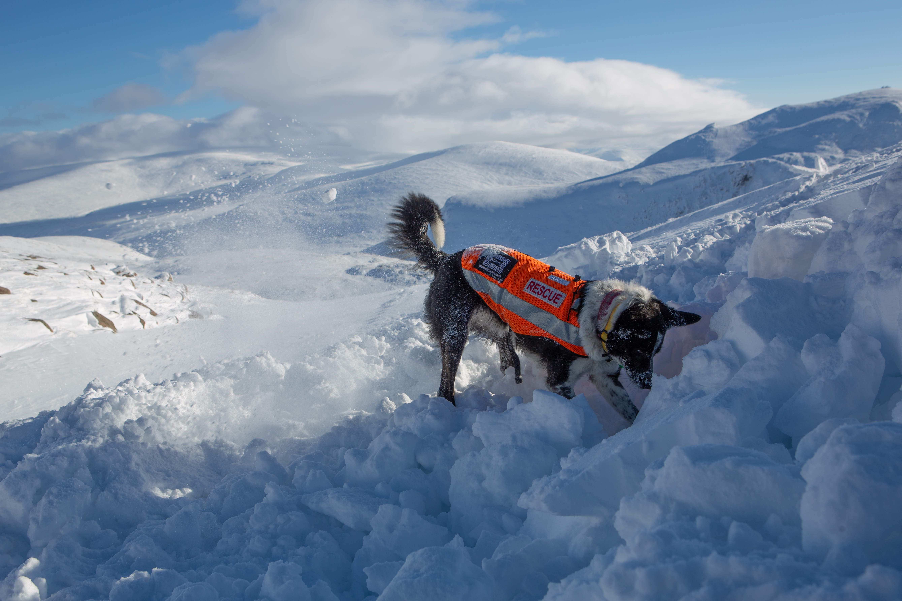
Past, Present and Future of
working search dogs
Rob Grange ICAR 2022
Trends and changes in search dog callouts

Slide 2
Aims of this presentation
To look at what callouts we have an how they change over time
What conclusions can we draw from the information?
To open a discussion about what our next generation of search dogs will do
To be quick because it’s nearly lunch

Slide 3
And to ask the question :
When we talk about our future

Slide 4
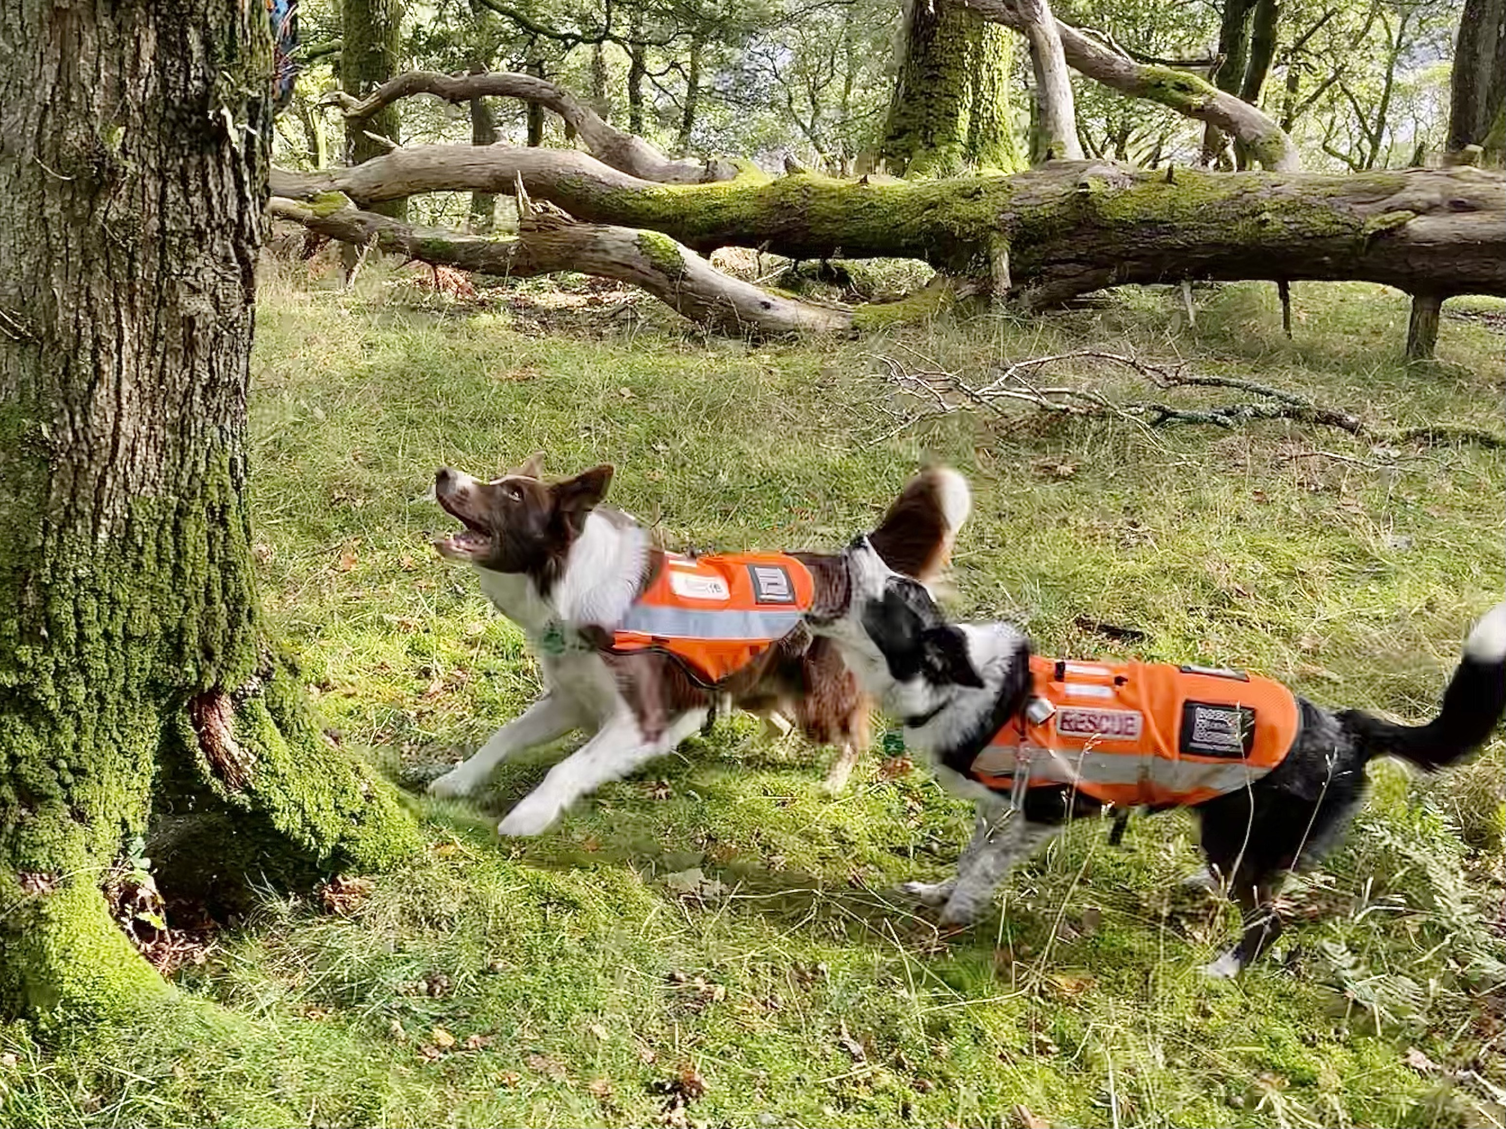
aRe we barking up the right tree?

Slide 5
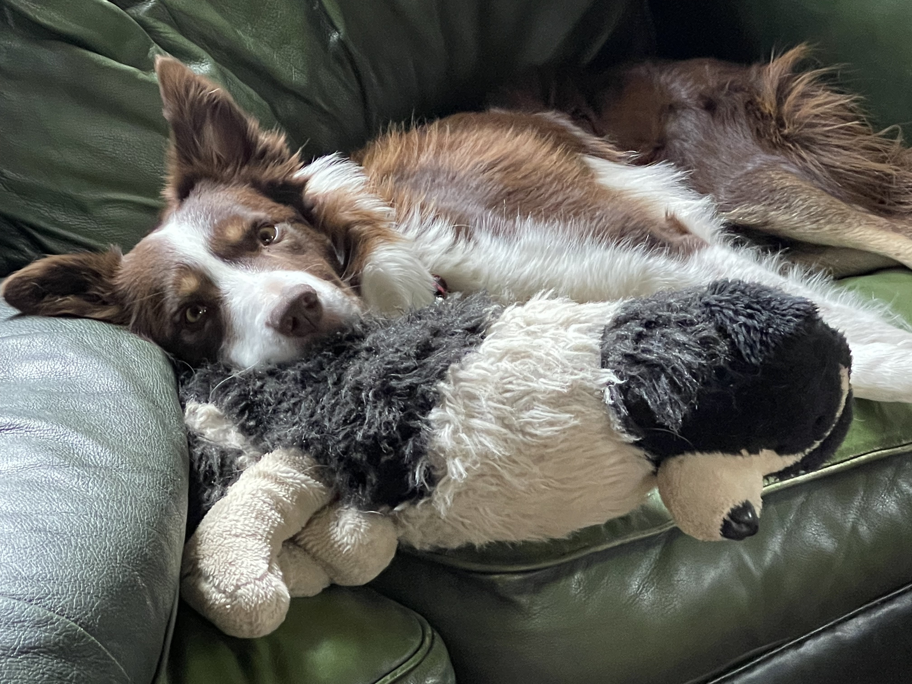
Changing callouts
Why ask the question?
LDMRSDA has had a large change in callouts
Is this reflected world wide and in all disciplines?
No one wants a board search dog!
Notes:
Big change in callout numbers in the last 10 years
We are putting a lot of effort into getting people trained and they are not doing a large number of callouts
We want to ask is this reflected world-wide and what disciplines are effected

Slide 6
callout information
I sent out a a quick questionnaire to give us some idea
Small amount of data
2 main data sets
Thank you to all the associations that helped,
I will buy you your beer in the bar later

Slide 7
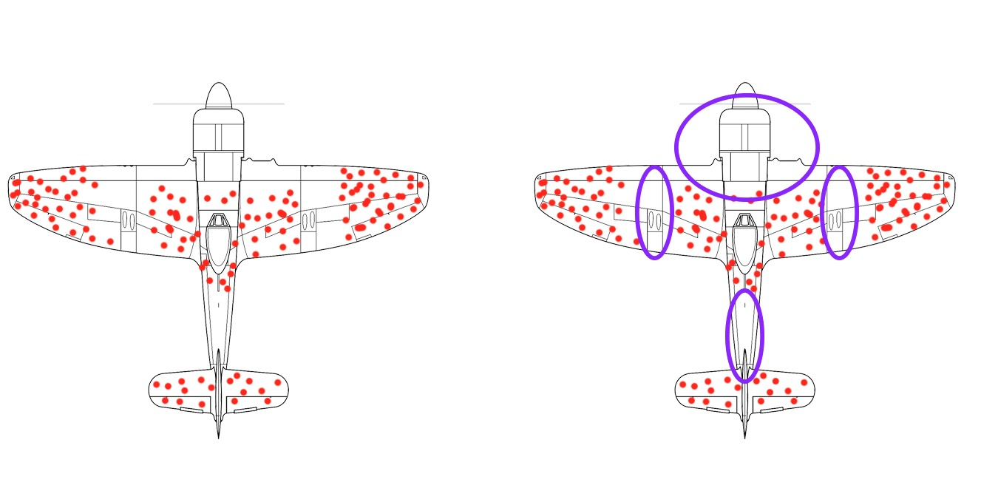
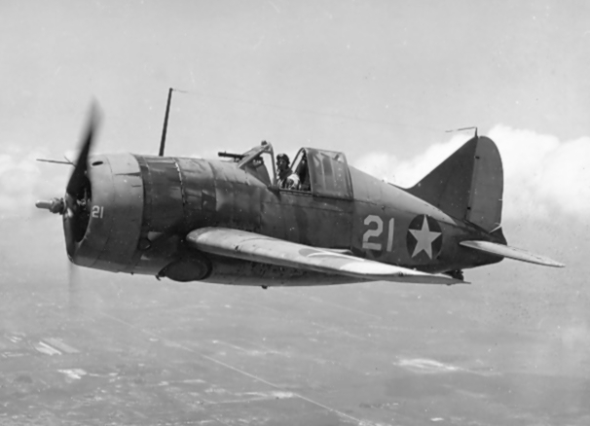
Data - the wrong solution
A little story, nothing to do with search dogs
Look at the data with an open mind
The solution might not be what you see but what is missing
Notes:
Bomer pic
WW II, American navy had a problem, Many aircraft were getting shot down to help solv After each mission, the bullet holes painstakingly recorded.
(show picture).
solution was simple Increase the armour to these BUT Hungarian statistician-Abraham Wald - critical flaw in the analysis
Missing Every plane that had been shot down real solution to protect the areas without holes
solution might not be in you see, but what is missing

Slide 8
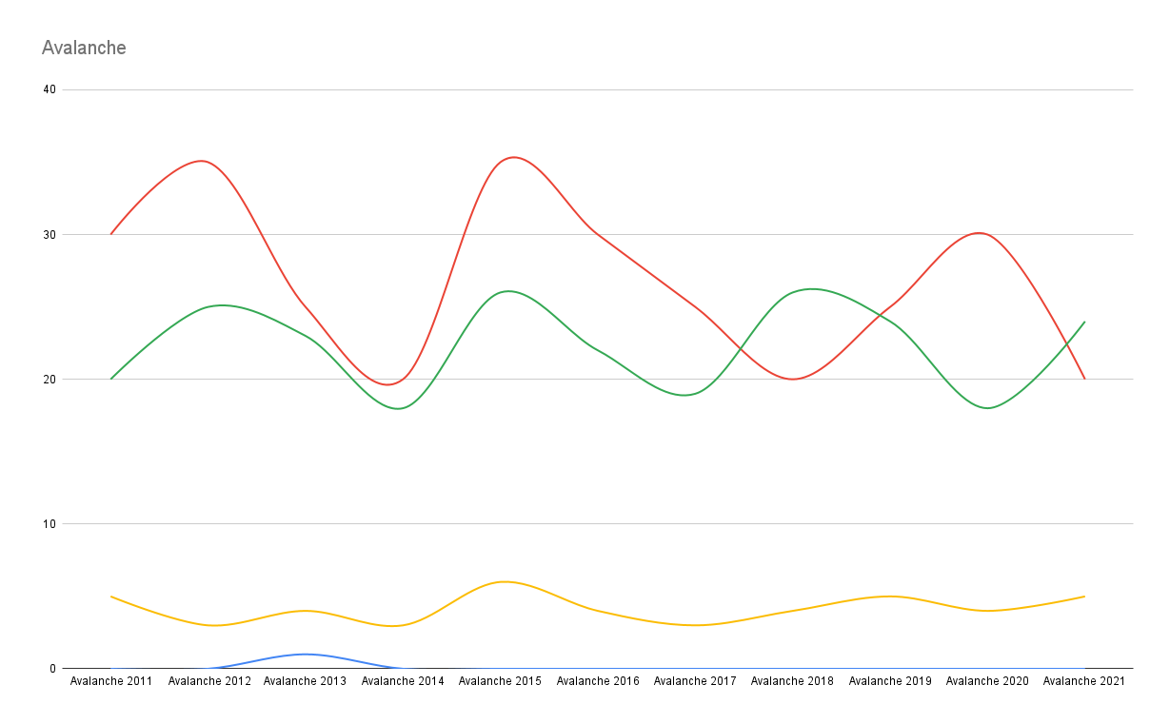
Avalanche Statistics 2011 - 2021
Fluctuations
Trends over time
Is it all ok?
Climate change

Slide 9
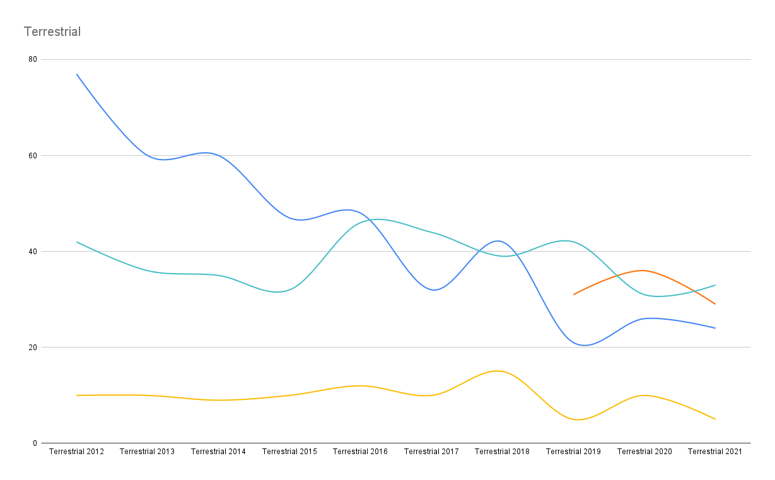
Terrestrial Statistics 2011 - 2021
Change over time
No one bucking the trend
Technology making a difference
Are our casualties changing?
Notes:
callouts for people being lost have gone up
number searches has gone down
Use of phones And phone find systems

Slide 10
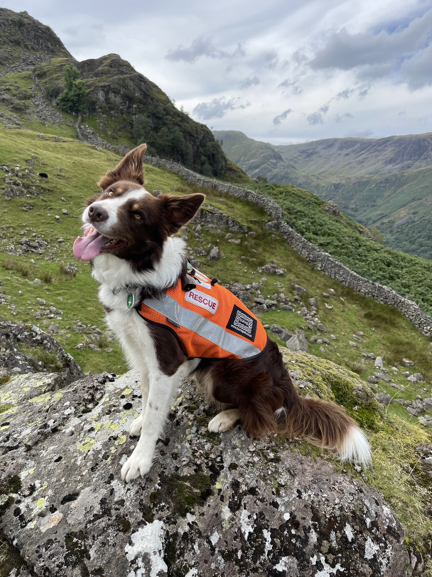
Terrestrial
  types of missing person
Fewer missing unhurt walkers
Similar number of fatal or serious injury
Similar or Increased number of dementia
Similar or Increased number of despondent
Notes:
Generalised information for the UK, I would like to get stats

Slide 11
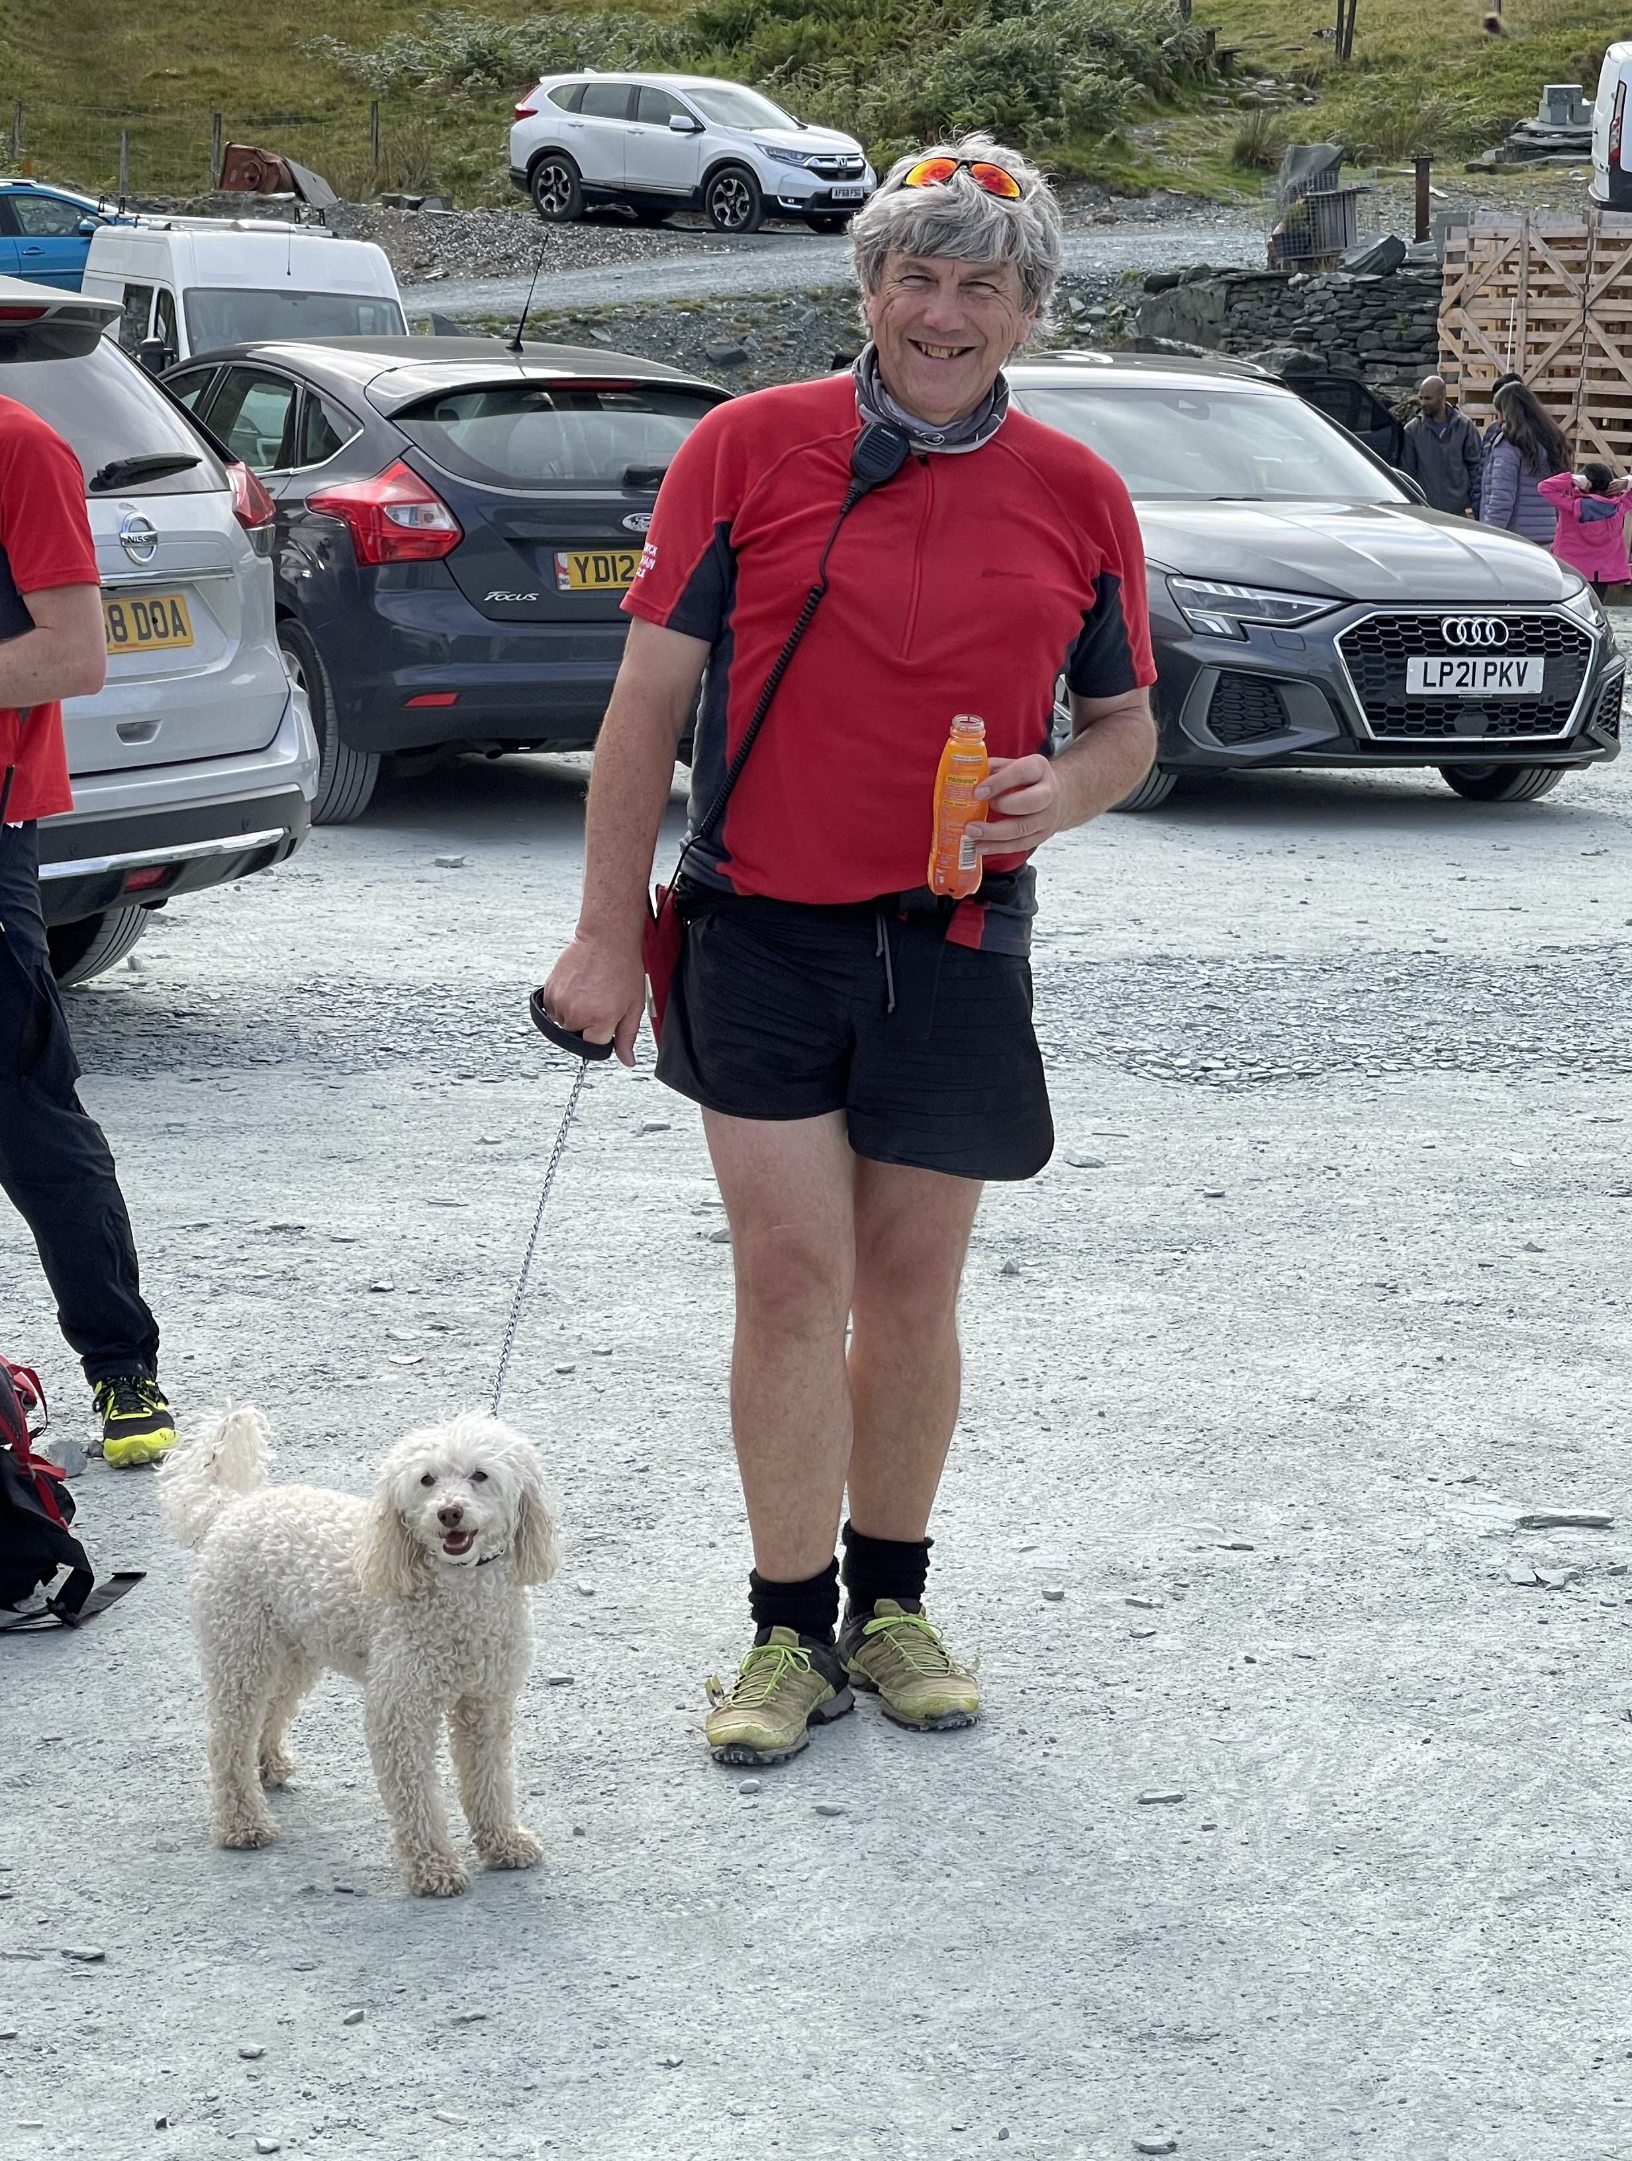
Discussion ideas:
Do we need to be proactive?
Are we providing the right dogs for todays and tomorrows searches?
Where will we be in 10 years time?
How do we stay current with fewer callouts?
Should we adapt current disciplines for modern callouts?
Multi discipline dogs?
New disciplines?
Lead times (training dogs and instructors)?
Should we gather this data from all associations?
Notes:
Go though these quite quickly

Slide 12
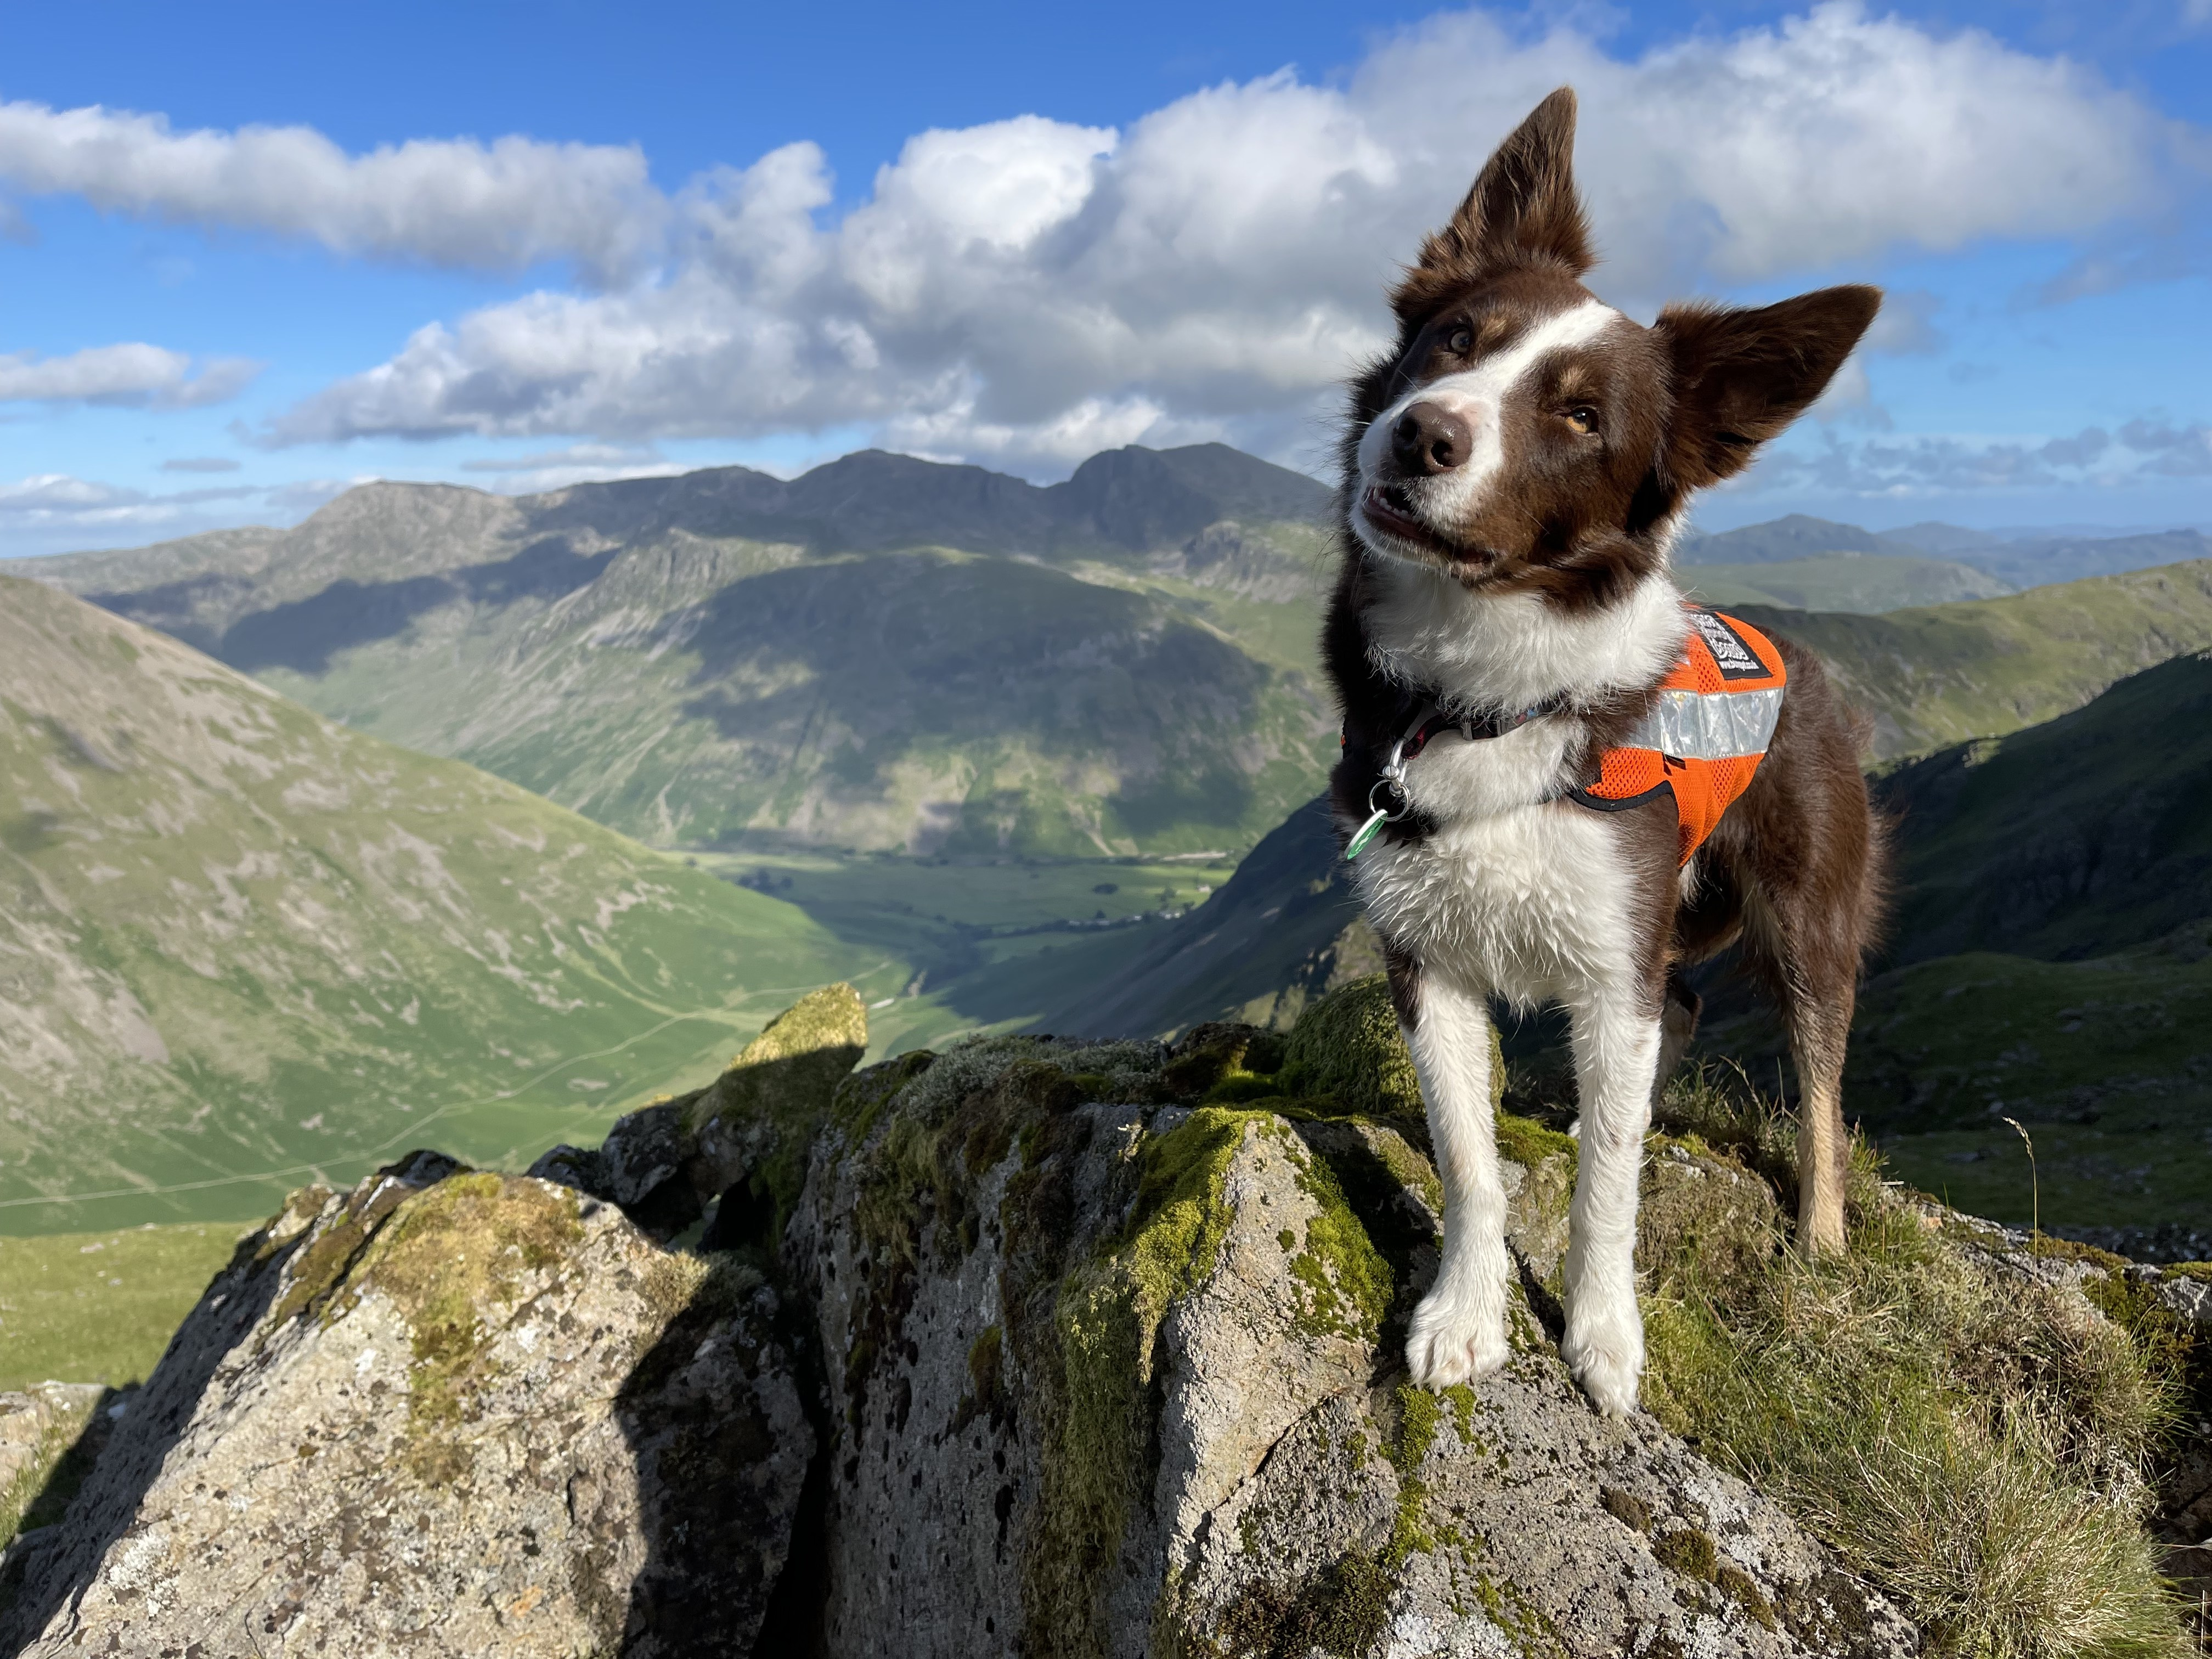
Thank
you
  Questions
  Discussion
Notes:
I will repost those discussion ideas

Slide 13
Discussions:
Do we need to be proactive?
How do we stay current with fewer callouts
Where will we be in 10 years time?
Are we providing the right dogs for todays and tomorrows searches?
Adapt current disciplines for modern callouts?
Multi discipline dogs?
New disciplines?
Lead times (training dogs and instructors)?
Should we gather this data from all associations?

