Slide 1

Learning from mistakes
David Benson
Notes:
Intro, there’s only 4 slides
We talk about success, rightly so, but what about our failures and the lessons they bring
Keep trailing in the spotlight, interest following 2021 virtual conference

Slide 2
Training weekend
2 blind trails - poor performance
Had to ask the question Should I remain on the call out list ?
Notes:
We have monthly training weekends among other training opportunities
2 poor perforfances, reasons for one probably a poor scent article, the other I don’t know , body was a very experienced trailing body, I am a guest
Learning ensuring the article is good, ask questions, smell it yourself, in this case it was heavily smelling of insect repellant, fact is a did all this so the real learning is feel empowered to say no not good enough
Trailing has its variables that effect performance
Dicussed at the training weekends closing out debrief , train with another group, so took the issue to Lakes Call out coordinator
Outcome poor weekend, don’t do it gain , stay on call out list

Slide 3
Following training weekend
3 blind trails - good performance
No question about remaining on callout list
Notes:
3 good trails
One 4 hour one 8 and the other ws a 24 with a 4 hour cross trail

Slide 4
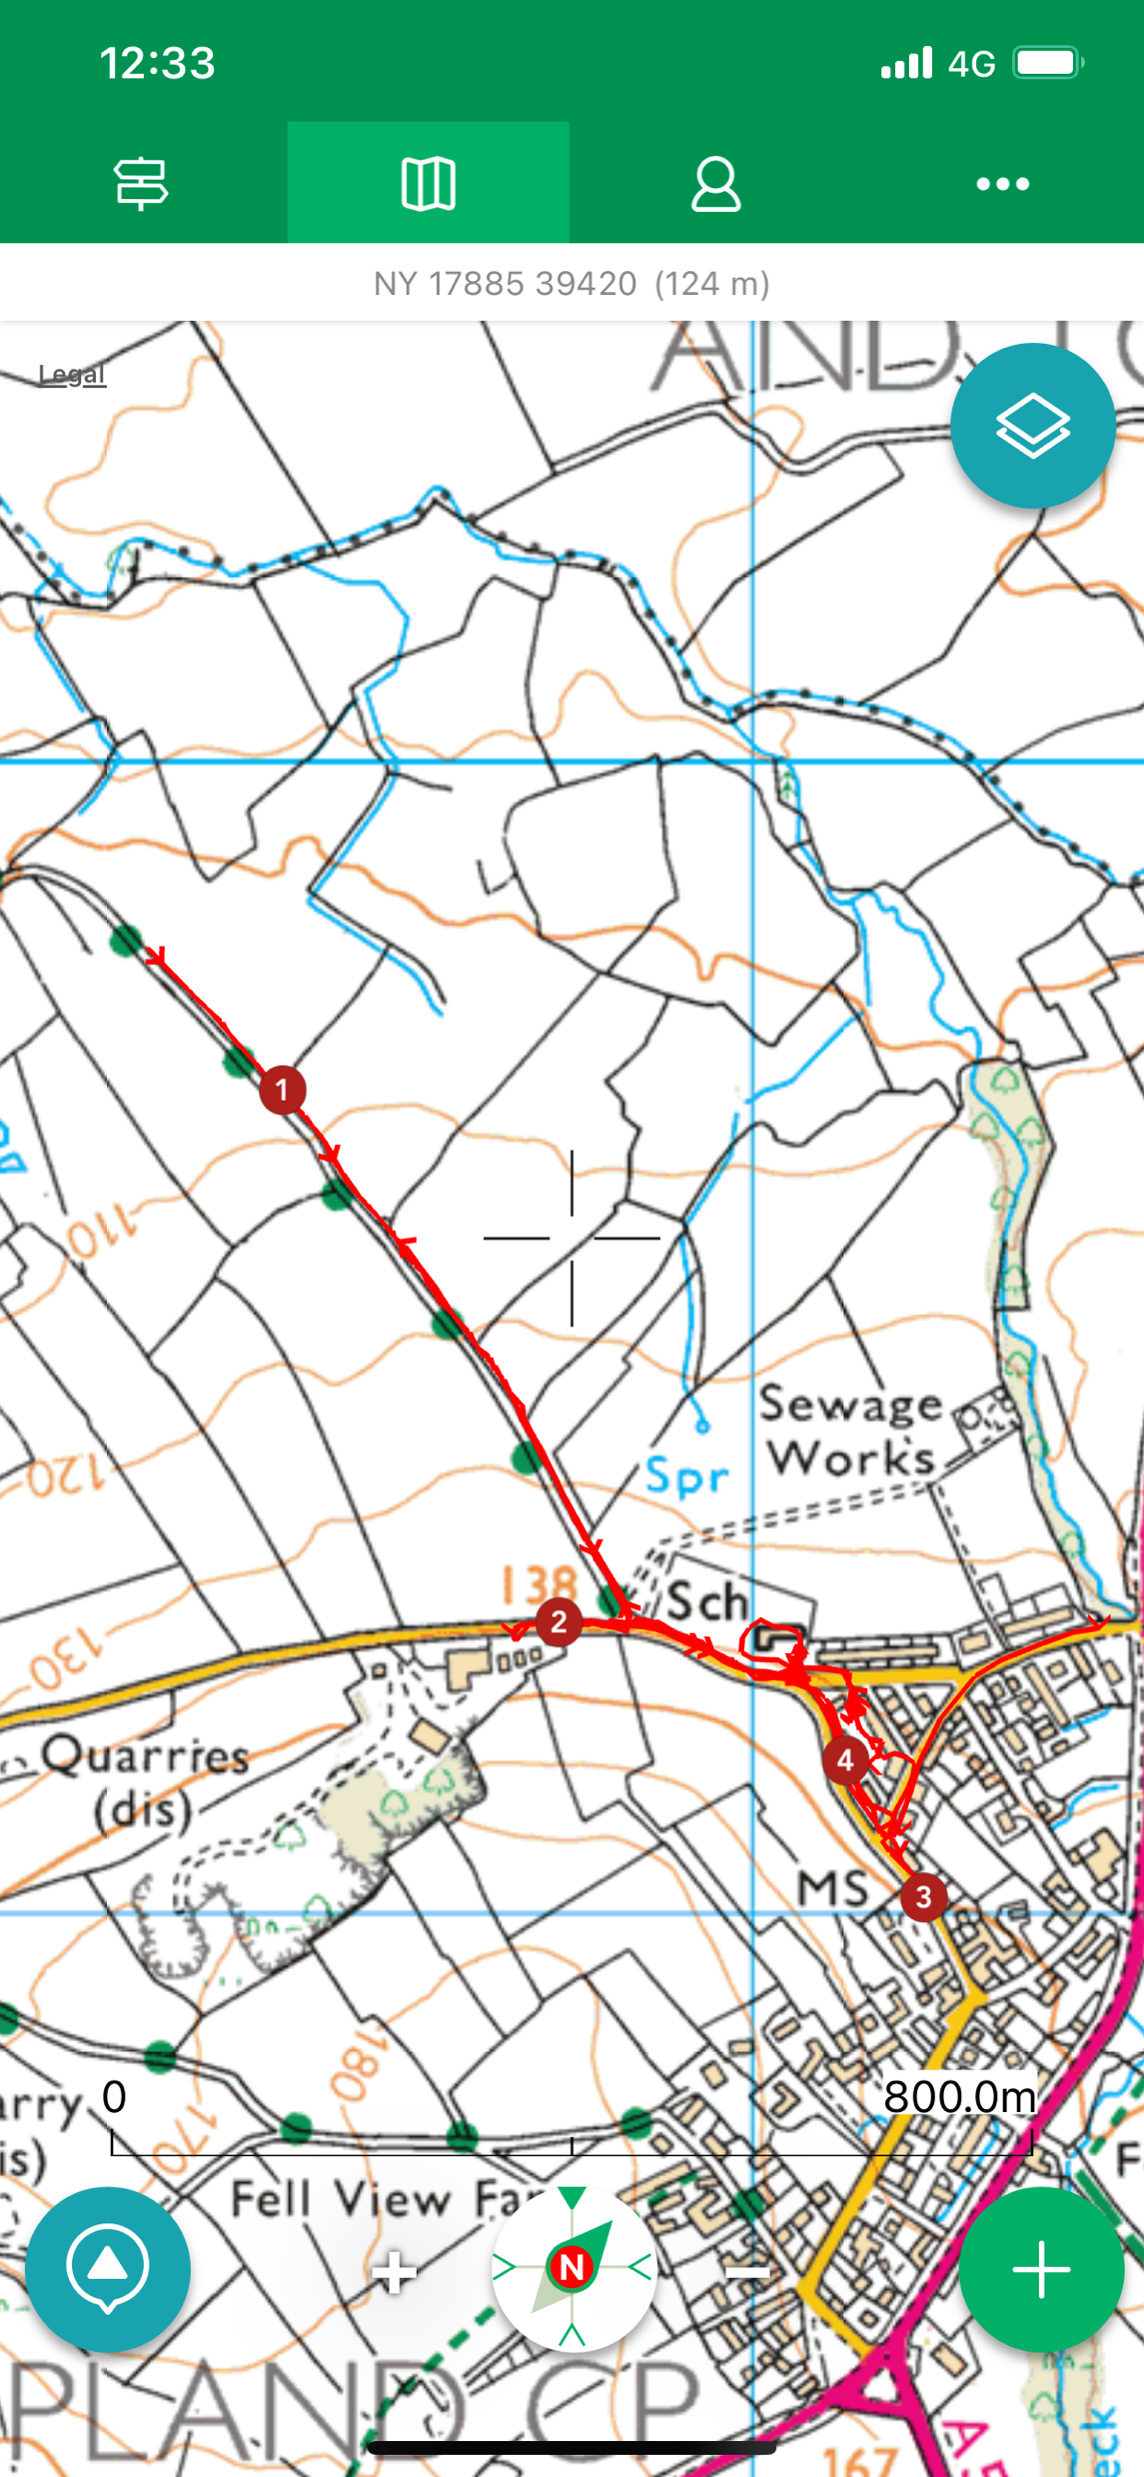
Call out – poor performance
Female
43 years old
intent on self harm
missing from home
Notes:
Explain the slide
October – 8 hours
Dry with occasional showers, cloudy

Slide 5
Call out – poor performance
Notes:
Explain the exits from home options

Slide 6
Call out – poor performance
Female
43 years old
intent on self harm
missing from home
Notes:
location

Slide 7
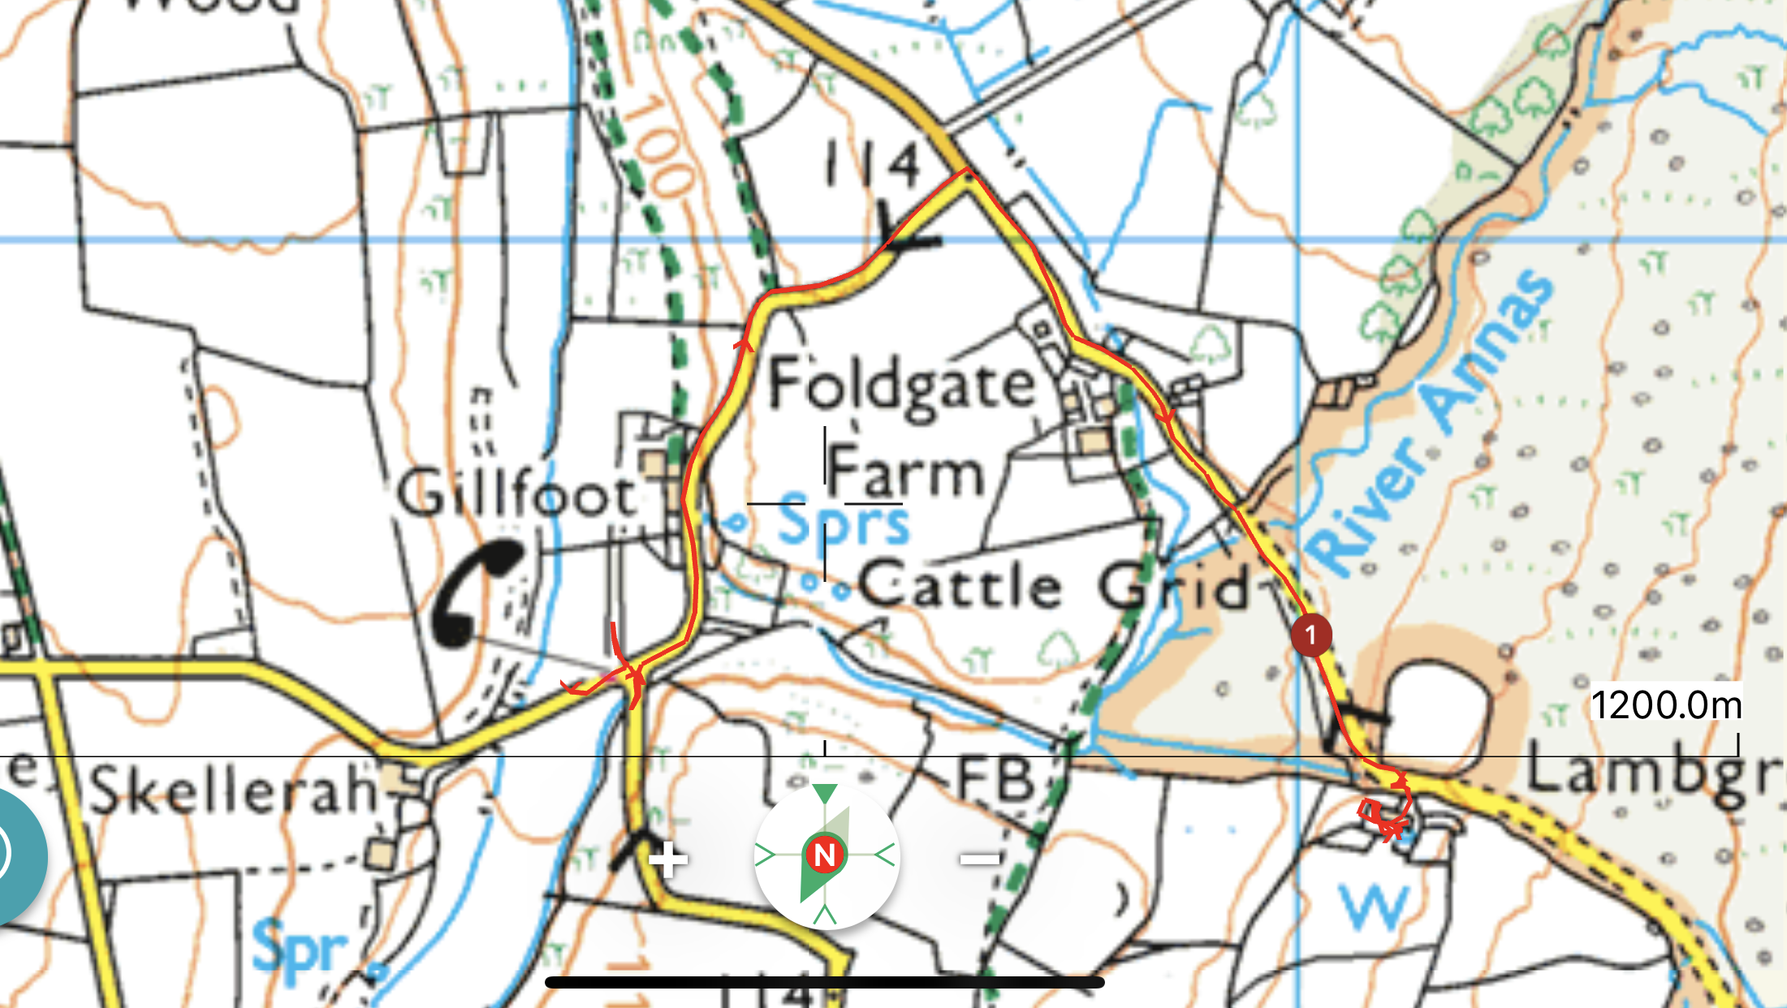
Call out – find
Female – 43 years old - intent on self harm - missing from home
Notes:
5 day later
Explain the slide
Job done in 36 minutes

Slide 8
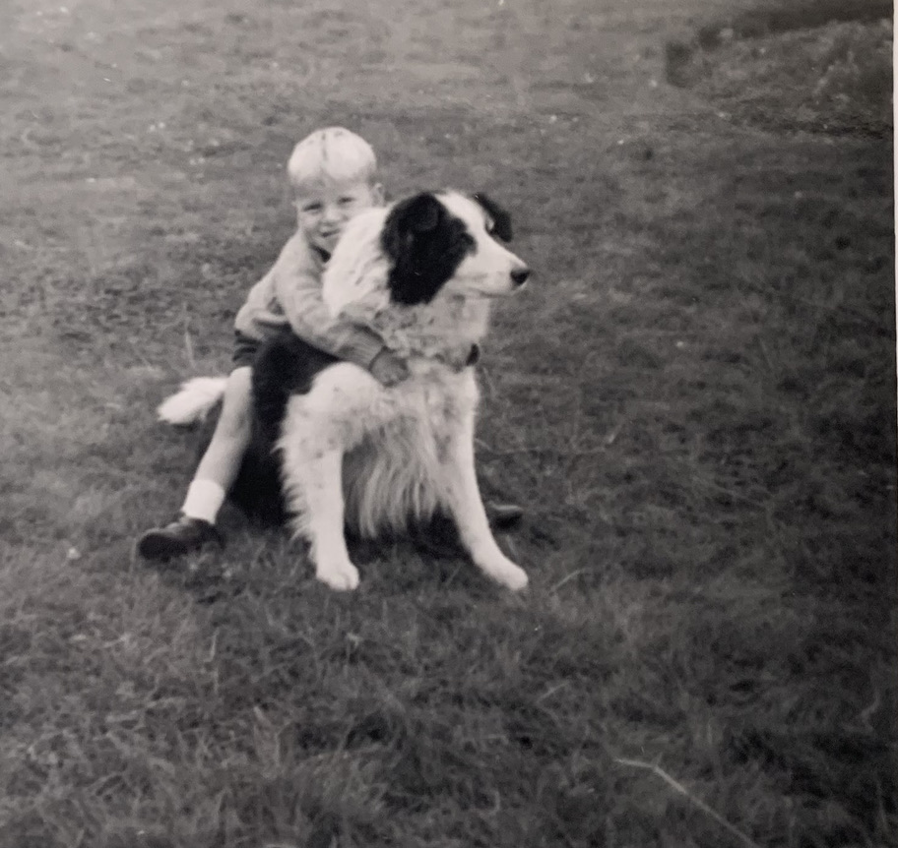
Thank you for listening

