Slide 1
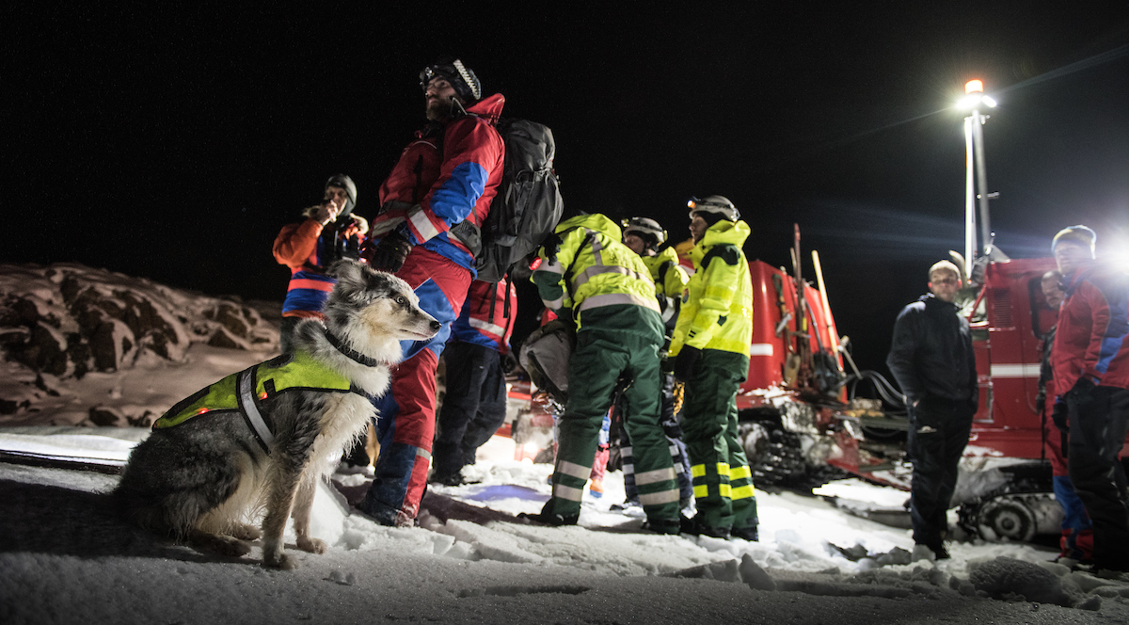
Accidents and incidence in K-9 at SAR work or training
Survey to dog handlers within ICAR
Þóra J Jónasdóttir, DVM, PhD
ICE-SAR

Slide 2
Accidents and incidence in K-9 at SAR work or training
Survey to dog handlers within ICAR
Þóra J Jónasdóttir, DVM, PhD
ICE-SAR

Slide 3
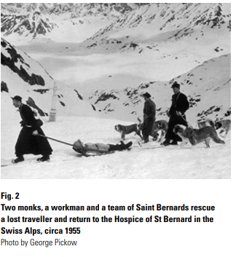
Canine SAR teams
Specially trained teams = handler + dog
Volunteers or professionals
Missing persons incidence
Disasters
  Man-made
  Natural
Crime scenes
Accidents
L.E. Gordon. The contribution of rescue dogs during natural disasters Rev.Sci.Tech. Off, Int. Epiz. 2018, 37 (1)
Notes:
Handler = owner, trainer, guardian, companion
Land slide, hurricanes, avalanches
Dogs have a long history of heroic service on the battlefield throughout the world. It is believed that they were used by Egyptians in battle as early as 4,000 BC
The estimate that one search and rescue dog can perform the work of 20–30 human searchers is often cited, but no credible reference has ever been provided. Still, the advanced search capabilities and importance of these dogs for search operations is recognised and valued around the world, as is evidenced by the increased frequency of the use of canine search teams worldwide.

Slide 4


Wide use of dogs for SAR work in different environment and terriories
Tracking dogs
Trailing dogs
Air scent dogs
  Mountain, ground,water/sea, snow, rubble
  Live humans
  Humans remains
  Terrestrial dogs
  Avalanche dogs
  USAR dogs
  Water dogs
  HRD dogs
Notes:
Tracking on the pretty much on the exact missing persons track (heavy particles and crushed ground vegetation) working in harness and line
Trailing follow subjects scent but not necessarily each footstep, using lighter scent particles, using harness and line
Further certification is required for a specific environment – wilderness, wide area, avalanche/snow, rubble, crime scene (vehicle, building, fire and land area search), arson/fire and water/swift water.
Canine search and rescue teams are an integral part of disaster response systems. Why? No one have found a better tool than dog to find victims in any disaster, natural or otherwise.

Slide 5
What kind of dogs?
Most SAR dogs belong to breeds bred for
  Working
  Herding
  Sporting
Important characteristics in a potential SAR dog
  Hunt drive
  Prey drive
  Ball drive
  Good temperaments
  Rely on scent rather than visual
  Inquisitive
Notes:
Or mixed breed of those

Slide 6
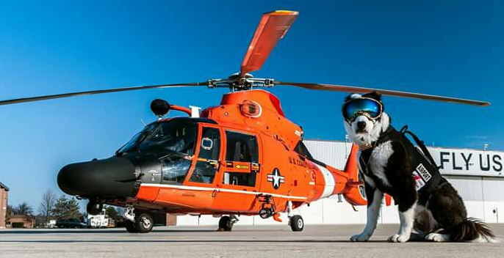
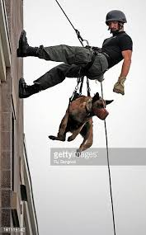
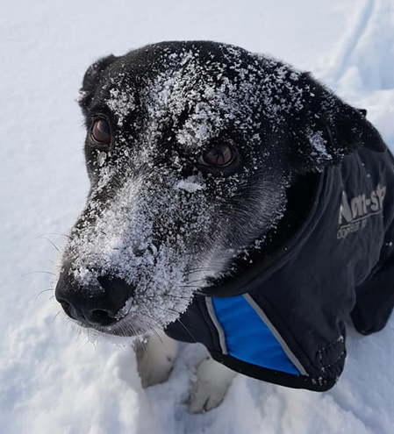
Our dogs
Travelling in all kind of vehicles
  Cars, boats, helicopters, planes, snowscooters, hengers, ATVs
Being lifted or lowered
  Helicopters, repelling, ski-lifts
Challanging terrain
  Mountains, snow, glaciers, cliffs, forrest, water, sea, rivers,
  lava, rubbel, unstable ground or buildings
Challanging weather
  Freezing cold, windy, hot, humid,
Challanging environment
  Loud noises, odors, high activity, strong lights, darkness, toxicants,
Notes:
Train and work in wide variety of enviornments
Distractions, deceased humans and animals, food, human scented clothing, earthquakes, hurricanes, tornadoes, tsunamis, floods and landslides.
Toxicants, solids, liquids, gases, respiratory exposure, dermal exposure, oral exposure, ocular exposure
What we need to be aware of: „As community attitudes toward the use of animals continue to change. Confidence in good animal welfare practices is critical to maintaining public support. Animals that work with and for people should have a good live irrespective of their work activities. In an optimal scenario, the animals’ work activities should be enhancing their quality-of-life experiences An animal's welfare is among others depending on nutrion, environment, physical and mental health. Sharing of evidence-based knowledge to ensure the wellbeing of working dogs“

Slide 7
Statistics of injuries and illnesses in SAR dogs
Mostly USAR dogs and studies from USA
  USA include following the Oklahoma City bombing (1995); the World Trade Center attacks (2001); the Joplin Tornado (2011); Hurricane Sandy (2012); the Moore, Oklahoma, Tornado (2013); the Colorado Floods (2013); the Oso, Washington, Landslide (2014); and Hurricane Matthew (2016).
  The International Rescue Dog Organisation (IRO) has sent canine rescue teams to earthquakes in Turkey (1999), Taipei China (1999), India (2001), Algeria (2003), Iran (2003) and Sumatra (2009), Haiti Earthquake (2010), the Japan Tsunami (2011) and the Nepal Earthquake (2015) among others
Notes:
USA include following the Oklahoma City bombing (1995); the World Trade Center attacks (2001); the Joplin Tornado (2011); Hurricane Sandy (2012); the Moore, Oklahoma, Tornado (2013); the Colorado Floods (2013); the Oso, Washington, Landslide (2014); and Hurricane Matthew (2016). United States teams were sent to the aftermaths of the Haiti Earthquake (2010), the Japan Tsunami (2011) and the Nepal Earthquake (2015).
The International Rescue Dog Organisation (IRO) has sent canine rescue teams to earthquakes in Turkey (1999), Taipei China (1999), India (2001), Algeria (20
03), Iran (2003) and Sumatra (2009), among others (31).

Slide 8
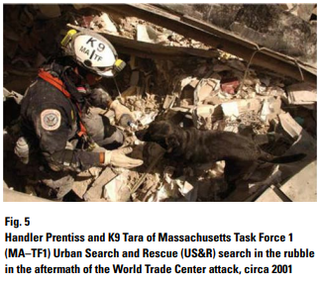
Deployment morbidity among SAR dogs after 11/9-2001
  96 dogs of 212 responded
  65 dogs experienced events during deployment
  17 events/1000 dog search hours combined
  Dogs at World trade center 6.6 x more likely to have events than dogs at the Pentagon
    Fatigue 6/1000 h
    Change in appetite 6/1000 h
    Cut and abrasions mostly feet 5/1000 h
    Dehydration 5/1000 dog search hours
    Respiratory tract problems 2/1000 h
    Heat exhaustion 2/1000 h
    Orthopedic or back problems 2/1000 h
DOI: 10.2460/javma.2004.225.868
L.E. Gordon. The contribution of rescue dogs during natural disasters Rev.Sci.Tech. Off, Int. Epiz. 2018, 37 (1)

Slide 9
Fifteen-year surveillance of pathological findings associated with death or euthanasia in SAR dogs deployed to the September 11, 2001, terrorist attack sites
DOI: 10.2460/javma.257.7.734 2020
Comparing cause of death
95 deployed SAR dogs, 55 non-deployed SAR dogs
Following natural death or euthanasia, 63 dogs necropsy
  44 exposed, 19 unexposed
87 dogs medical records/personal communications
Median age of death, exposed 12.8y vs 12.7y non-exposed
Respiratory disease infrequent (4,7%),
  4/5 pulm neoplasia in unexposed dogs
  Pulmonary particles more often in exposed dogs 95% vs 63% in non-exposed

Slide 10
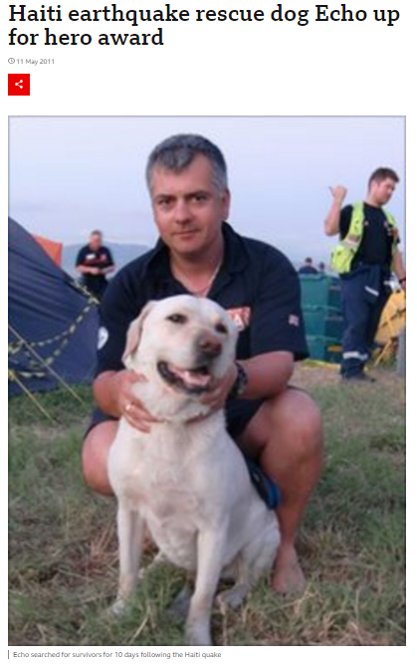
Injuries and illnesses among urban search-and-rescue dogs deployed to Haiti following the January 12, 2010, earthquake
23 Federal Emergency Managmeent Agency (FEMA) USAR dogs deployed to Haiti
Online survey dogs worked 1785 h
Of 33 handlers w 37 dogs 19 handlers w 23 dogs completed
Injuries and illnesses reported in 10/23 (43%)
8 multiple issues
  Dehydration 3.9 events/1000 h
  Wounding 3.4 events/1000 h
  Ocular discharge 1.1 events/1000 h
  Appetite decrease 1.1 events/1000 h

Slide 11
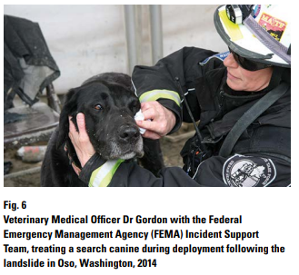
Injuries and illnesses among Federal Emergency Management Agency-certified search-and-recovery and search-and-rescue dogs deployed to Oso, Washington, following the March 22, 2014, State Route 530 landslide
DOI: 10.2460/javma.247.8.901
25 Federal Emergency Managment Agency search dogs
Dogs worked in total 2015 hours
Injuries reported in 21 dogs (84%)
In total events 66.5/1000 h worked
  Wounds (abrasions, pad wear, paw splits, lacerations) 28/1000 h
  Dehydration 10/1000 h
All events resolved during deployment or within 2 weeks
L.E. Gordon. The contribution of rescue dogs during natural disasters Rev.Sci.Tech. Off, Int. Epiz. 2018, 37 (1)
Notes:
Federal Emergency Management Agency-certified search dogs

Slide 12
Summary common deployment injuries USAR dogs
Operation related brasions, punctures or laceration to dogs paw pads
  Booties not reliable solution
  Primarly when searching on hot surfaces or protect previous injury
Dehydration
  Secure water supply
Hyperthermia
  Short work loads
  Appropriate rest
Notes:
Can not use cooling west for usar dogs
There was no clinically significant or repeatable improvement in plasma electrolyte composition or performance in electrolyte-supplemented dogs.

Slide 13
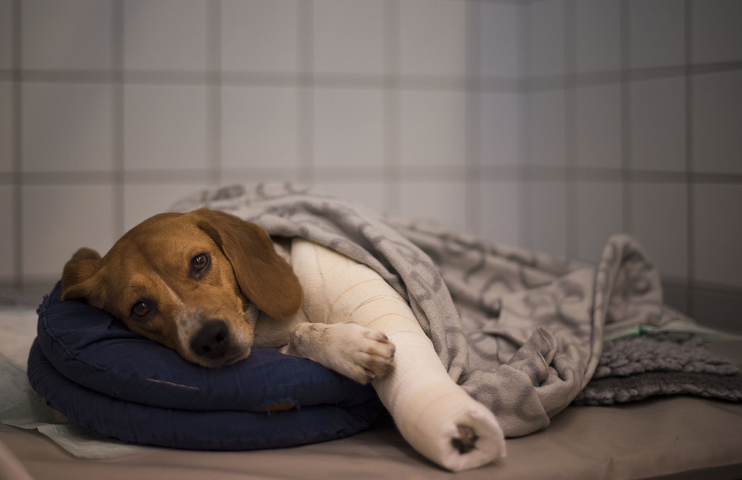
A veterinary perspective on prevention
Approximately 20% to 25% of trauma-related, prehospital fatalities in humans are due to preventable deaths
Role of veterinary profession to reduce incidense of disease and injury and promote welfare in working dogs
Despite importance of working dogs to society it is surprisingly little research of working dogs in the veterinary litterature
Operational guidelines for prevention of injury and illness could lower the incidence of accidents
Training of SAR dog handlers in pre-hospital trauma care could diminish the morbidity and seriousity
Notes:
There are limited data in the veterinary literature on the causes of loss and early retirement of working dogs, and targeted research is required to better determine factors that affect their incidence
Approximately 20% to 25% of trauma-related, prehospital fatalities in humans are due to preventable deaths. Data are lacking, however, on the nature and the prevalence of operational canine (OC) prehospital deaths. It is plausible that OCs engaged in high-threat operations are also at risk for suffering some type of preventable death. Tactical Combat Casualty Care has significantly reduced human fatality rates on the battlefield. Standardized guidelines specifically for prehospital trauma care have not been developed for the OC caregiver

Slide 14

Our ICAR survey - Accidents and incidence
215 participated
Notes:
Norway 49%
Iceland 9,3%
Sweden 28,3%

Slide 15
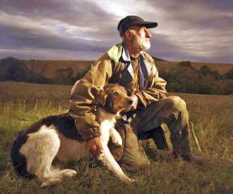
Years of experience
Years in the Search and Rescue field
Years working with SAR dogs
In total 2450 years!
On avarage 11,4 y
Median 10 y
From 4 months- 45 y (five 40 years)
Age of handlers 24-80 y
Mean age 45,4 y
Human years added 9720 years
In total 2427 years!
On avarage 11,3 y
Median 9 y
From 4 months-40 y (two 40 years)

Slide 16




Gender and role
Gender
Role
7%
54%
30%
64%

Slide 17

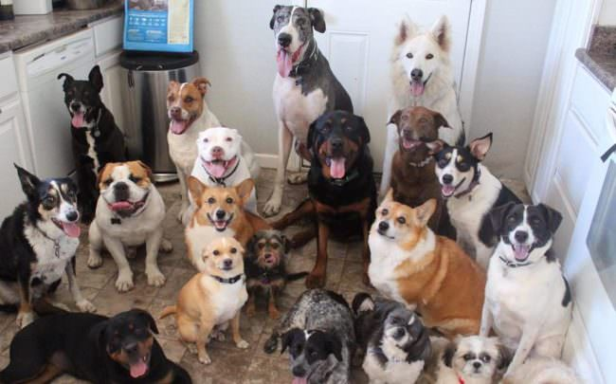

Number of dogs and insurance
Number of dogs certified or trained
Are dogs in SAR insured?
Number of dogs certified or trained (own) all together 559 dogs
On avarage 2,6 (1-15*) pr handler
25%
72%
Notes:
One Slovakia with 45 dogs?

Slide 18


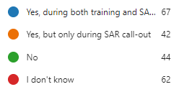
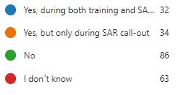
Registrations of accidents or incidens in SAR work
For humans
For dogs
15%
29%
31%
29%
16%
20%
20%
40%

Slide 19
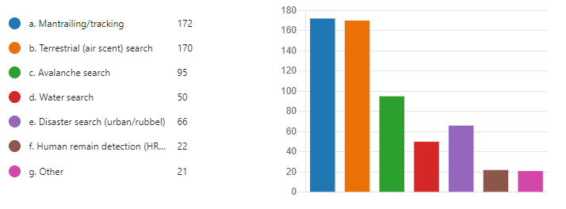
In what field have you been training in SAR dogs?
80%
79%
44%
23%
31%
10%
10%

Slide 20
Accidents during training and call outs
Number of accidents |  | 1 | 2 | 3 | 4 | 5
At training | No of handlers | 88 | 31 | 18 | 8 | 4
At call out | No of handlers | 27 | 5 | 1 | 1 | 0
Notes:
At training yes 88 No 127 (215) At Call out yes 27 No 183 (210)
>200 accidents at training and less than 50 accidents at call outs
7% trail (79) 56% terr (80) 12% ava (44) 0,5% water (23) 13% disaster (32) 0,5% HRD other

Slide 21

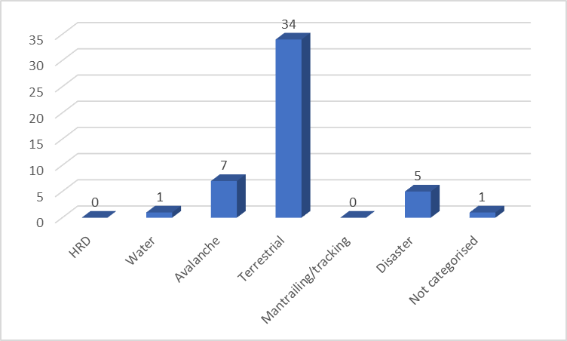

Accidents during call outs
13%
87%
48 cases of accidents
Number of accidents | 1 | 2 | 3 | 4 | 5
Number of handlers | 27 | 5 | 1 | 1 | 0

Slide 22
How serious was the injury the dog suffered?

Slide 23
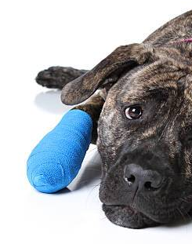
Localisation of injury
Notes:
Point to differences paws and bones/joints in extremities training vs call out

Slide 24
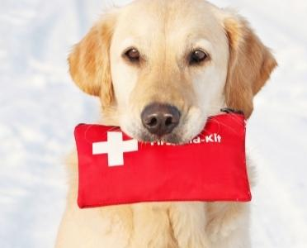
Nature of injury
Notes:
Laceration vs tenderness – training vs call out

Slide 25
After an accident, did your dog return to SAR work?

Slide 26

If returning to SAR training/work how many weeks of „sick leave“
At training 126 cases (>0 days) with all together 709 weeks of sick leave = 13,6 years. Mean 5,6 weeks
At call out 25 cases (>0 days) with all together 134 weeks of sick leave = 2,6 years. Mean 5,4 weeks
Notes:
142 and 31 cases replied about sick days after accidents for at training and at call out respectively
At training half of the dogs (52%) and recover in 2 weeks or shorter AND 65% of the dogs having accident at call out

Slide 27
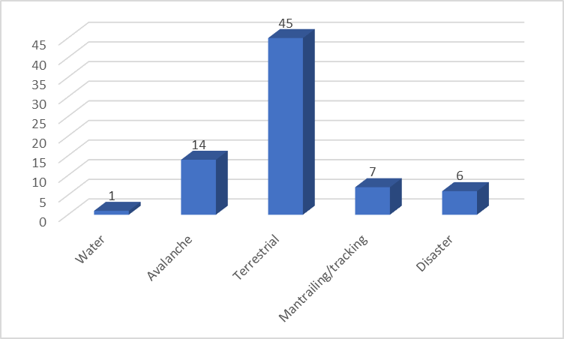
Have you experiencied incidence with dog at training or at call out?
167 replied
No 137 (82%)
Notes:
Remaing distribution between categories of dog work

Slide 28
Take home message?
We should improve in registrations of accidents and illnesses during training and call outs
Accidents do happen most commonly at terrestrial training – can we do better?
Most accidents with paws and extremities
Most accidents result in a veterinary consultation
it is wise to insure your SAR dogs
Luckily most injuries are not serious and in over half of the times the dogs recover in couple of weeks

Slide 29
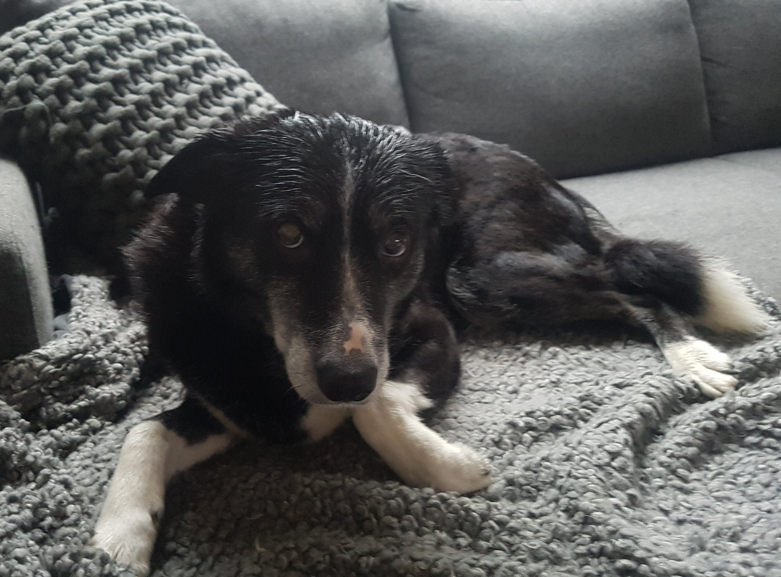


Slide 30
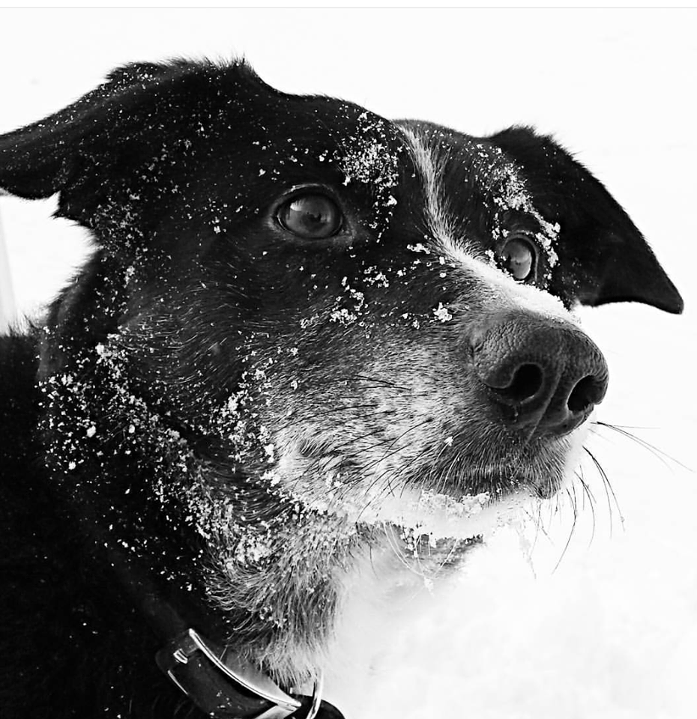
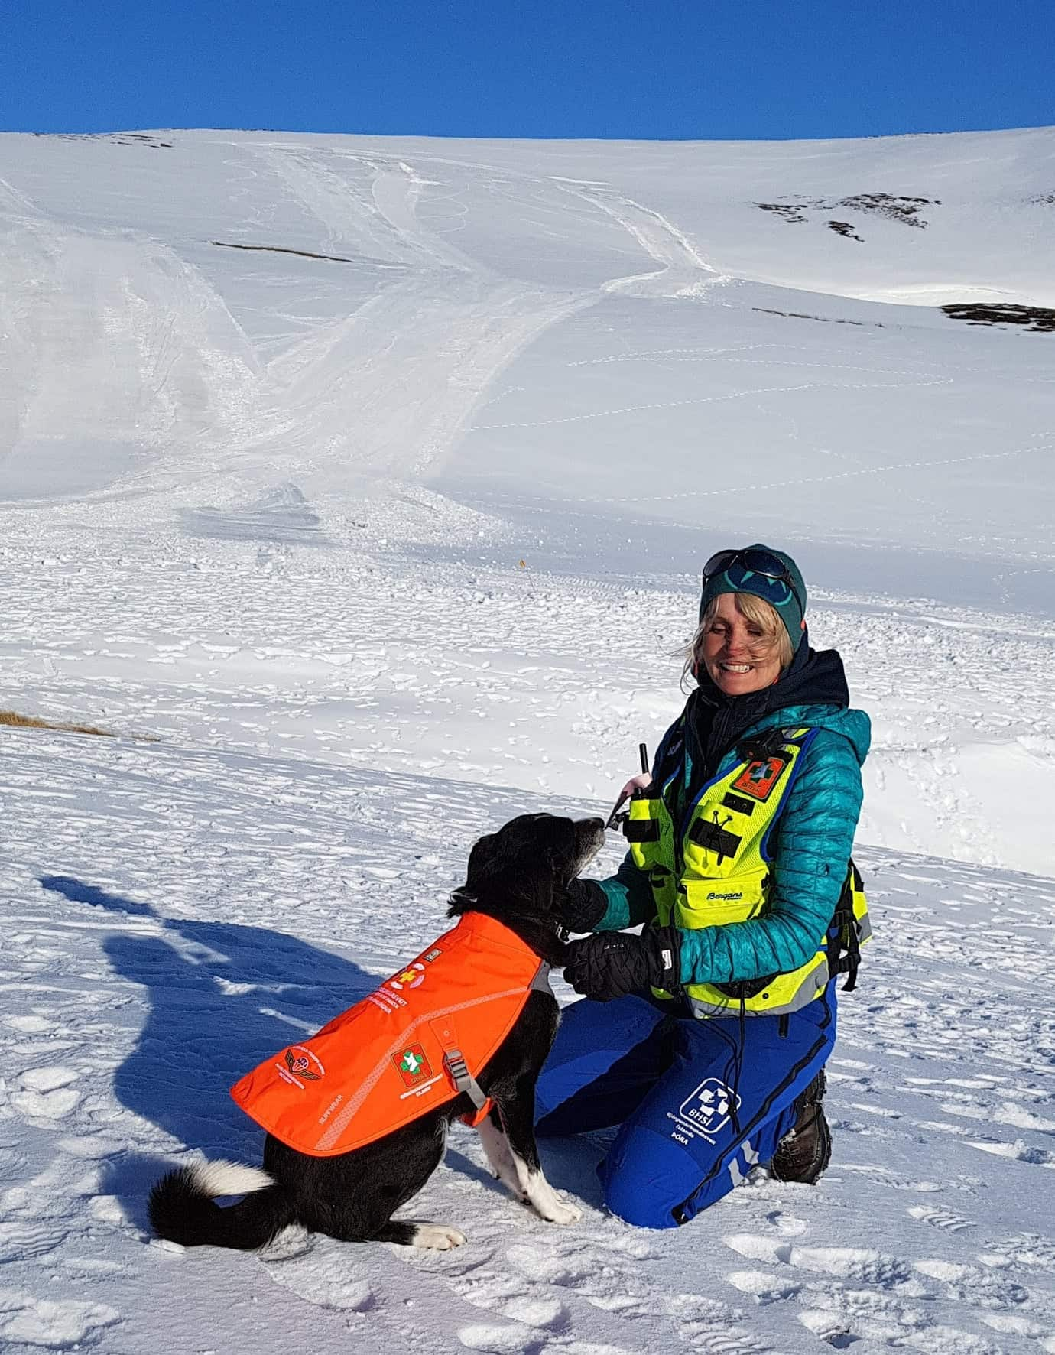

Slide 31
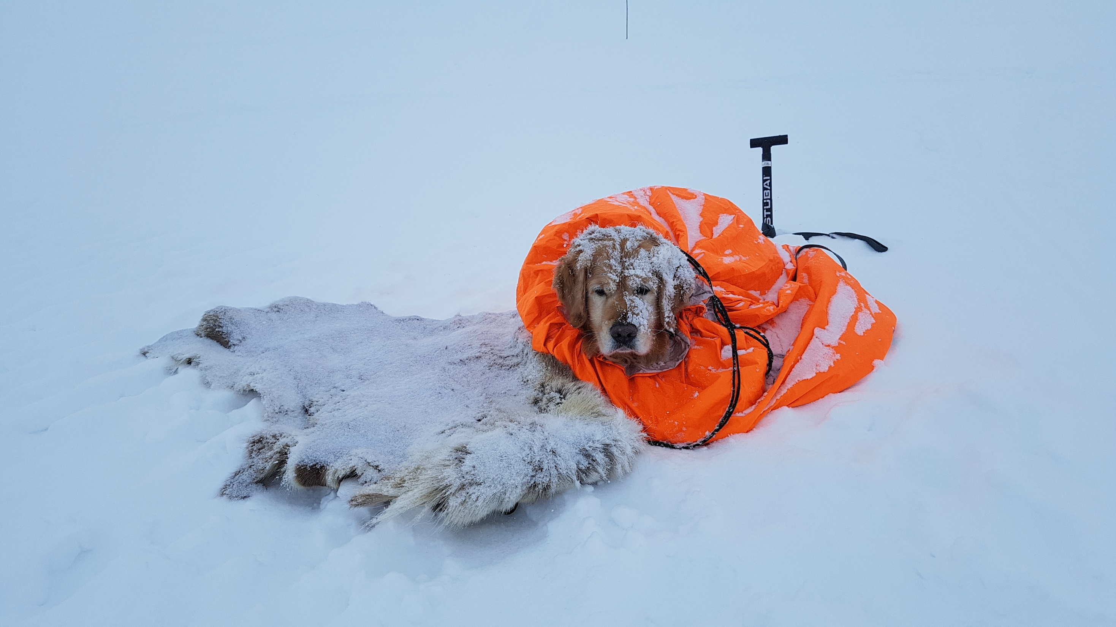

Slide 32
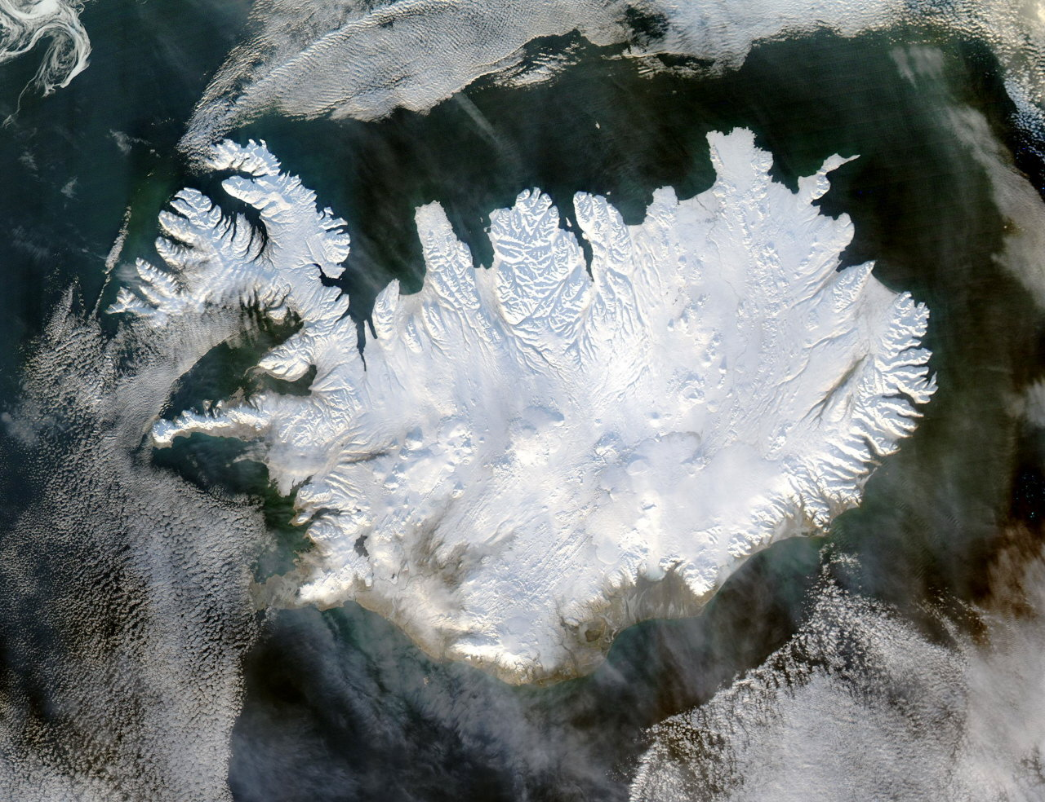
103.000 km²
339.000 persons
3,3 souls pr. km²

