Slide 1
Working together during missions
ICAR 2022 Montreux

Slide 2
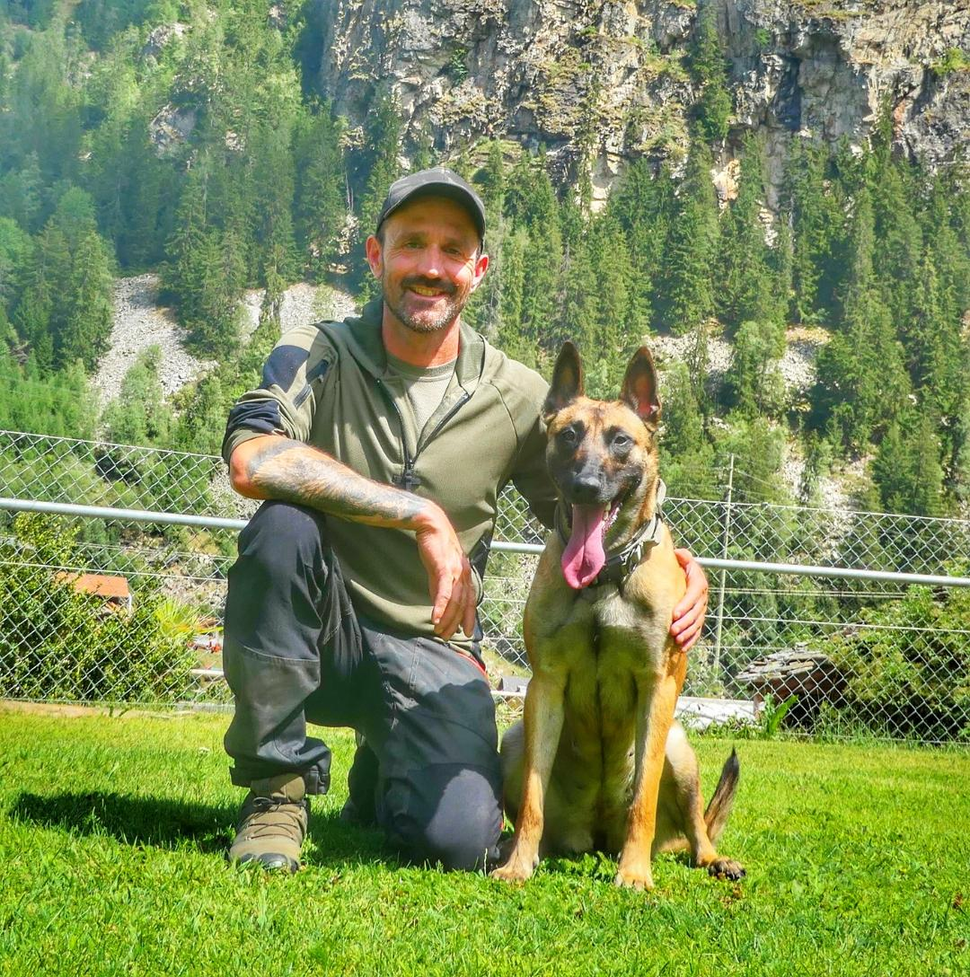
Imboden Philipp
Switzerland
Professional Dog Trainer
Instructor for:
Avalanche-dogs
Area-search-dogs
Mantrailing.

Slide 3
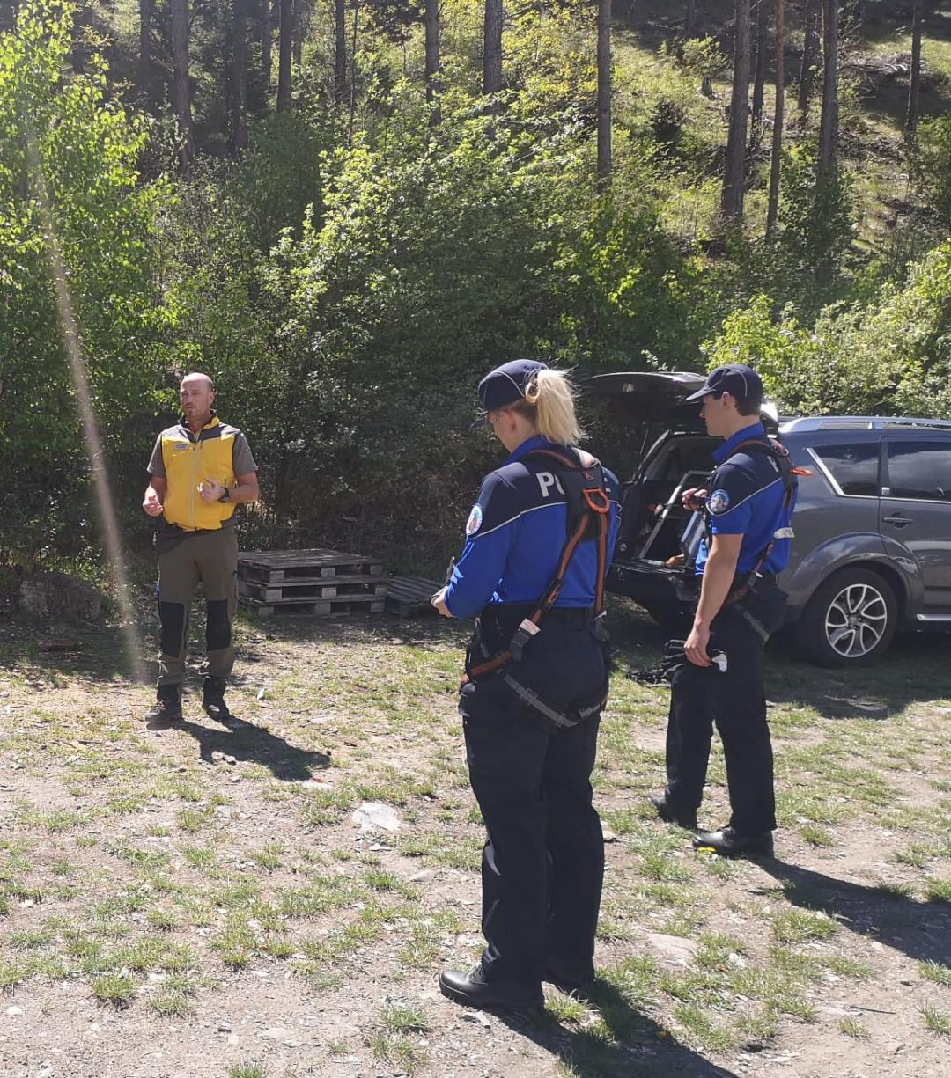
Facts/Informations
Missing Person
Woman
62 years old
Dementia
48h missing
Call from the Police

Slide 4
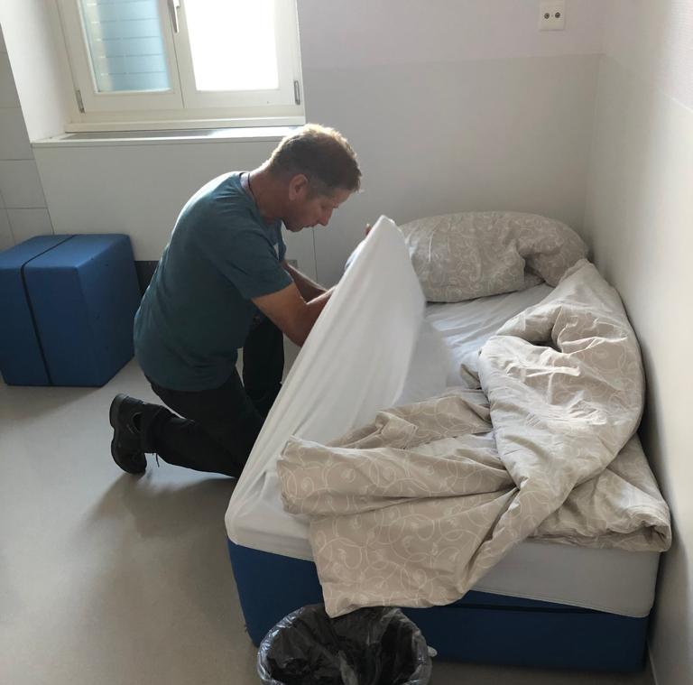
Start of the operation
First step:
Get a good (!) scent at the house of the victim.
Compress/ Gloves

Slide 5
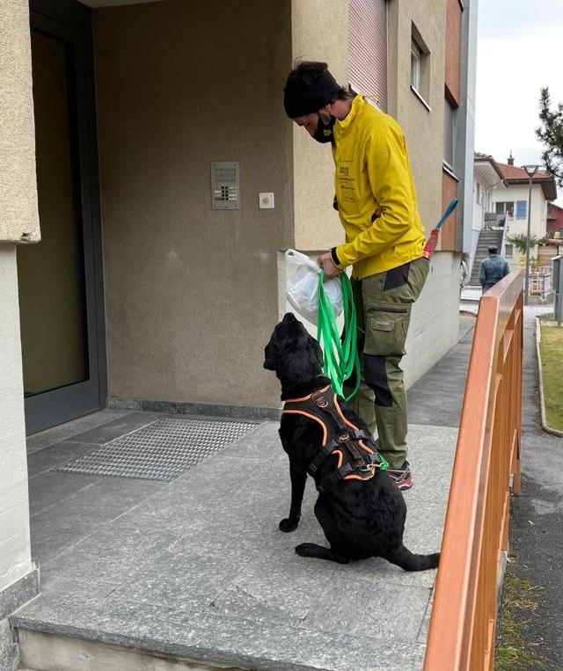
Start search
Information from the husband of the victim: «She went to a capelle, in the forest.»
Start the search, at the entrance of the house.

Slide 6
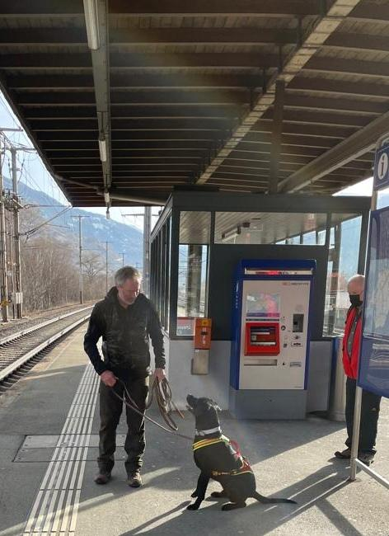
First understandings
Victim went to the trainstation…
2 Mantrailing dogs presented «negativ signal» at rail nr. 3.
Clarifications with the train crew.
Directions? Time? Cameras?

Slide 7
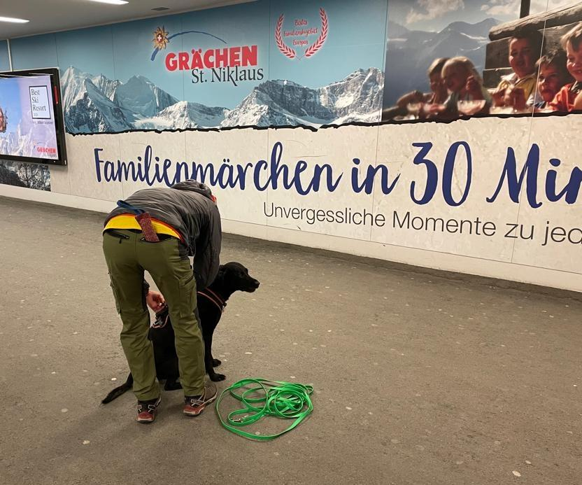
New informations
Camera spotted the victim at station «Brig.»
Dogs sheduled again at the exit of the trainstation.

Slide 8
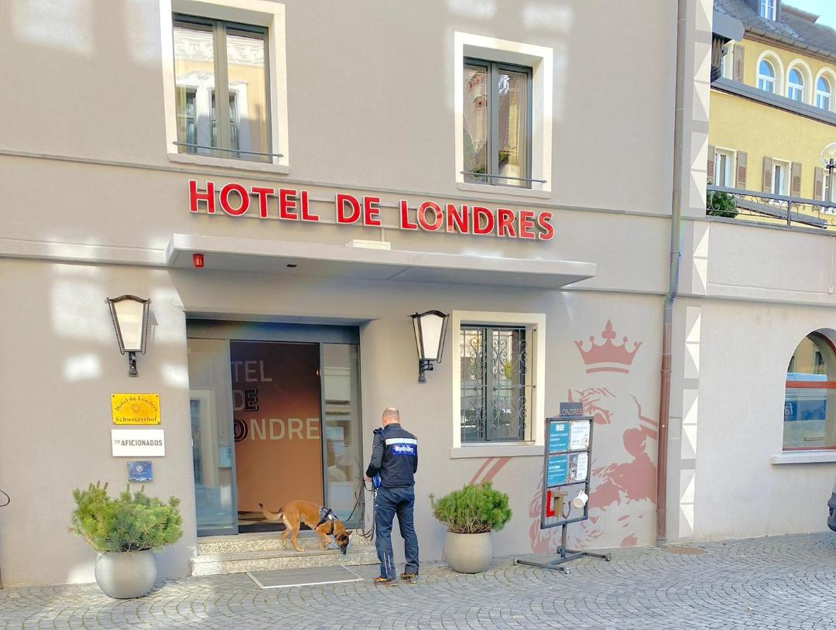
Next Stop
The dogs showed that the victim went insinde this hotel in Brig.
Information from the hotel owner: The victim left the hotel 1h ago, back entrance.
No search inside

Slide 9
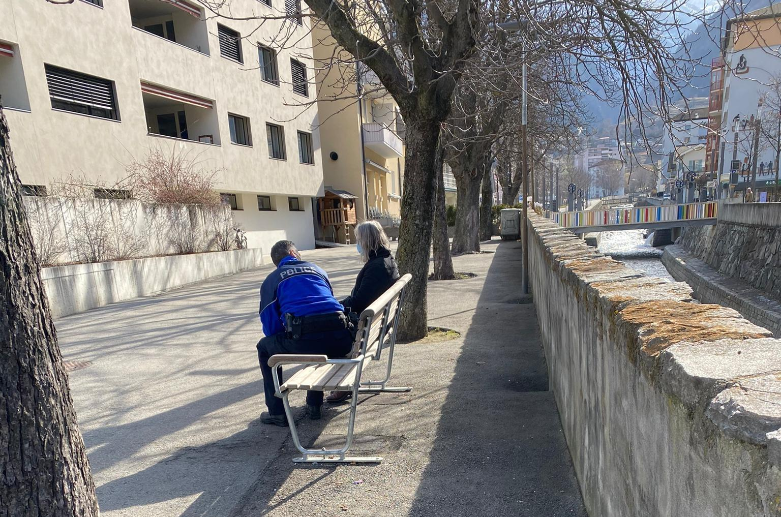
Happy end!
The dogs found the victim on a bench.
Confused, but in good condition.
On misssion:
3 dogs over 2 days.
Working together with:
Police, relatives, train-crew, hotel manager.
Understanding: TRUST YOUR DOGS!!!! ☺

Slide 10
Questions
Thank you!

