Slide 1


New system for training avalanche dogs
Notes:
Schweiz eingeteilt in die verschiedenen regionen

Slide 2
New system for training avalanche dogs
Old
Module 1
Module 2 → Certification
Module 3 → Recertification
Module 4 → Recertification after 2 years break
New
Basic Course 1
Basic Course 2 → Certification for existing dog handlers
Basic Course 3 → Certification for new dog handlers
Advanced training → Recertification

Slide 3
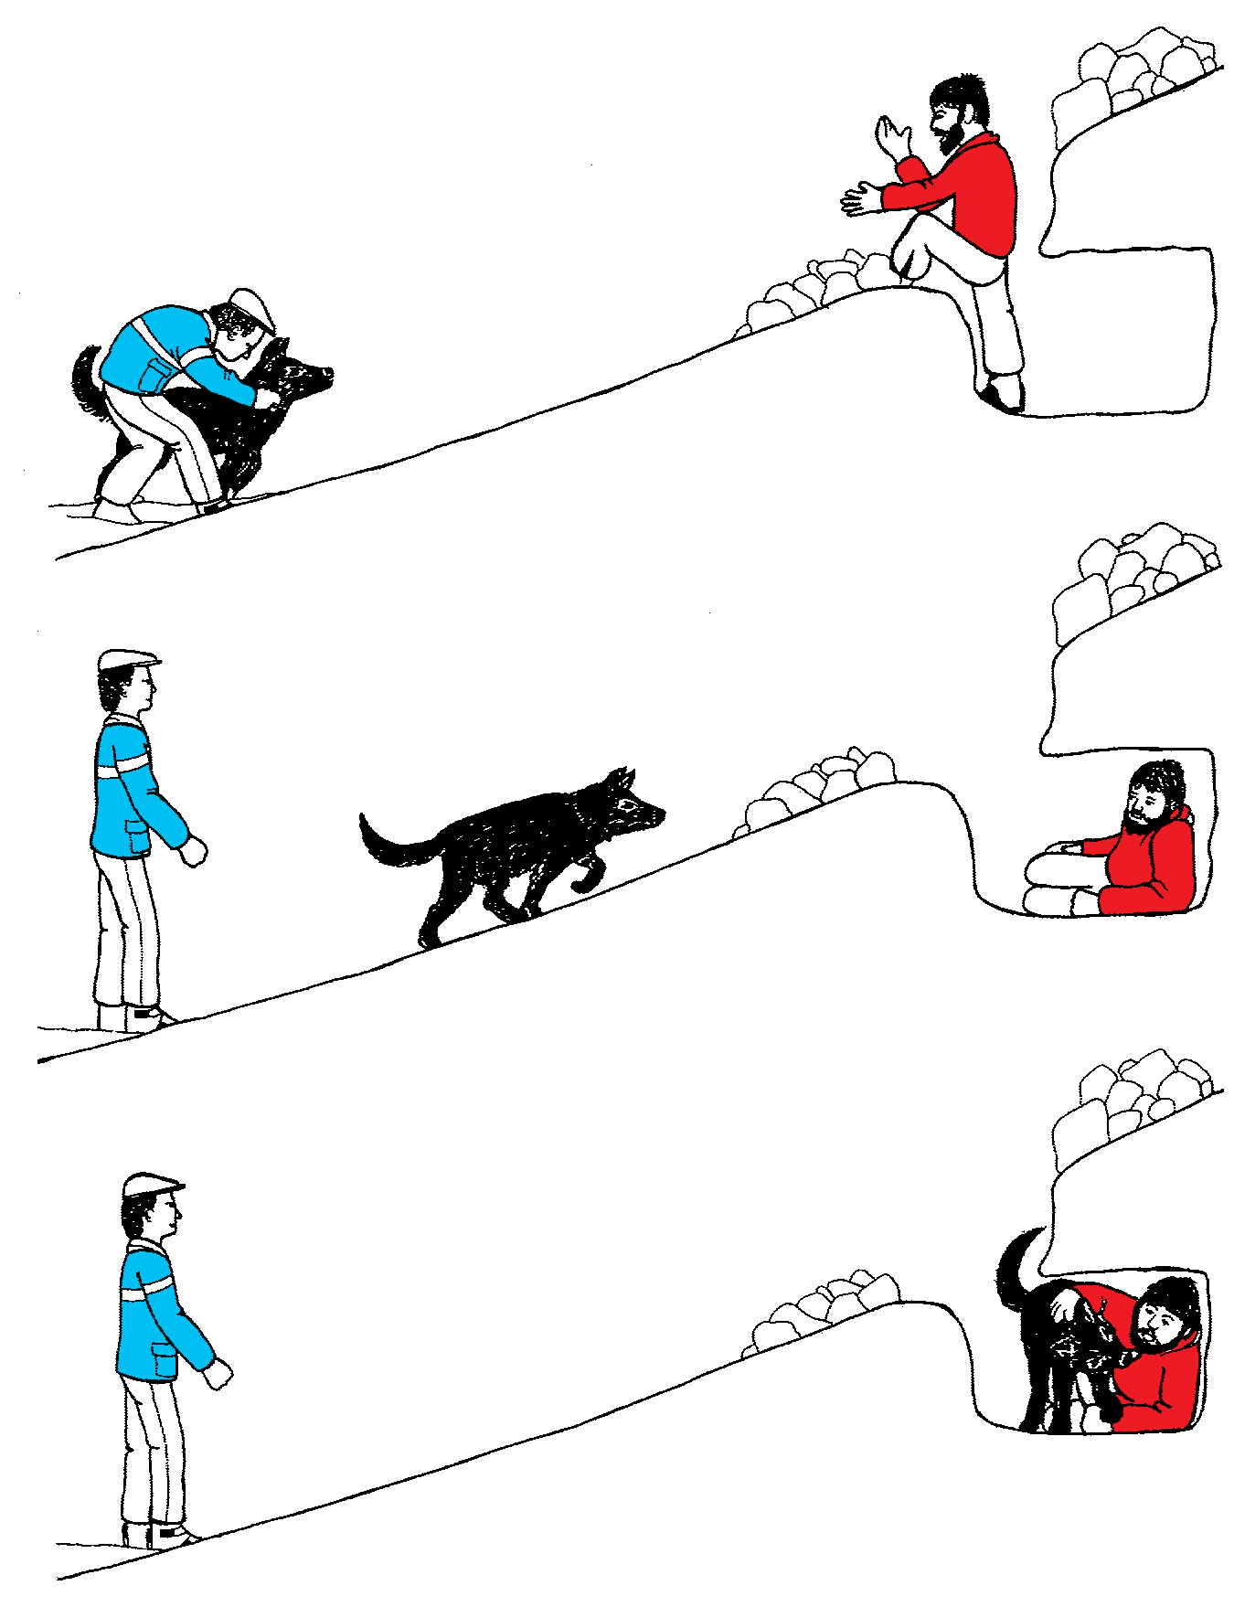
Module 1
Phase 1 open cave (old)
1 exercise

Slide 4
New system for training avalanche dogs
The young dog learns to
To detach from the handler
To work independently at long distance ( digging)
To promote the nose work
To recognize the individual scent and to consolidate it for itself
To ignore empty holes, although the individual scent of the person is present.
To stay in the hole with the person.

Slide 5
New system for training avalanche dogs
The handler learns
To have confidence in his dog
To lead the dog with patience
Not to make any impact on the dog
To recognize the independence of the dog
That the figurant in the hole is the most important person

Slide 6
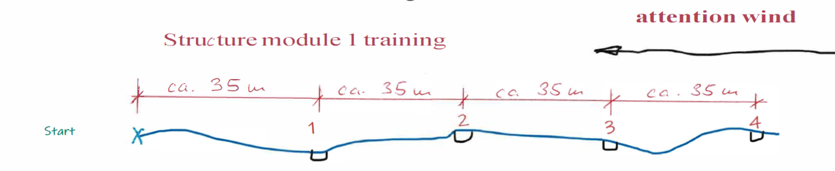
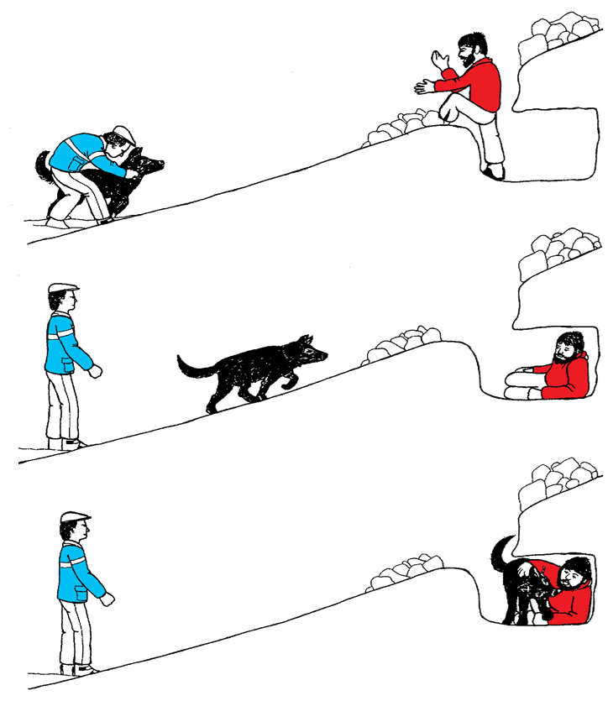
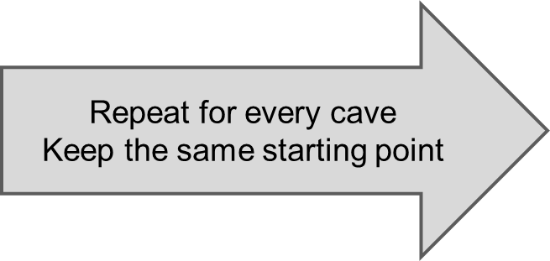
Basic Course 1
Phase 1 open cave (new)
4 exercises
Notes:
- Der junge Hund lernt:
o sich vom HF lösen
o Auf grosse Distanz selbstständig Arbeiten ( Scharren)
o Förderung der Nasenarbeit
o Den Individualgeruch zu erkennen und für sich zu festigen
o Leere Löcher , obwohl der Individualgeruch der Personen vorhanden ist, zu ignorieren
o Im Loch bei der Person zu bleiben.

Slide 7
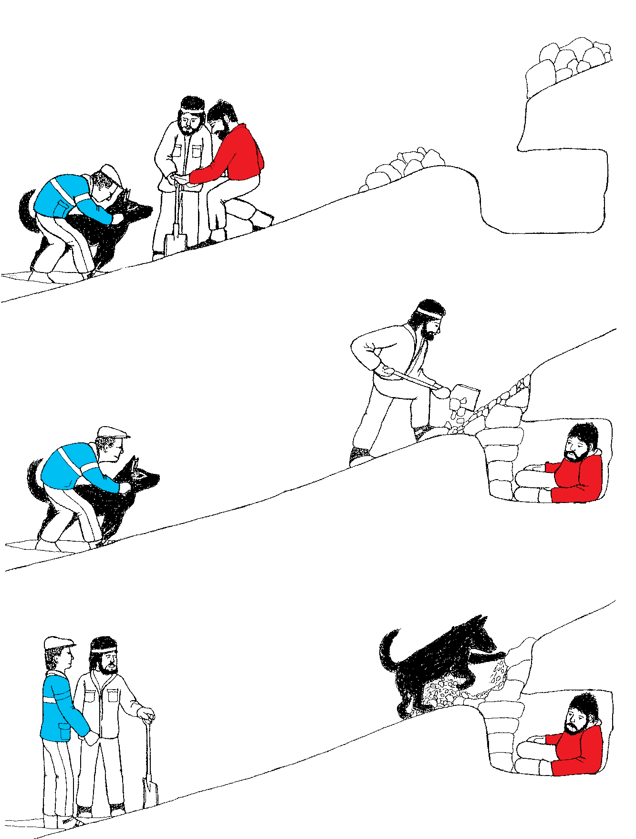
Module 1
Phase 2 closed cave (old)
1 exercise

Slide 8
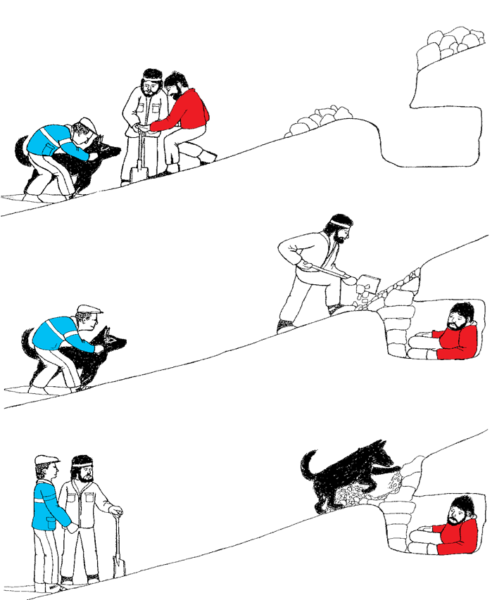
Basic Course 1
Phase 2 closed cave (new)
4 exercises
Repeat for every cave
Keep the same starting point

Slide 9
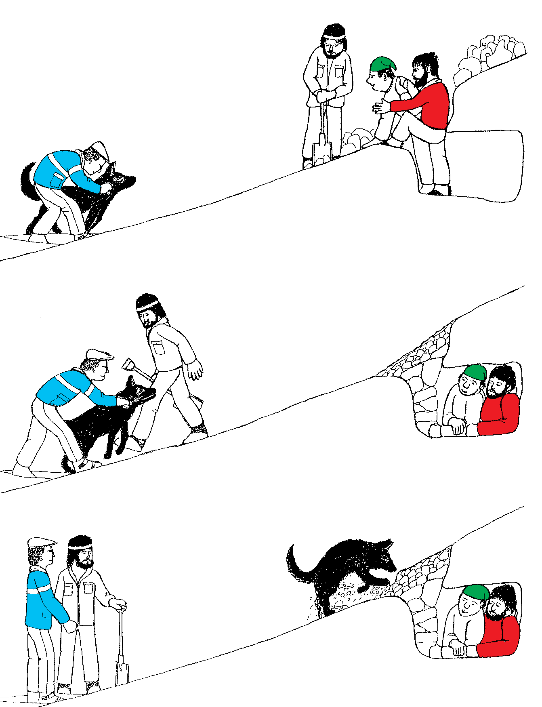
Module 1
Phase 3 figurant, closed cave (old)
1 exercise

Slide 10
Basic Course 1
Phase 3 figurant, closed cave (new)
4 exercises
Repeat for every cave
Keep the same starting point

Slide 11
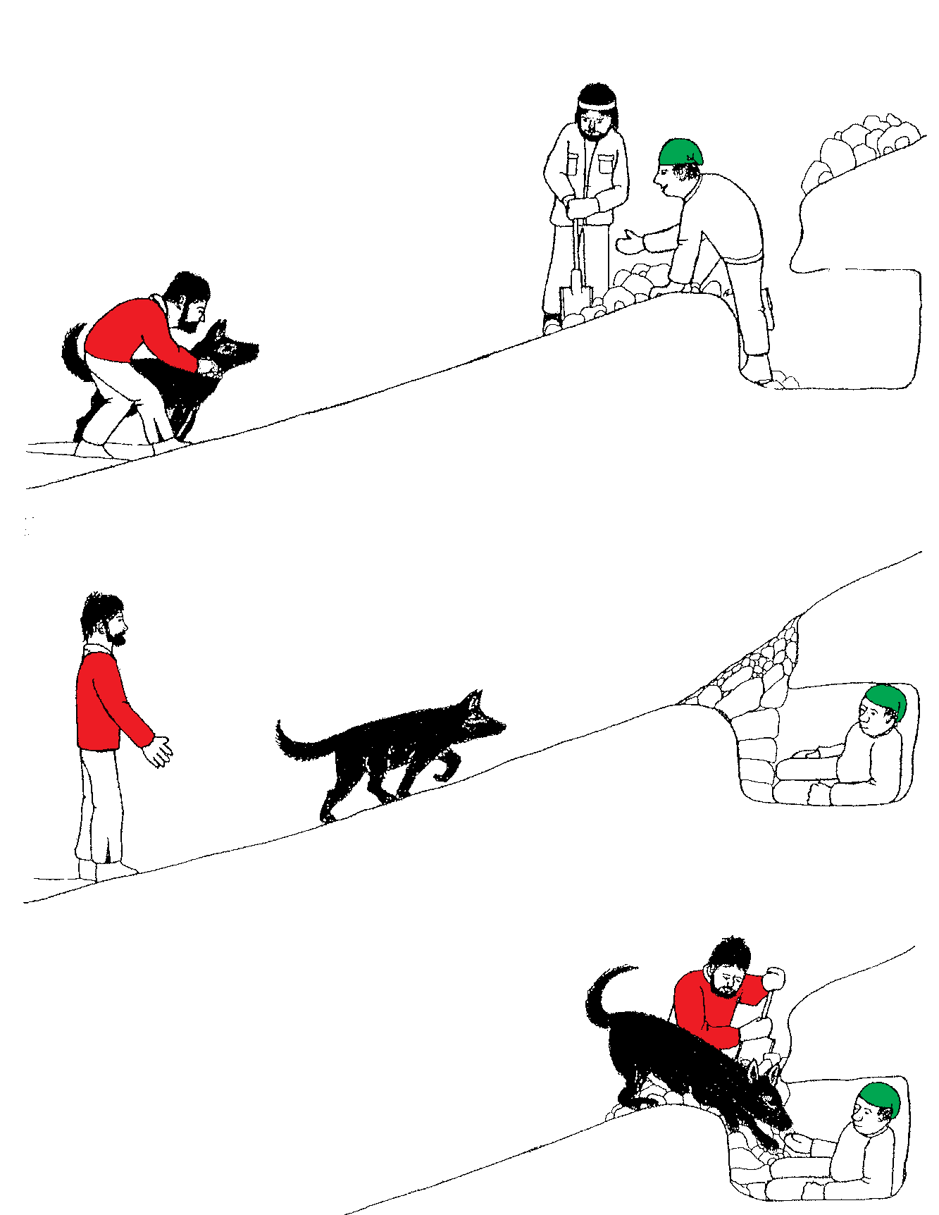
Module 1
Phase 4 handler stays with dog (old)
1 exercise

Slide 12
Basic Course 1
Phase 4 handler stays with dog (new)
4 exercises
Repeat for every cave
Keep the same starting point

Slide 13
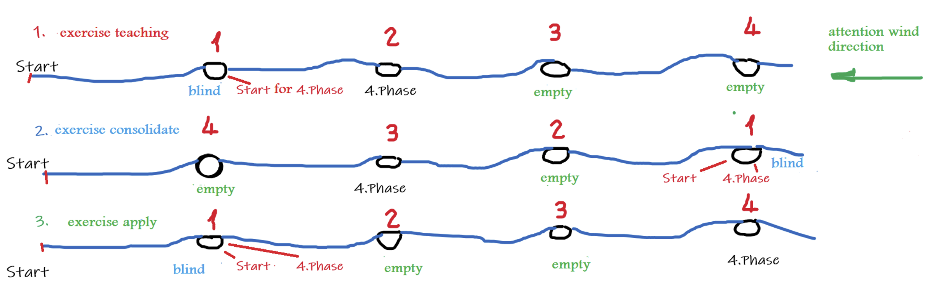
Basic Course 2
3 steps: Teach – Consolidate - Apply
Notes:
Schweiz eingeteilt in die verschiedenen regionen

Slide 14
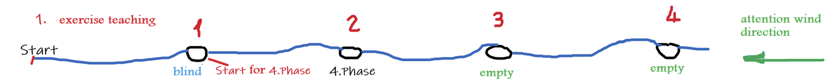
Basic Course 2
Step 1: Teach
Start and then search for the blind person (cave 1)
From blind person start for the 4th phase on cave 2 (the figurant starts at the dog)
Handler moves away with dog (as soon as the figurant disappears in the cave) before start
Handler starts his search on cave 2

Slide 15
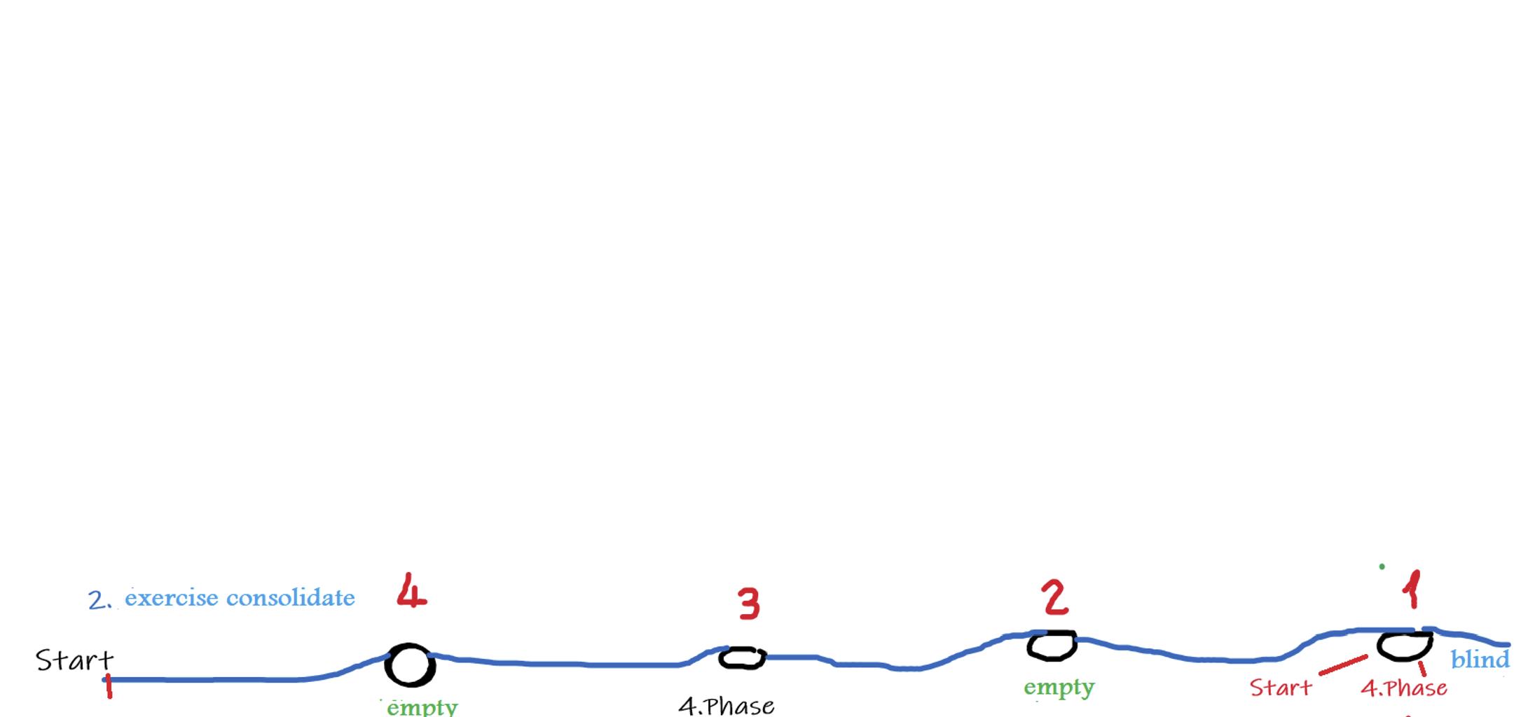

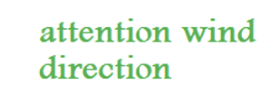
Basic Course 2
Step 2: Consolidate
Pay attention to the order of the caves, the starting point changes
Start and then search for the blind person cave 1
From blind person start the 4th phase on cave 3 (the figurant starts at the dog). Dog handler moves away with the dog (as soon as the figurant disappears in the cave) before the start of search
Handler starts his dog to search cave 3
Notes:
Schweiz eingeteilt in die verschiedenen regionen

Slide 16
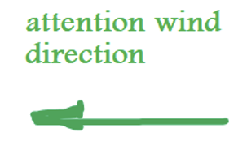
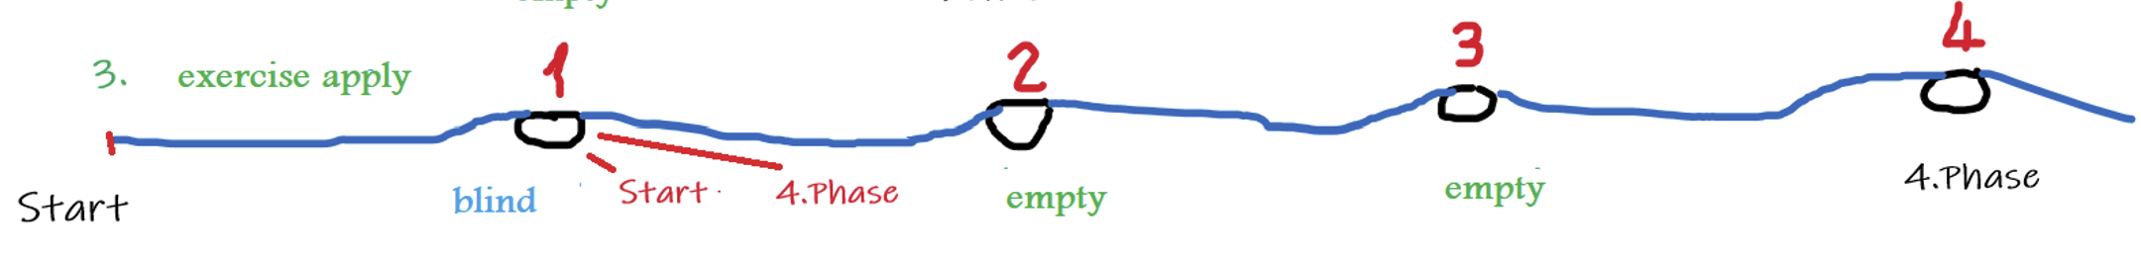
Basic Course 2
Step 3: Apply
Start and then search for the blind person (cave 1)
From blind person start for 4th phase on cave 4 (the figurant starts at the dog)
Handler moves away with the dog (as soon as the figurant disappears in the cave)
Handler starts his dog to search on cave 4

Slide 17
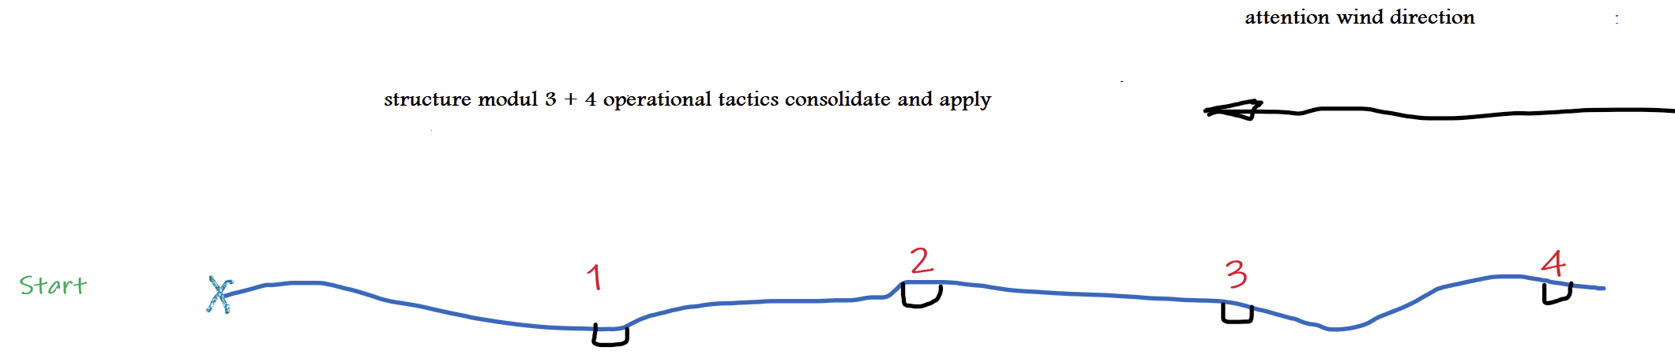
Basic Course 3 + 4
Apply
Phase 2 (handler in closed cave) on cave 2
Phase 2 (handler in closed cave) on cave 4
Phase 4 (handler stays with dog, figurant in cave) on cave 1
Phase 4 (handler stays with dog, figurant in cave) on cave 3
Notes:
Schweiz eingeteilt in die verschiedenen regionen

Slide 18
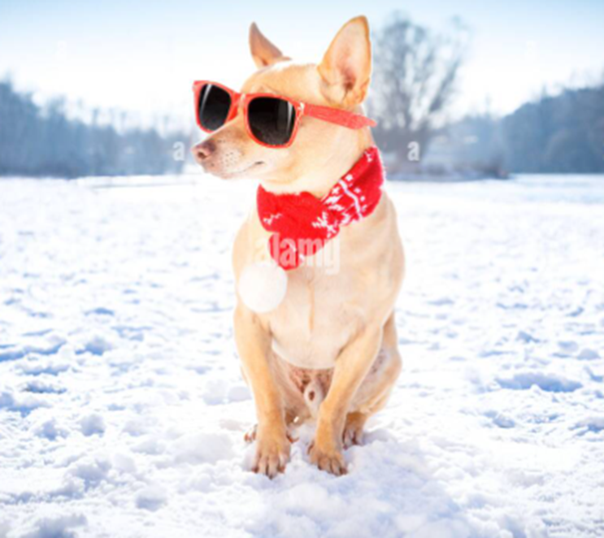
New system for training avalanche dogs

