Slide 1
Norwegian search and Rescue Dogs (NRH) new approval program

Slide 2
Objectives of the new approval program
Set out the Executive Board’s framework ensuring that dogs and handlers are trained in accordance with NRH’s vision:
“Expertise searching for missing persons – a leading player in the search and rescue service”
Make certain that the dogs and their handlers have the required education, are quality assured and approved, and can assist the voluntary rescue service and our principals finding missing persons

Slide 3
Objectives of the work
Module 1
Module 2
Module 3
Module 4
Alter the approval program from a testing program to an education program:
Train rescuers for the voluntary rescue service Train and educate the dog handlers in all exercises defined in the national search and rescue guidelines
Align the education to expectations
Basic education
Practical education and skill tests
Further education and mid term exam
Exam and final approval

Slide 4
Objectives of the work
Module 1
Module 2
Module 3
Module 4
Make information about the education program available to all members:
What knowledge and which skills that are to be obtained (described by "learning objectives") How an exercise is to be performed when learning objectives are to be checked (described under “Execution" ) Which conditions that are to be emphasized during approval (described under “Assessment and basis for completion of tasks”)
Learning objectives and execution
Assessment and basis for completed tasks

Slide 5
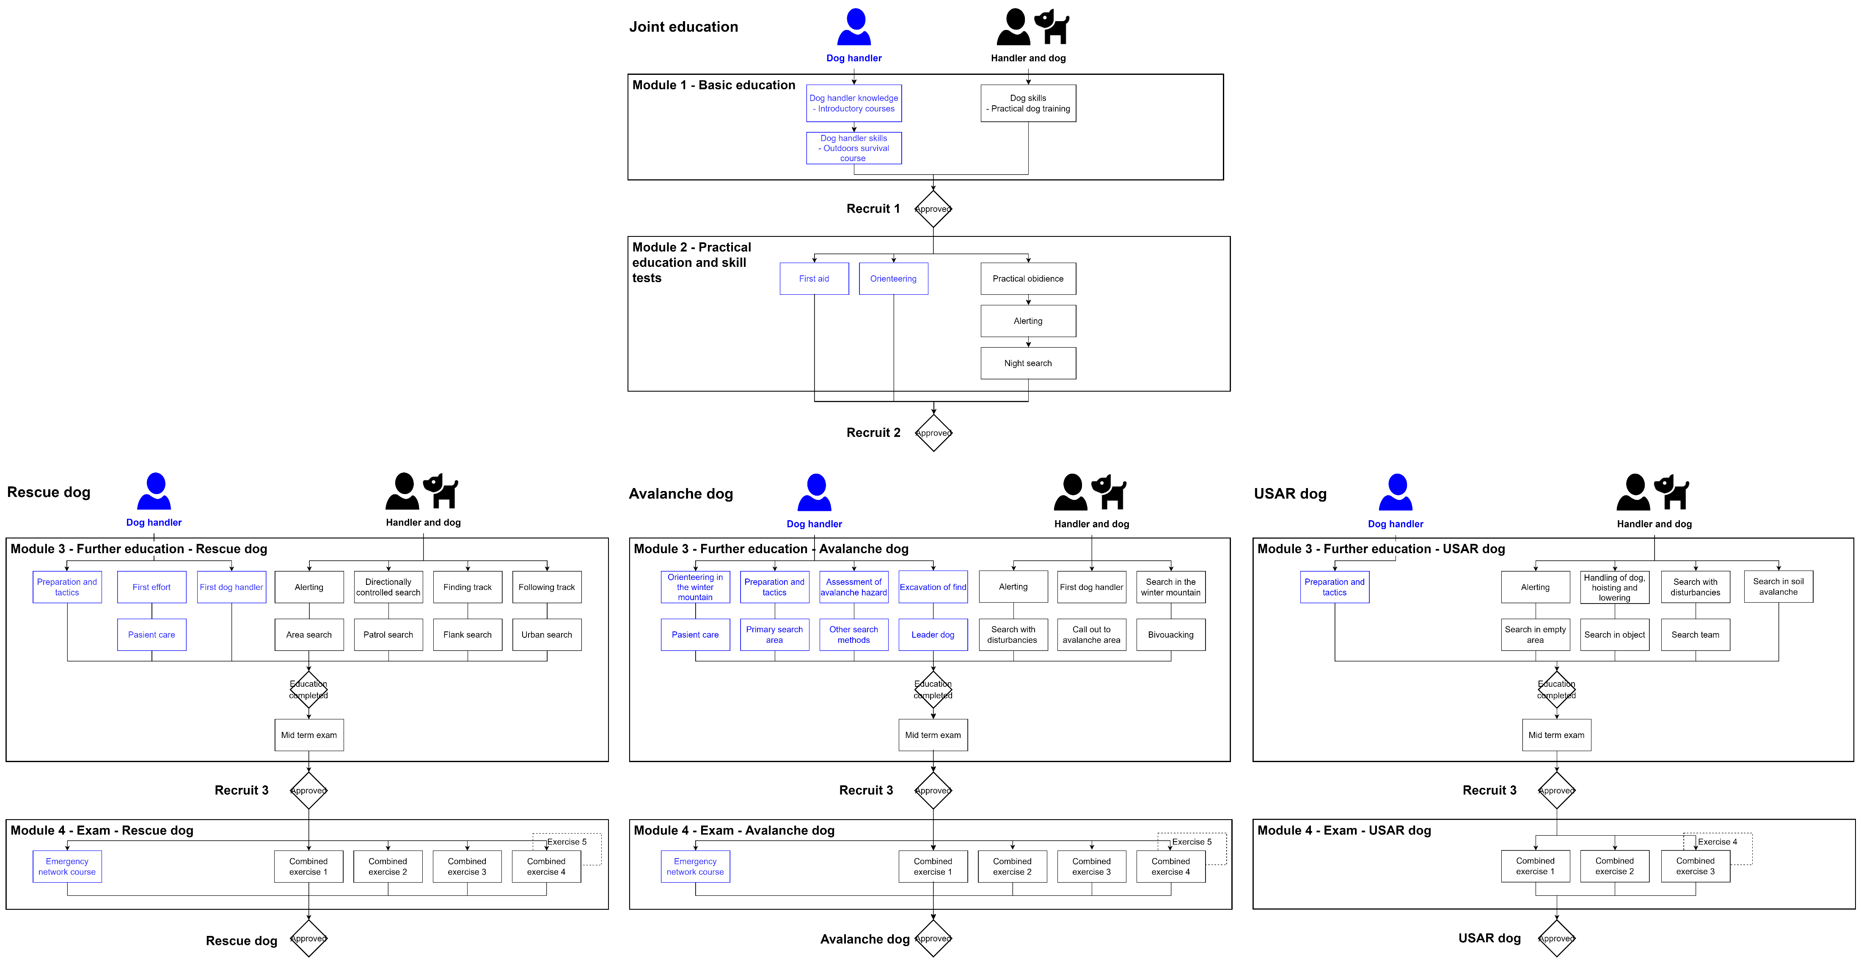
Program Structure

Slide 6
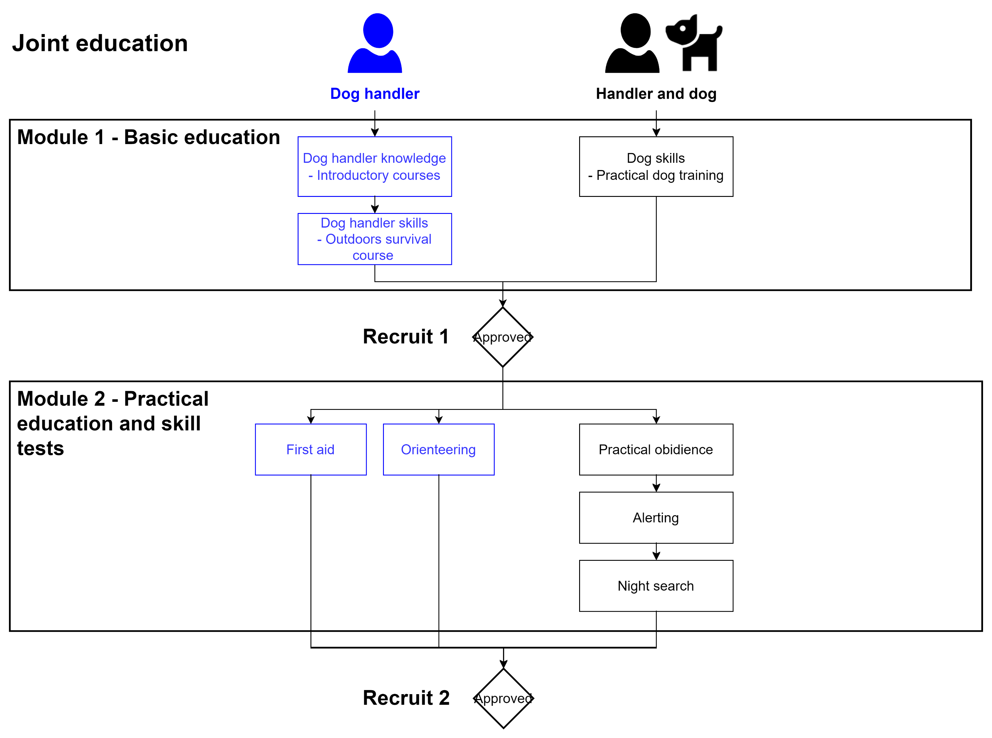

Slide 7
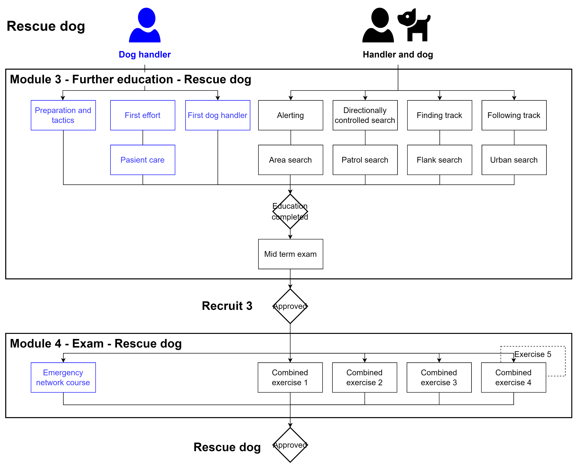

Slide 8
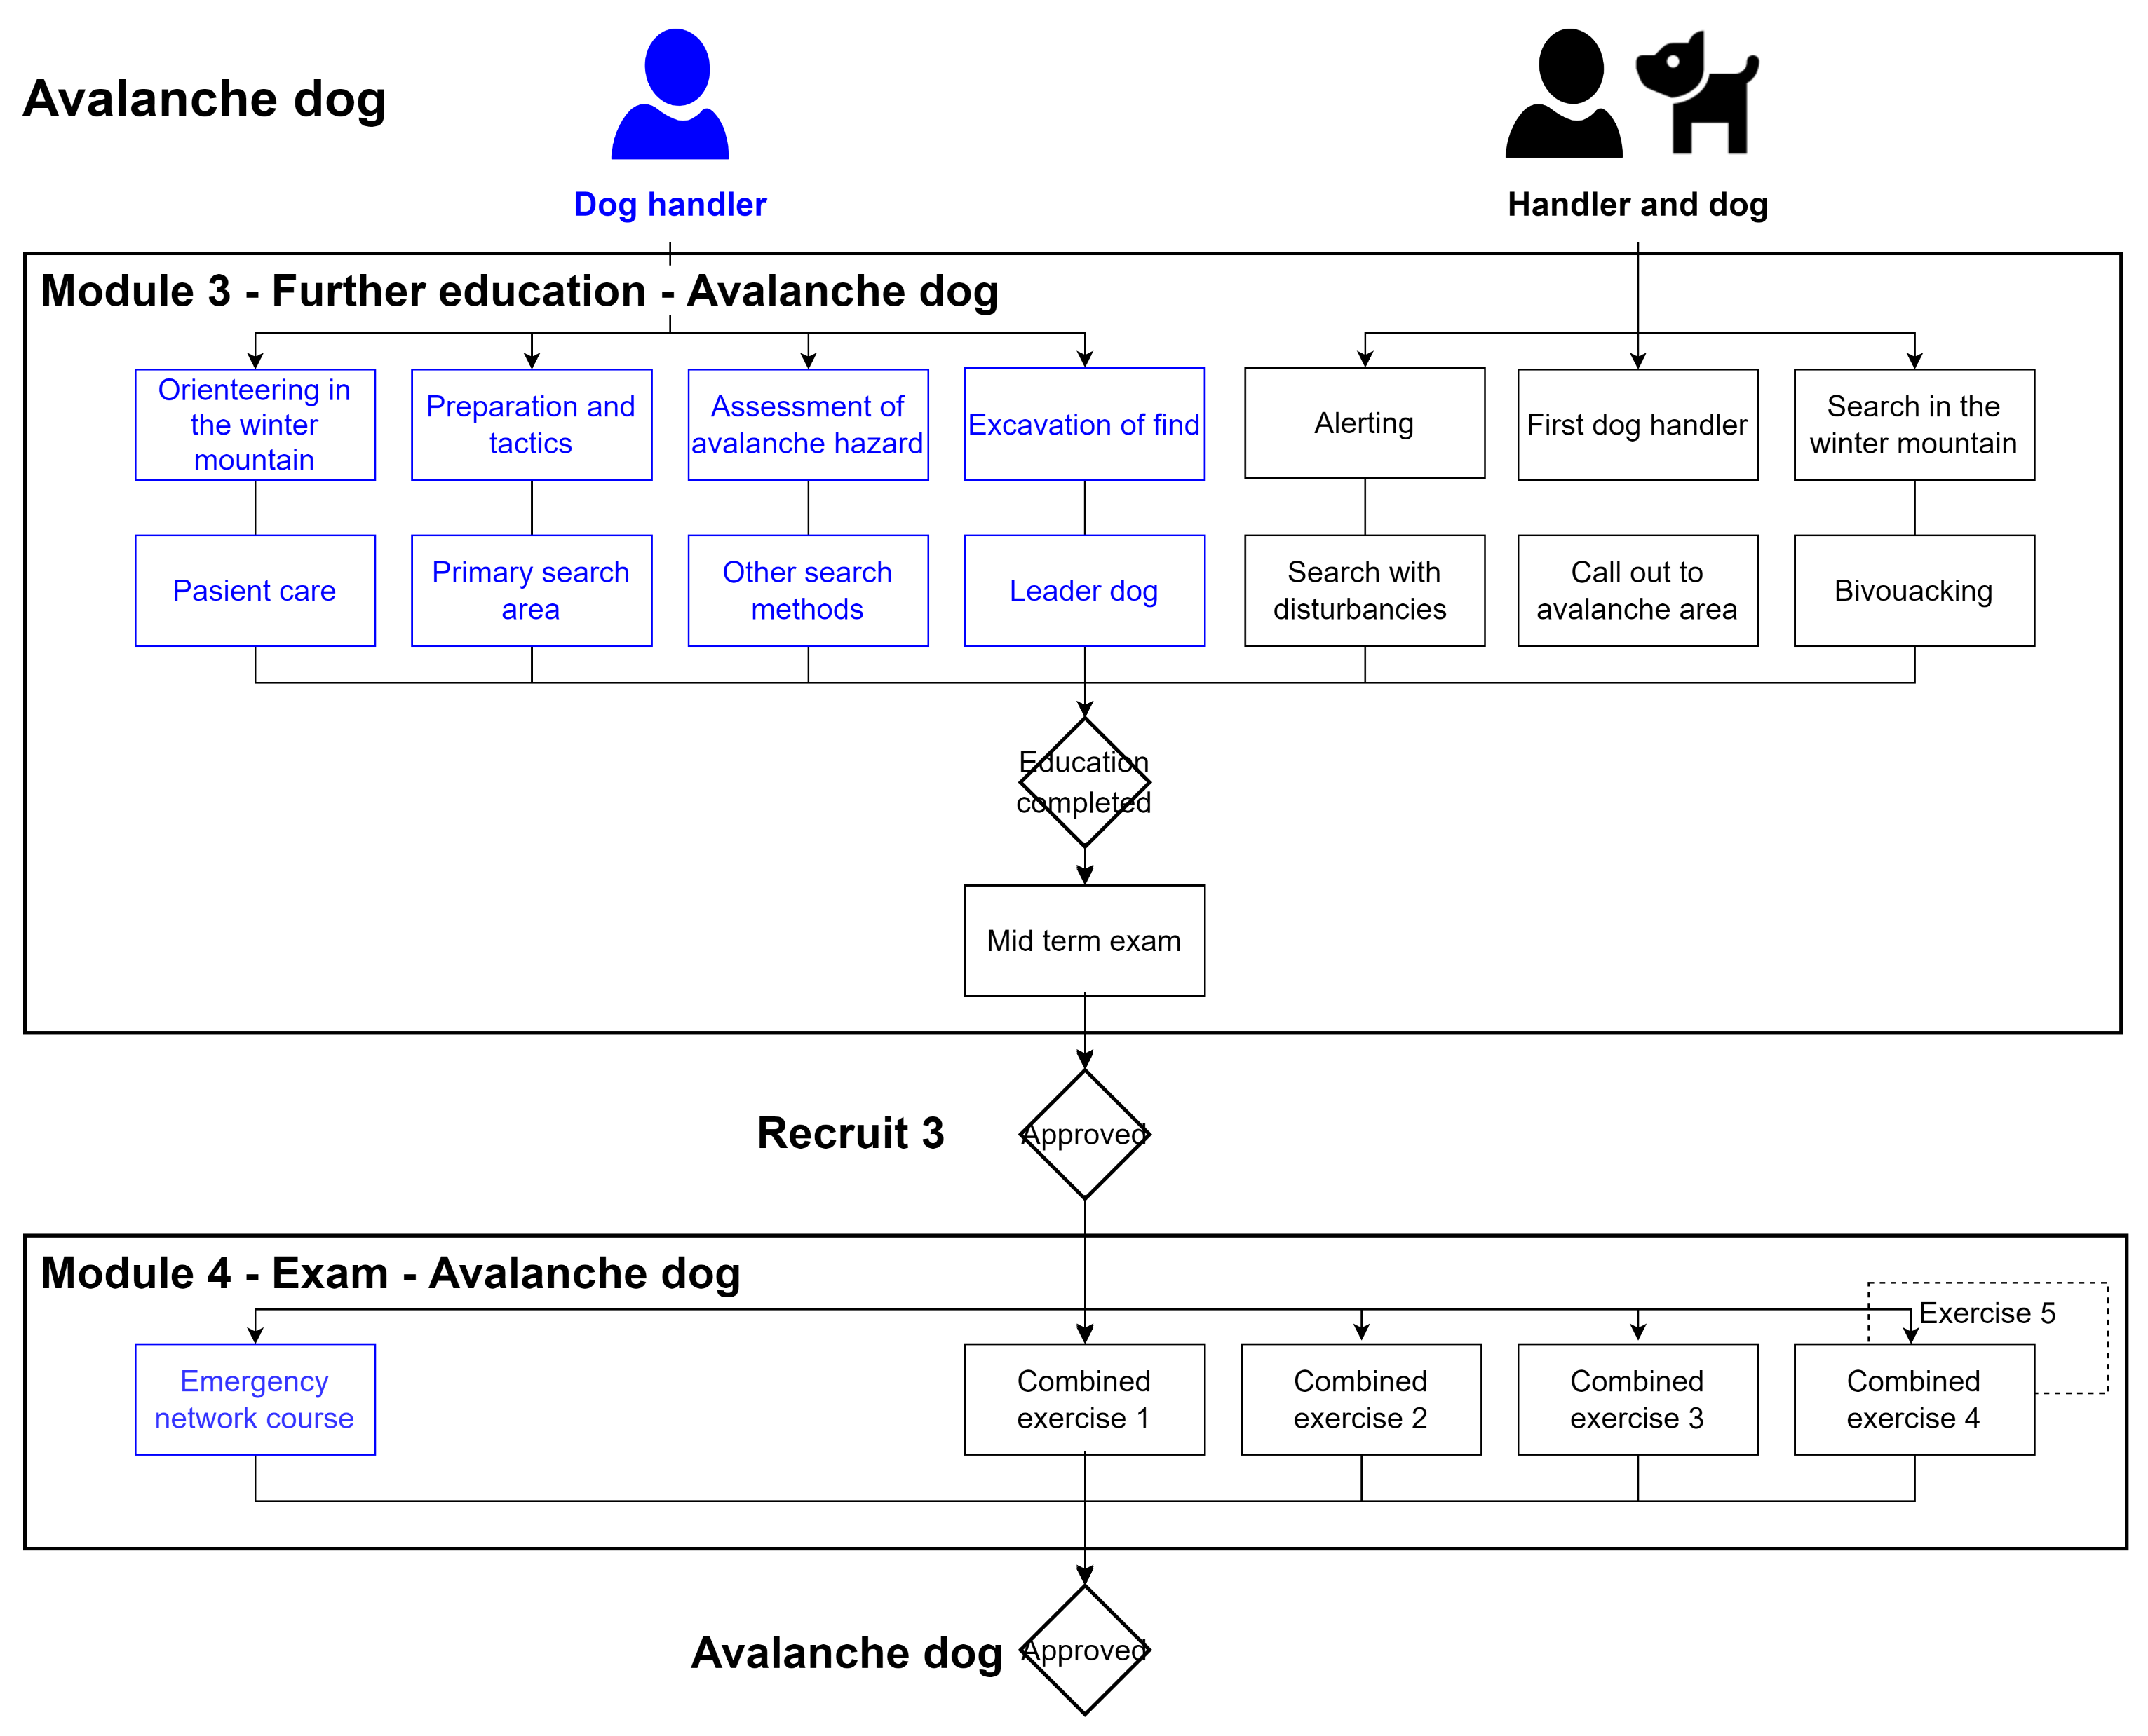

Slide 9
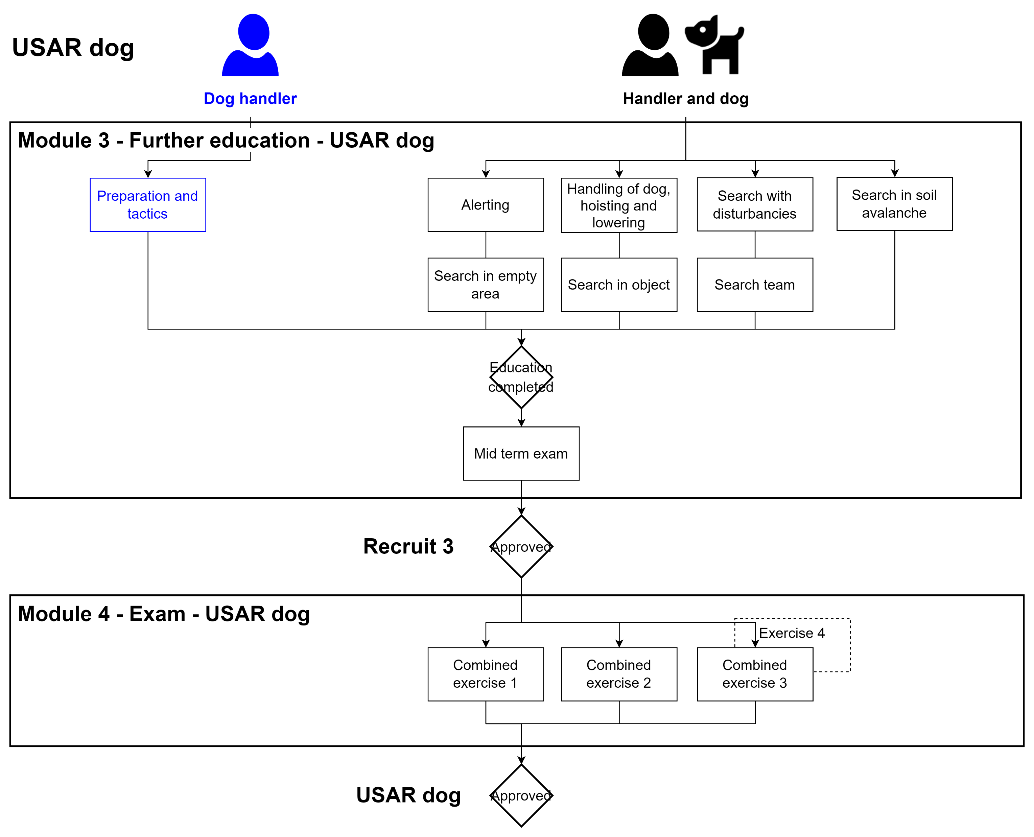

Slide 10
Module 4 exam rescue and Avalanche dogs
Rescue dog – Combined exercise #15:
E-1 Preparation and tactics
E-3 Pasient care
E-5 Alerting
E-7 Flank search
E-8 Finding track
E-9 Following track
Avalanche dog – Combined exercise #14:
L-1 Preparation and tactics
L-2 First dog handler avalanche
L-3 Pasient care
L-4 Search in the winter mountain
L-5 Alerting when finding burried people and people on the surface
L-7 Other search methods
L-8 Assessment of avalanche hazard
L-9 Search with disturbancies
L-10 Primary search area

Slide 11
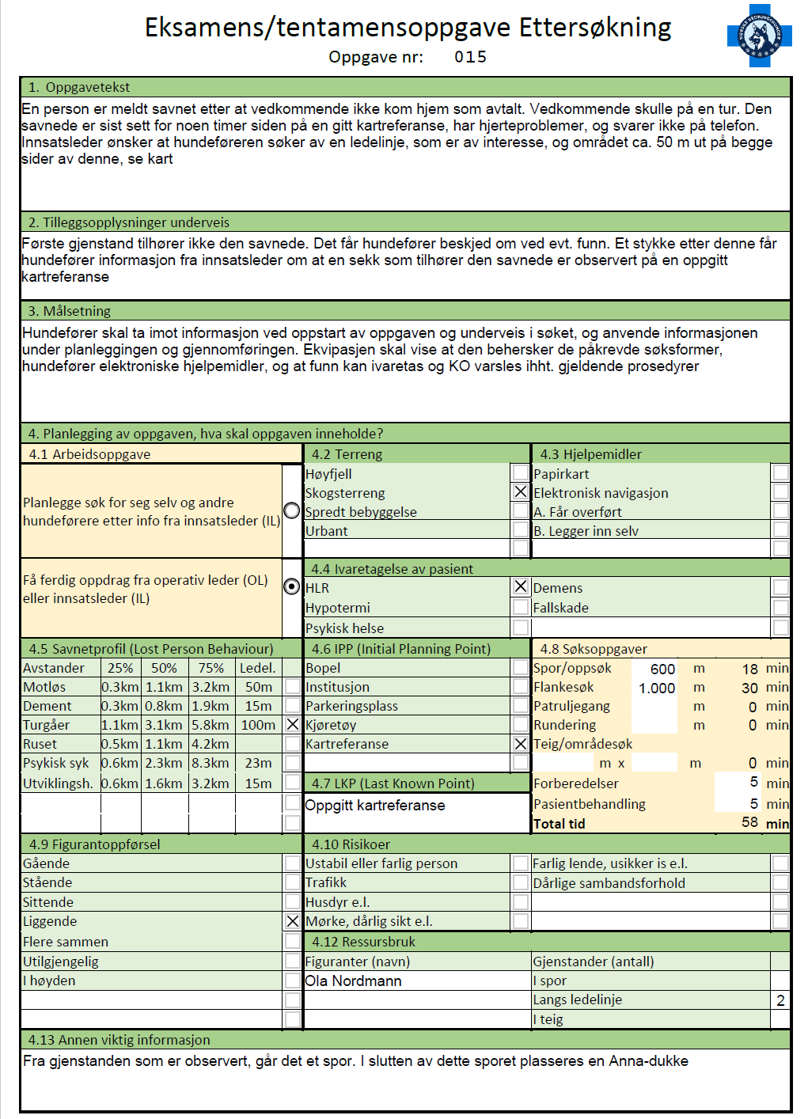
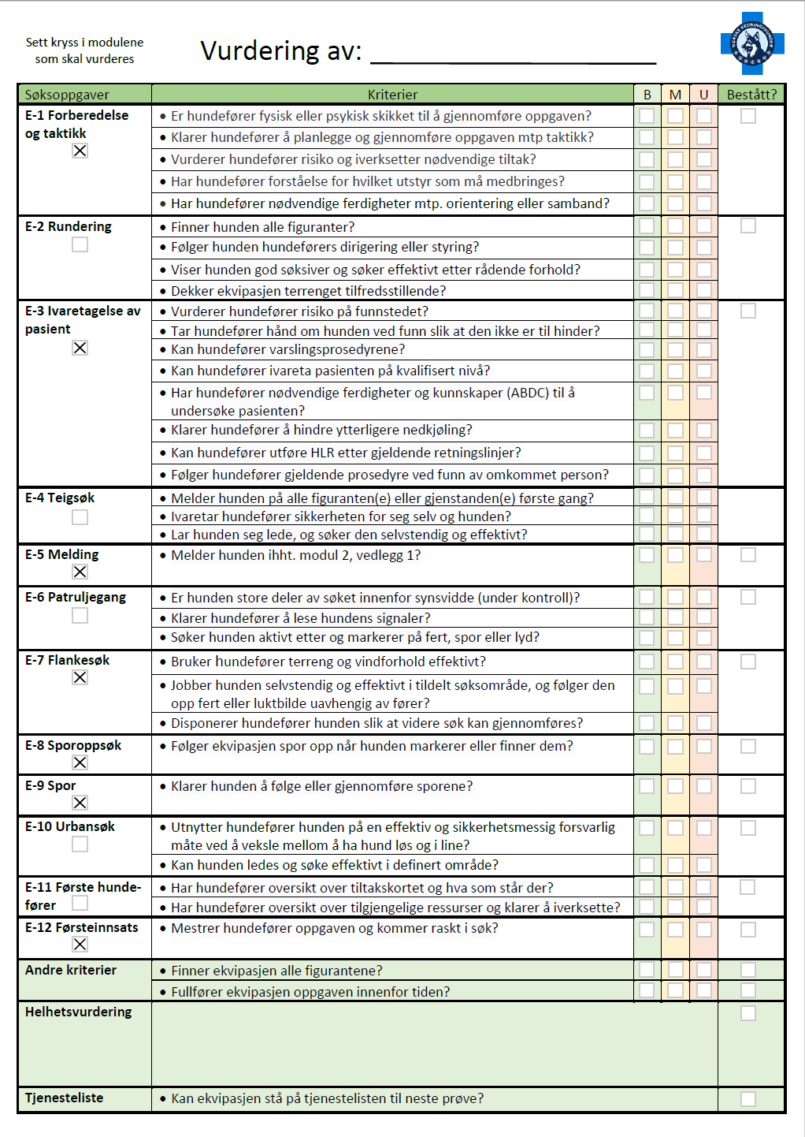
Evaluation form

