Slide 1
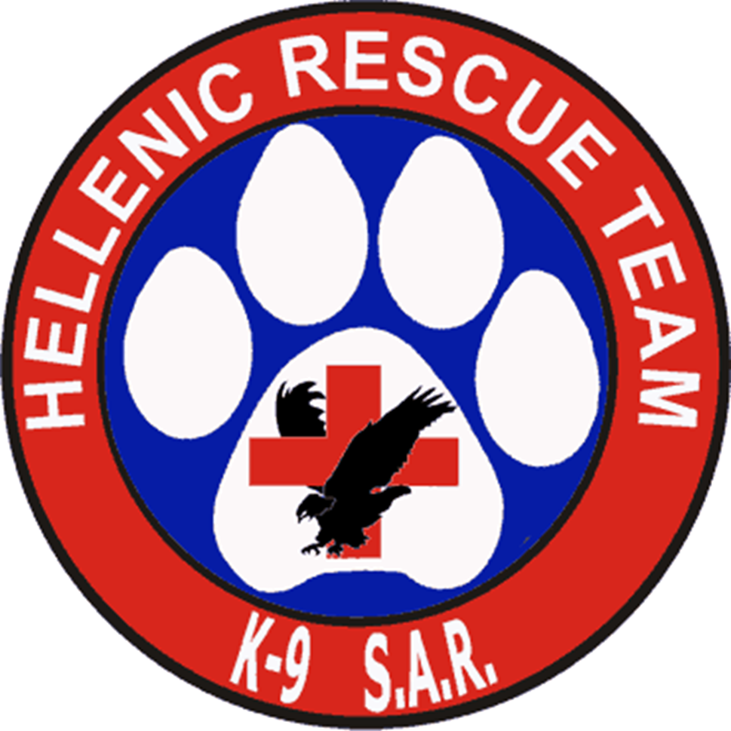
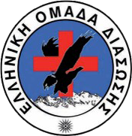
Presentation:
Katerina Batsioudi
Head of HRT K9 Department
SAR Dogs in Greece

Slide 2
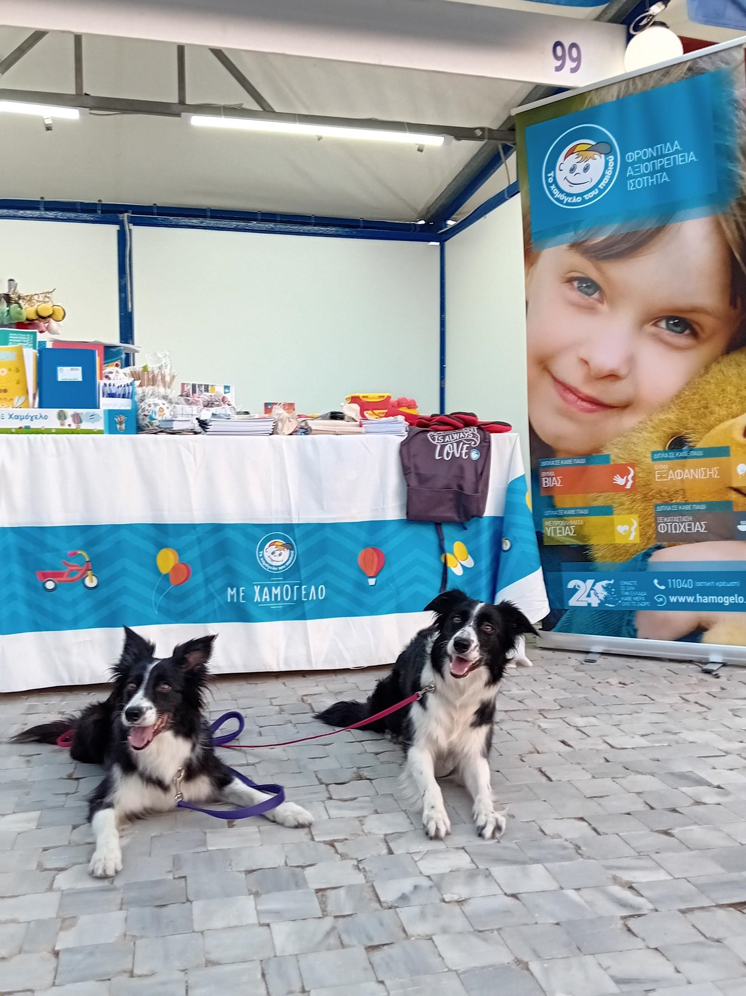
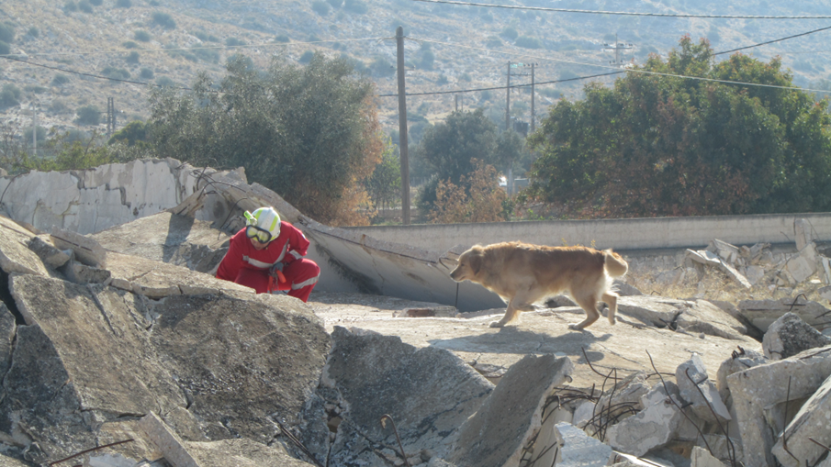
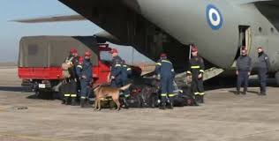
  Hellenic Rescue Team (HRT)
  Fire Service Rescue Dogs
  Other Voluntary and Professional Organizations
Organizations and Training
Notes:
Search and Rescue (SAR) dogs play a crucial role in Greece, particularly during natural disasters such as earthquakes, floods, and wildfires, which the country frequently experiences. These dogs are trained to locate missing persons, survivors, or victims buried under rubble or trapped in dangerous environments. Here’s an overview of SAR dogs in Greece:
1. Organizations and Training:
Hellenic Rescue Team (HRT): One of the prominent volunteer organizations that deploys SAR dogs in Greece. Their canine unit consists of highly trained dogs that specialize in locating people in collapsed buildings or wilderness areas. They often collaborate with government agencies, fire departments, and international rescue teams.
Fire Service Rescue Dogs: The Hellenic Fire Service also uses trained SAR dogs, particularly in post-earthquake operations or large-scale search efforts. These dogs are critical in quickly locating survivors who are trapped beneath debris.
Other Voluntary and Professional Organizations : Dedicated groups that train and deploy SAR dogs across the country for various emergencies, including missing persons in urban or wilderness areas.

Slide 3
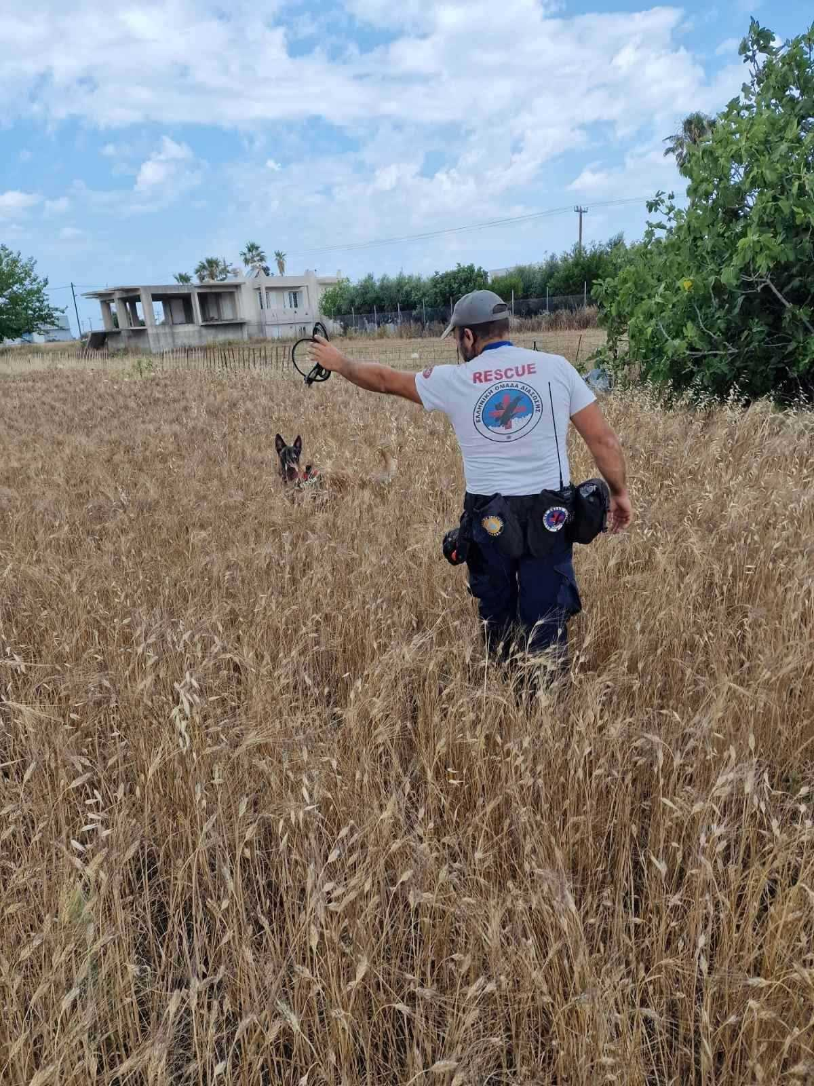
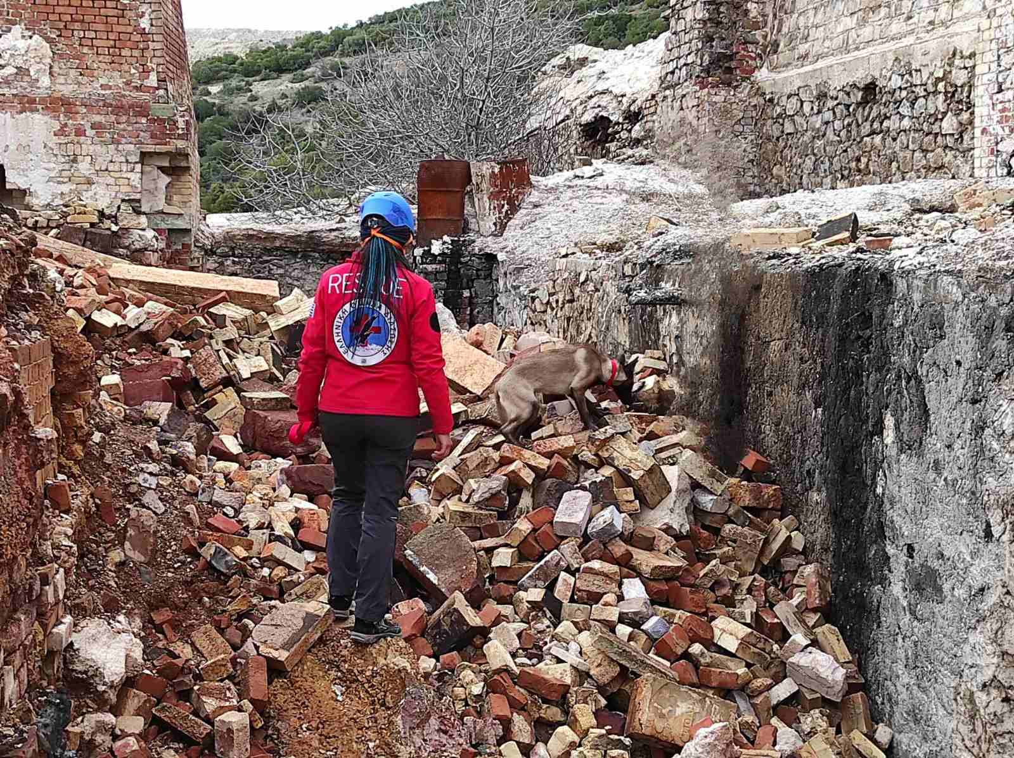
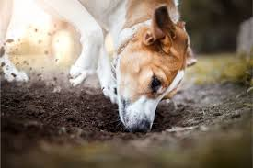
  Air-scenting Dogs/ Open Area
  Air-scenting Dogs/ Disasters
  Human remains detection (HRD) dogs
Types of SAR Dogs
Notes:
2. Types of SAR Dogs:
Air-scenting Dogs/ Open Area: These dogs are trained to detect human scent carried by the wind. They work quickly over large areas and are commonly used in outdoor search operations, such as forests, mountains, or rural landscapes.
Air-scenting Dogs/ Disasters: These dogs are specialized in finding people buried under rubble, which is critical in the aftermath of earthquakes. They are trained to indicate live human scent and assist rescuers in narrowing down their search in collapsed structures.
Human remains detection (HRD) dogs: These dogs are specially trained canines used to locate human remains. Their ability to detect the scent of decomposition makes them invaluable in search and rescue missions, forensic investigations, and disaster recovery efforts.

Slide 4
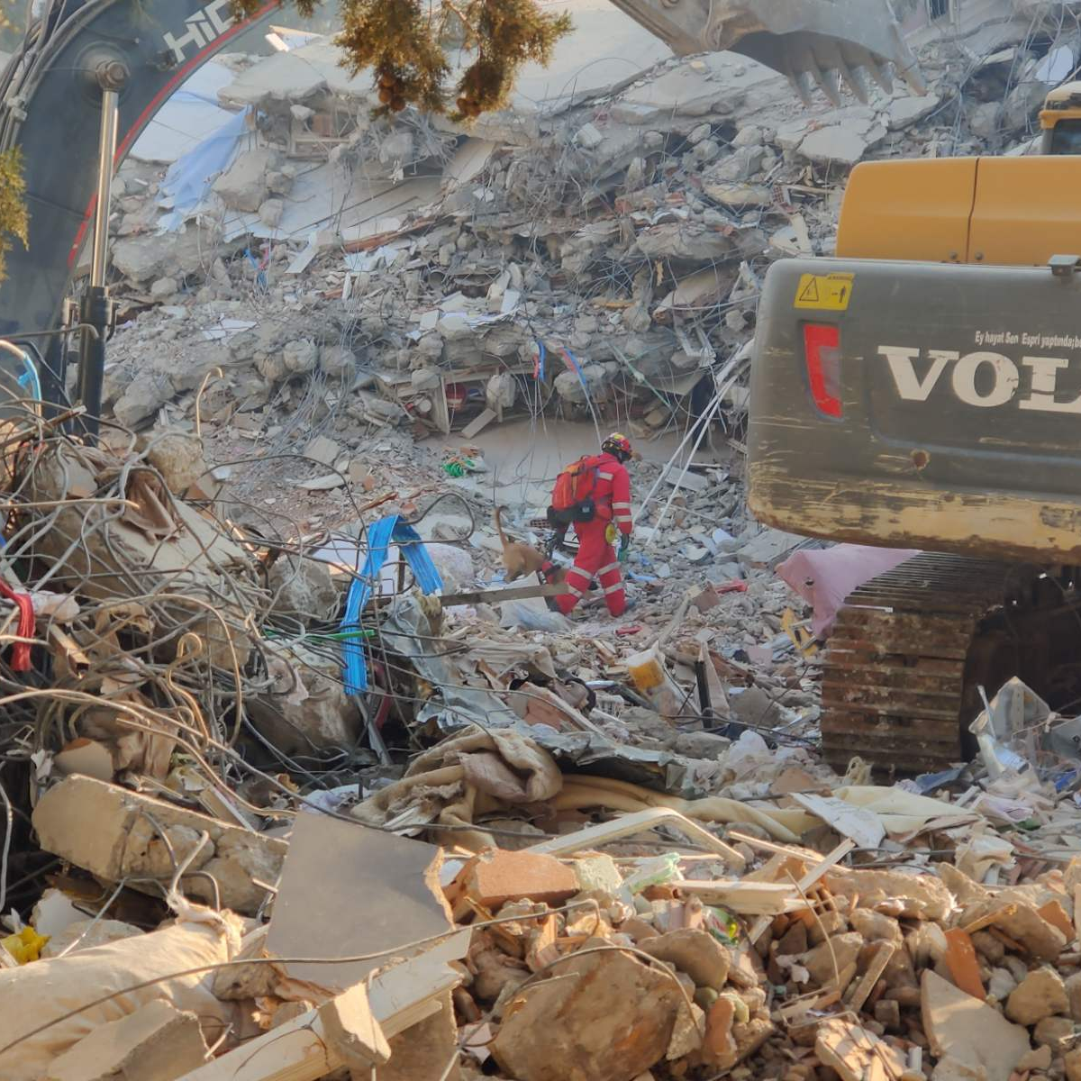
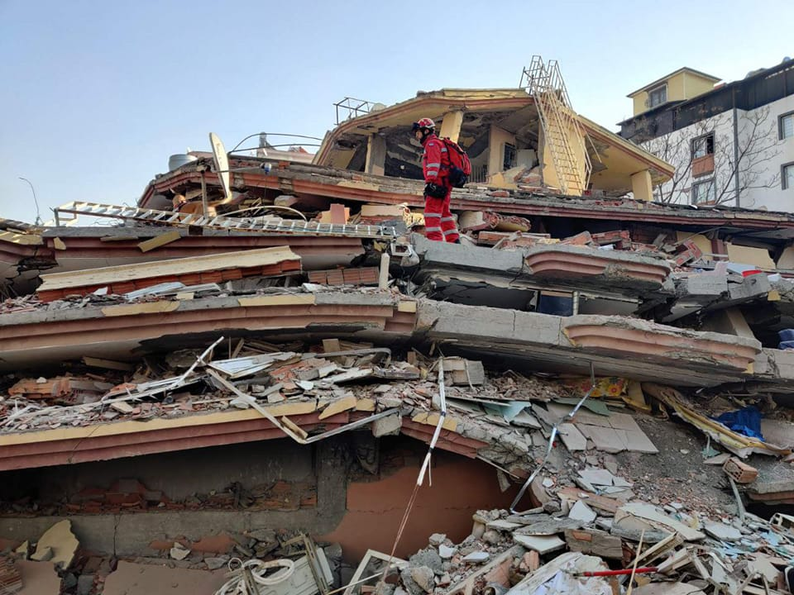
  Earthquakes
  Floods
  Man-made disasters
Role in Natural Disasters
Notes:
Earthquakes: Greece is prone to seismic activity, and SAR dogs are deployed immediately after an earthquake to search for survivors trapped under collapsed buildings. Their ability to cover large areas and locate people quickly makes them invaluable in the crucial first hours after a disaster.
Floods: In flooding situations, SAR dogs assist in locating people swept away by water or those trapped in inaccessible areas.

Slide 5
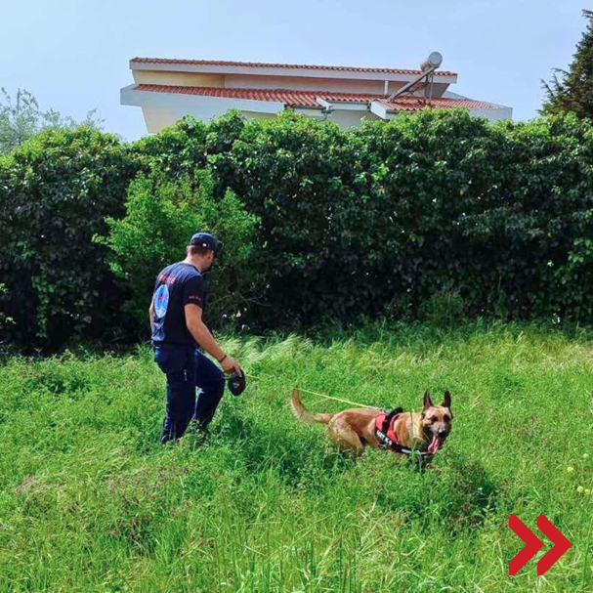
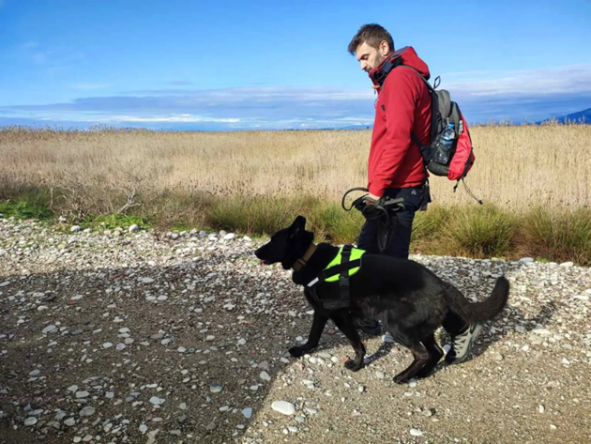
  Air-Scenting
  Efficient in Time-Sensitive Searches
Role in locating missing people
Notes:
Search and Rescue (SAR) dogs are also used in Greece and around the world to locate missing people with Alzheimer's disease or other forms of dementia. Alzheimer's patients can often wander away from their homes or care facilities, becoming disoriented and unable to find their way back. SAR dogs play a crucial role in finding these individuals quickly, as time is often critical due to risks such as exposure to the elements, accidents, or injuries.
Air-Scenting: In cases where time is critical, air-scenting dogs can cover large areas quickly. These dogs are trained to detect any human scent in the area and are useful in searching large, open spaces like parks, fields, or rural areas where an Alzheimer's patient may have wandered.
Efficient in Time-Sensitive Searches: People with Alzheimer’s or dementia often wander without a clear direction, meaning they can travel long distances in unpredictable ways. SAR dogs can help locate them faster than traditional search teams because they can work in harsh or inaccessible environments, and their keen sense of smell allows them to pick up on a person’s scent even when visual clues are missing.

Slide 6
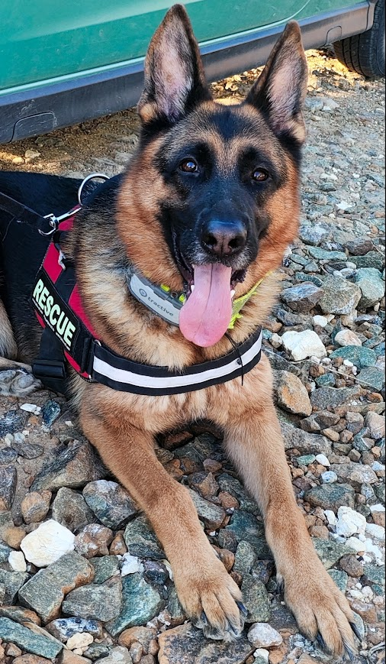
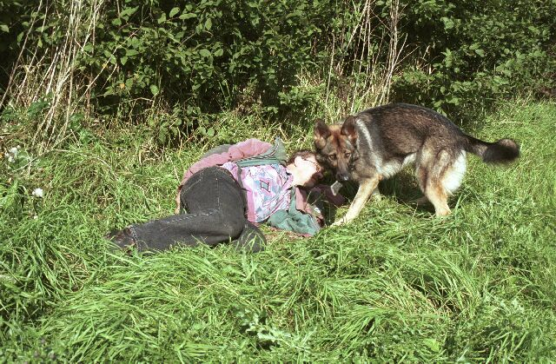
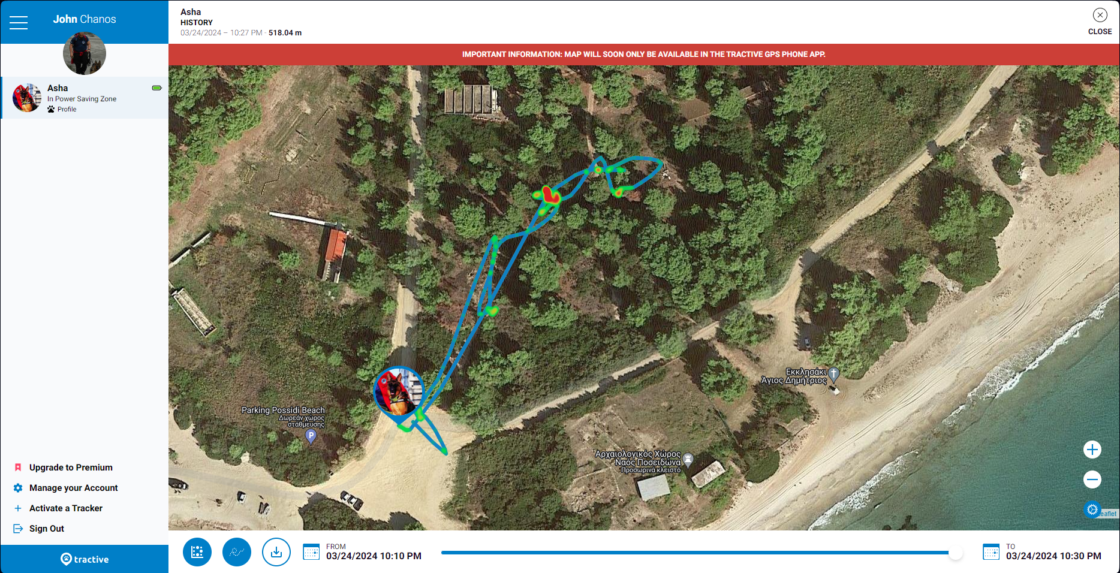
Common Situations and Challenges
  Unpredictable Movement
  Wandering in Dangerous Areas
Training Specific to Dementia Patients
  Calming the Person
  Non-Aggressive Search Behavior
  Non-barking Notification
Common Situations and Challenges/Training
Notes:
Common Situations and Challenges:
Unpredictable Movement: Unlike some lost persons, Alzheimer's patients often don’t follow predictable patterns, which makes them harder to find using typical search techniques. SAR dogs are extremely valuable in such cases, as they don’t rely on patterns, but instead on scent trails.
Wandering in Dangerous Areas: Patients with Alzheimer's might wander into dangerous places like highways, dense forests, or near water bodies. In these situations, time is of the essence, and SAR dogs can significantly reduce search time by identifying the person's location more quickly than human searchers alone.
Training Specific to Alzheimer's Patients:
SAR dogs used to search for people with Alzheimer's require specialized training because:
Calming the Person: Alzheimer's patients may be confused, scared, or agitated when found. Dogs are trained not just to find them but to approach gently, in a manner that doesn't startle or further confuse the person.
Non-Aggressive Search Behavior: Unlike dogs trained for criminal apprehension or more aggressive operations, SAR dogs for missing persons, especially those with dementia, are trained to be calm, patient, and non-threatening.

Slide 7
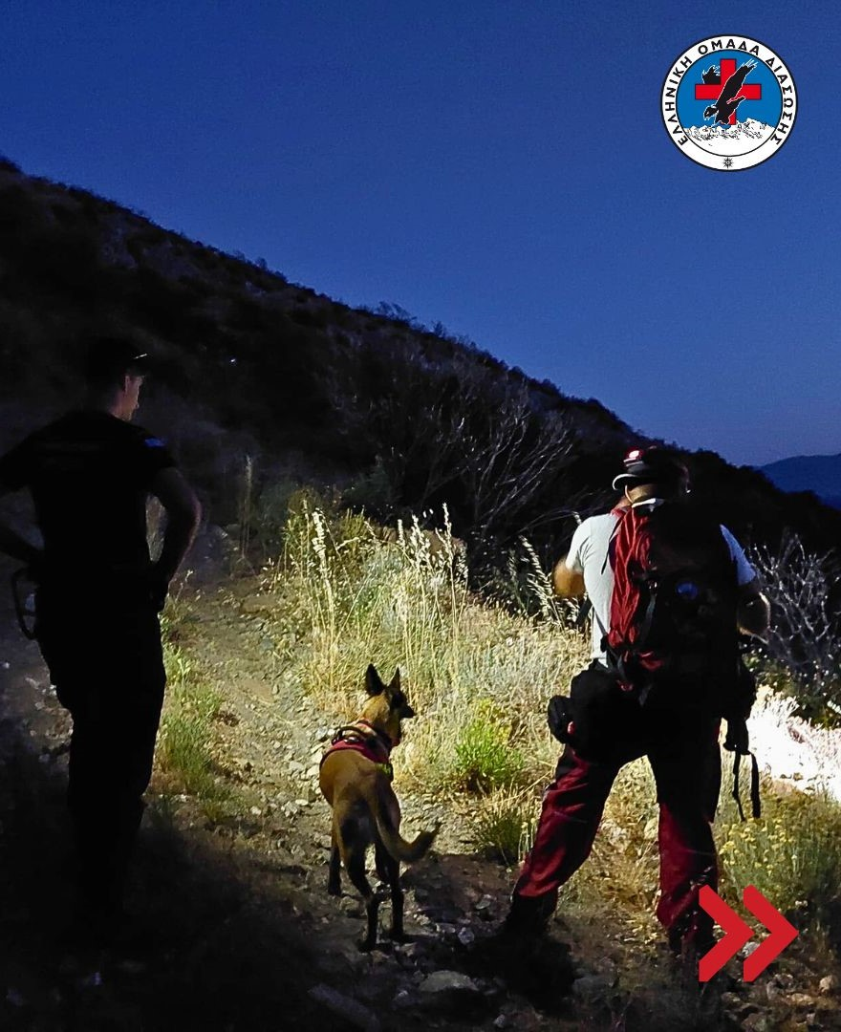
SAR Dogs’ Advantages in Alzheimer’s Searches
  Speed
  Adaptability
  Non-Invasive
SAR Dog Deployments in Dementia Cases in Greece
Notes:
In Greece, similar to many other countries, there are reports of elderly individuals with Alzheimer’s going missing, particularly in rural areas. In such cases:
Volunteer SAR Teams and organizations like the Hellenic Rescue Team (HRT) often deploy dogs to search for missing elderly individuals. These teams collaborate with the police, local authorities, and sometimes family members.
SAR Dogs’ Advantages in Alzheimer’s Searches:
Speed: Their ability to quickly track down a person through their scent or air-scenting techniques saves critical time in rescue operations.
Adaptability: SAR dogs can work across various terrains — forests, mountains, urban environments — which is essential in Alzheimer's cases where the person could be anywhere.
Non-Invasive: The gentle approach of SAR dogs is crucial when dealing with potentially scared or confused individuals.
SAR dogs remain a vital resource in locating missing people with Alzheimer’s in Greece, and their specialized training allows them to operate in a wide variety of situations, making them indispensable in these sensitive and urgent rescue efforts.

Slide 8
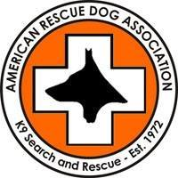

  Selecting the Air-Scenting Search Dog
  Basic Training, Obedience and Agility
  Beginning Search Training
  Advanced Search Training
  Handler Standards and Equipment
  Responding to a Search
  Conducting the Search
  Disaster Training-Disaster Missions
  First-Aid for Search
  Lost Person Behavior
Training protocol
Notes:
SAR dogs undergo rigorous training, usually starting from a young age. Their training includes obedience, agility, and search techniques specific to the environments they’ll be working in (urban, rural, or mountainous).
The terrain in Greece can be challenging, with rocky mountains, dense forests, and urban environments that require adaptable and highly trained dogs.
SAR dogs are typically selected from breeds known for their intelligence, agility, and strong work ethic, such as German Shepherds, Belgian Malinois, and Labradors.

Slide 9
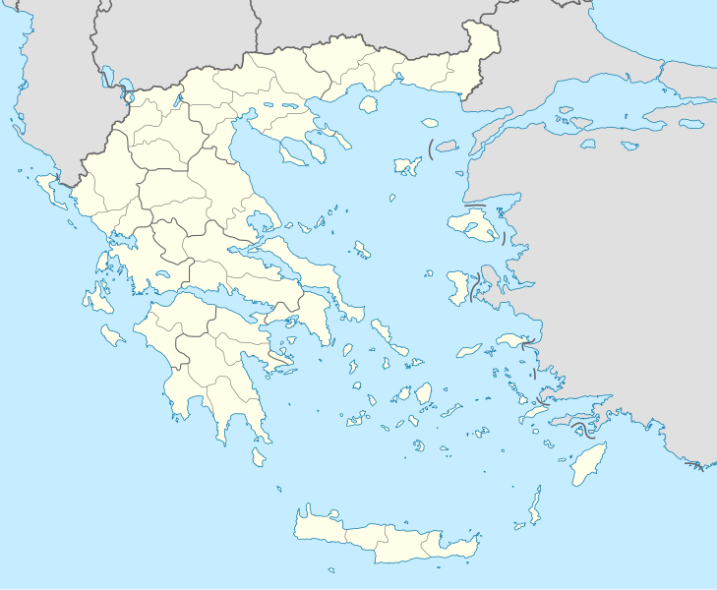


Training and Challenges
Notes:
SAR dogs undergo rigorous training, usually starting from a young age. Their training includes obedience, agility, and search techniques specific to the environments they’ll be working in (urban, rural, or mountainous).
The terrain in Greece can be challenging, with rocky mountains, dense forests, and urban environments that require adaptable and highly trained dogs.
SAR dogs are typically selected from breeds known for their intelligence, agility, and strong work ethic, such as German Shepherds, Belgian Malinois, and Labradors.

Slide 10
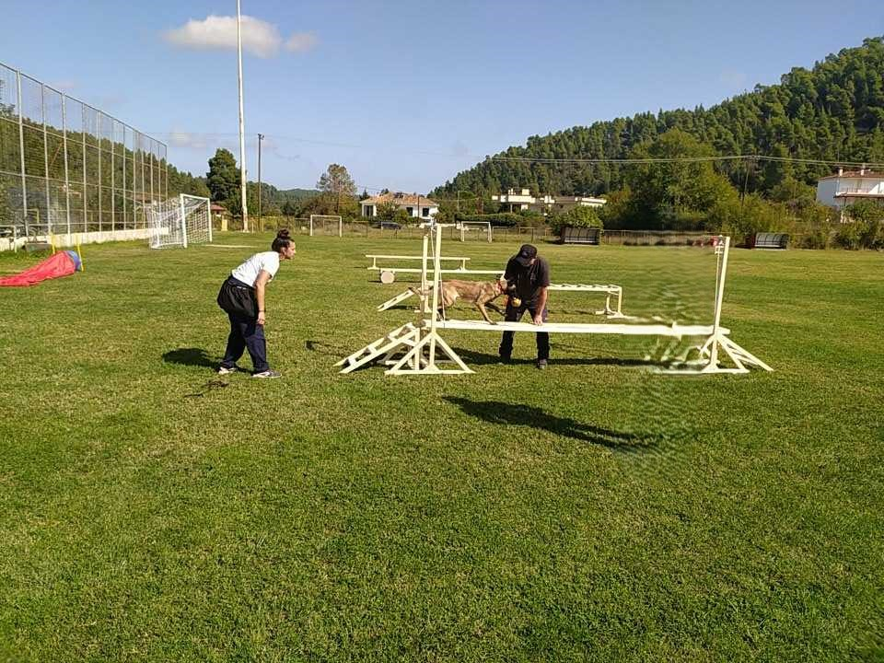
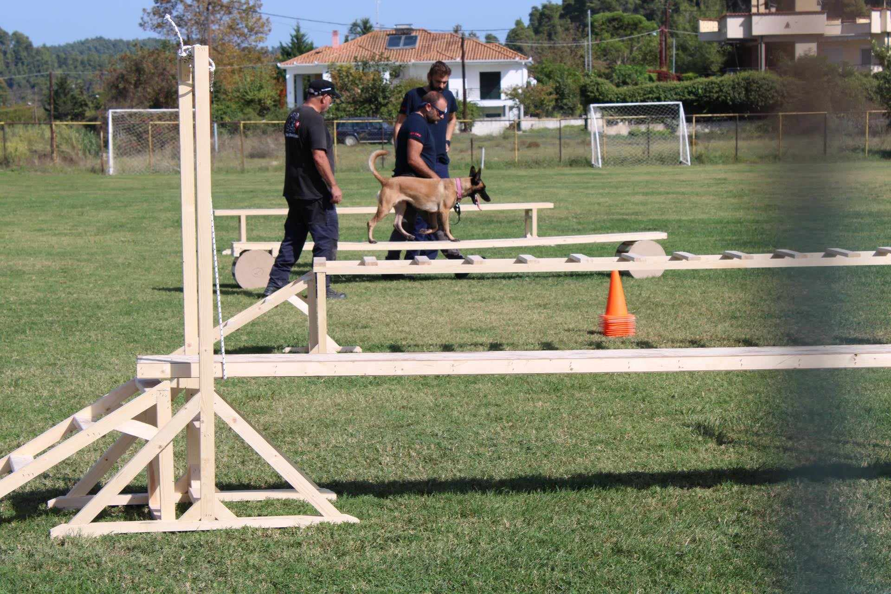
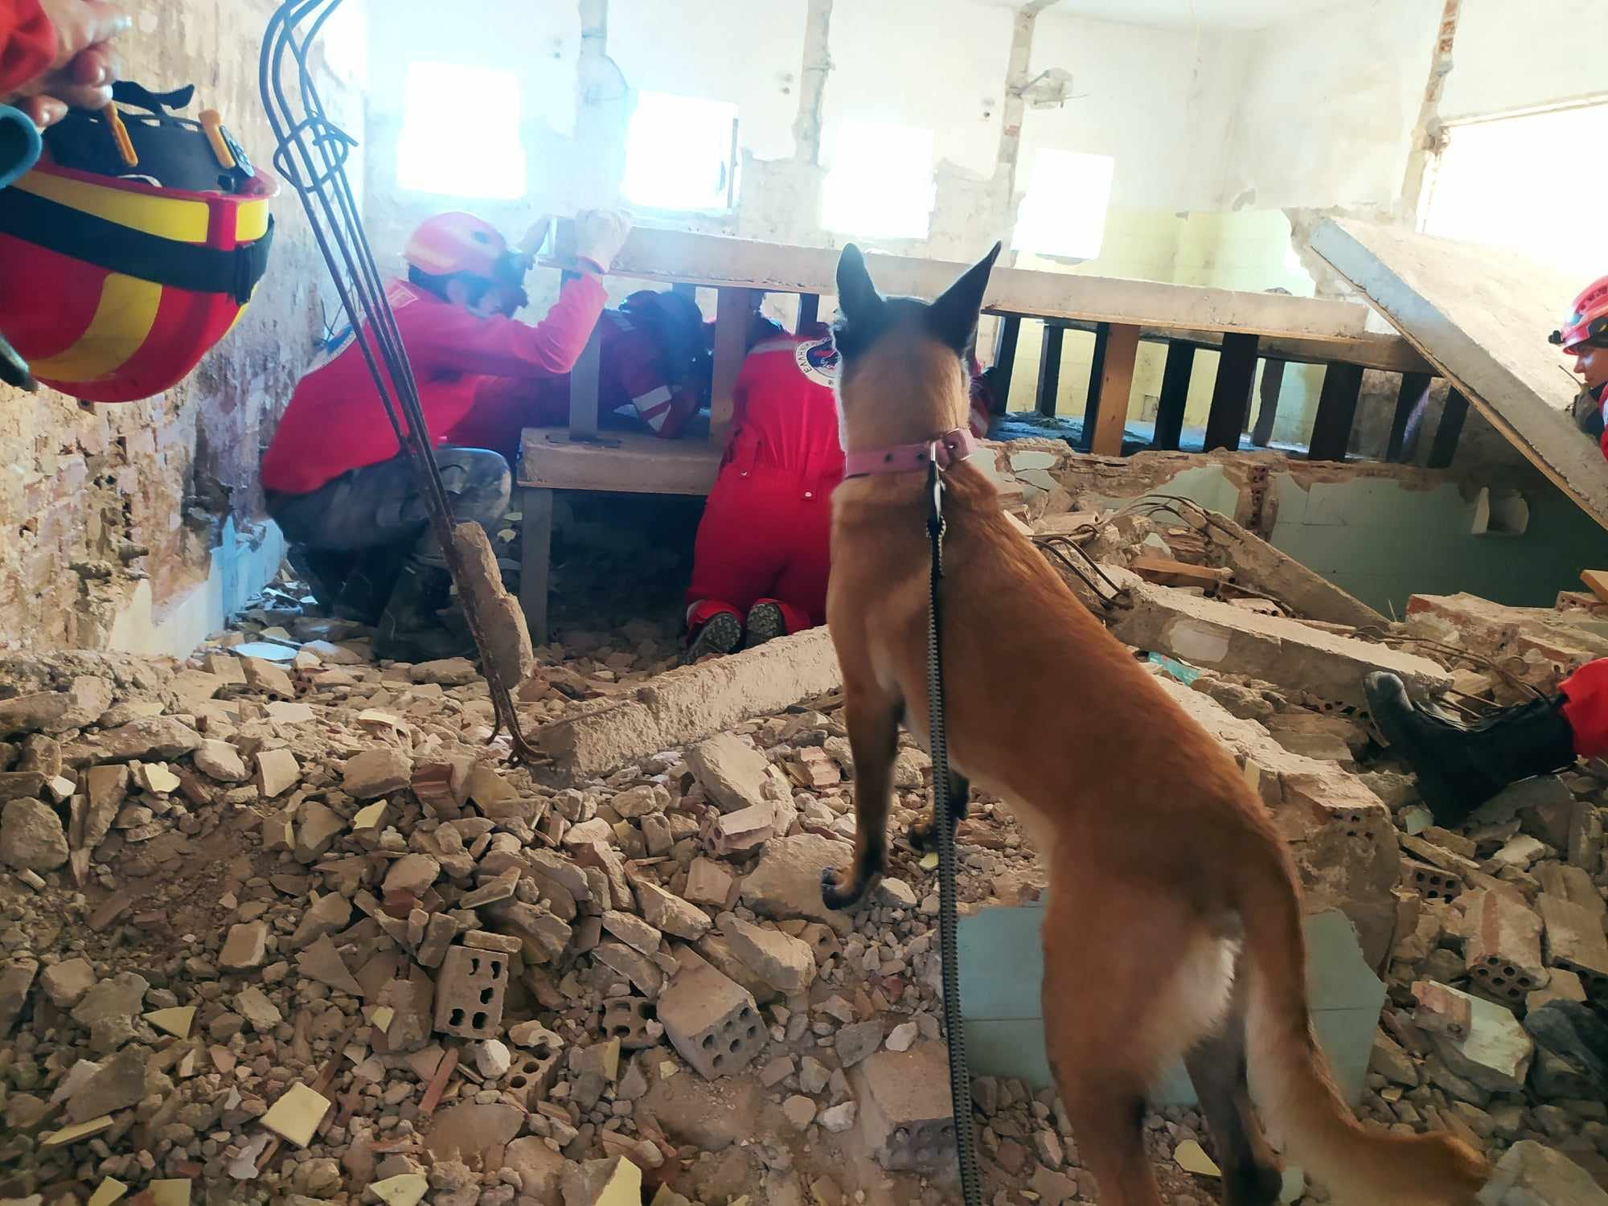
Training and Challenges

Slide 11
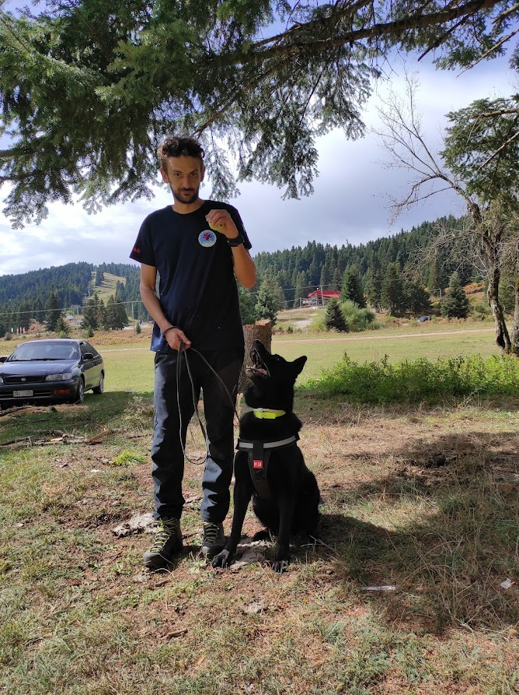
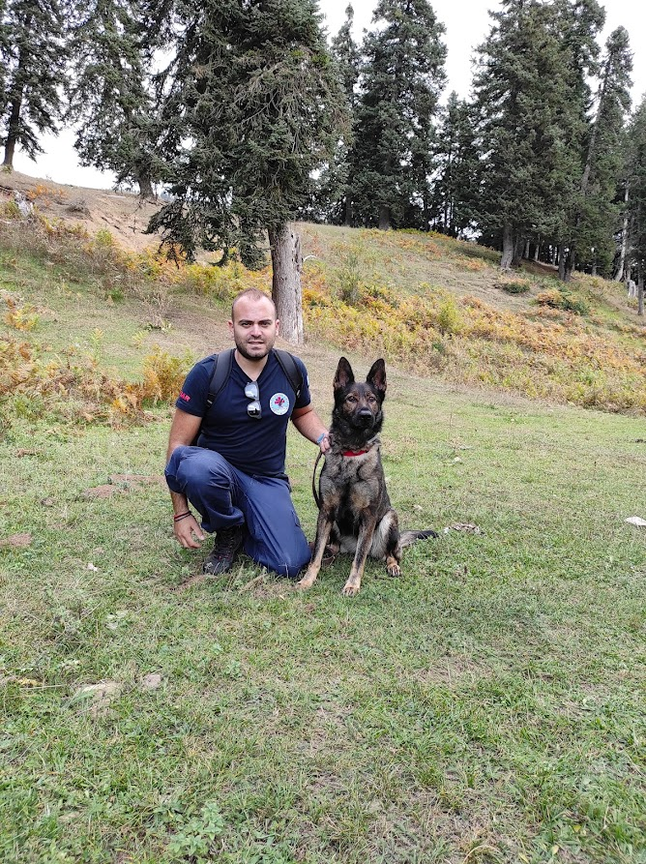
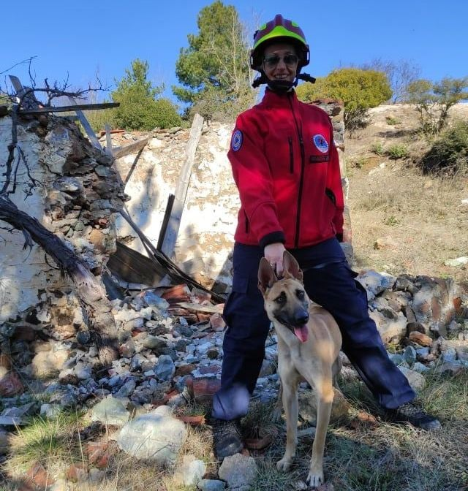
Manos and Andie
Evita and Siba
Kostas and Ramon
Volunteerism in Greece
Notes:
Volunteerism in Greece, like in many other countries, faces a number of challenges. Despite the desire of many individuals and organizations to contribute to social causes, the volunteer sector in Greece struggles with systemic issues that hinder its effectiveness. Here are some of the key problems that volunteers and organizations in Greece encounter:
1. Lack of Infrastructure and Organization
Coordination Issues: Many volunteer efforts in Greece lack centralized coordination. There are a number of NGOs and grassroots organizations, but they often work in isolation, leading to duplication of efforts and inefficient use of resources.
Bureaucratic Hurdles: Volunteers, especially those from abroad, often face complex legal and bureaucratic requirements, such as getting the right permits or dealing with restrictions, which can discourage participation.

Slide 12
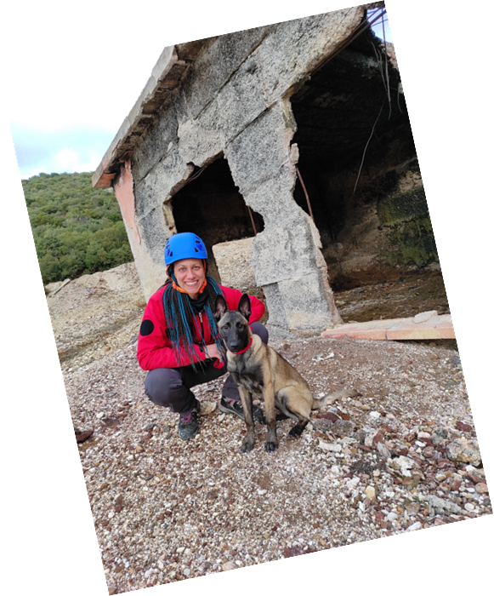
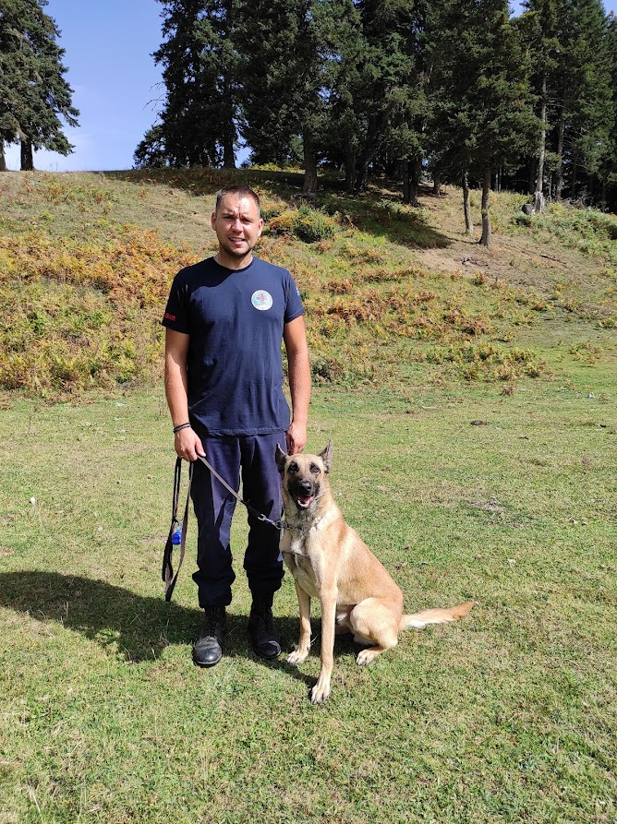
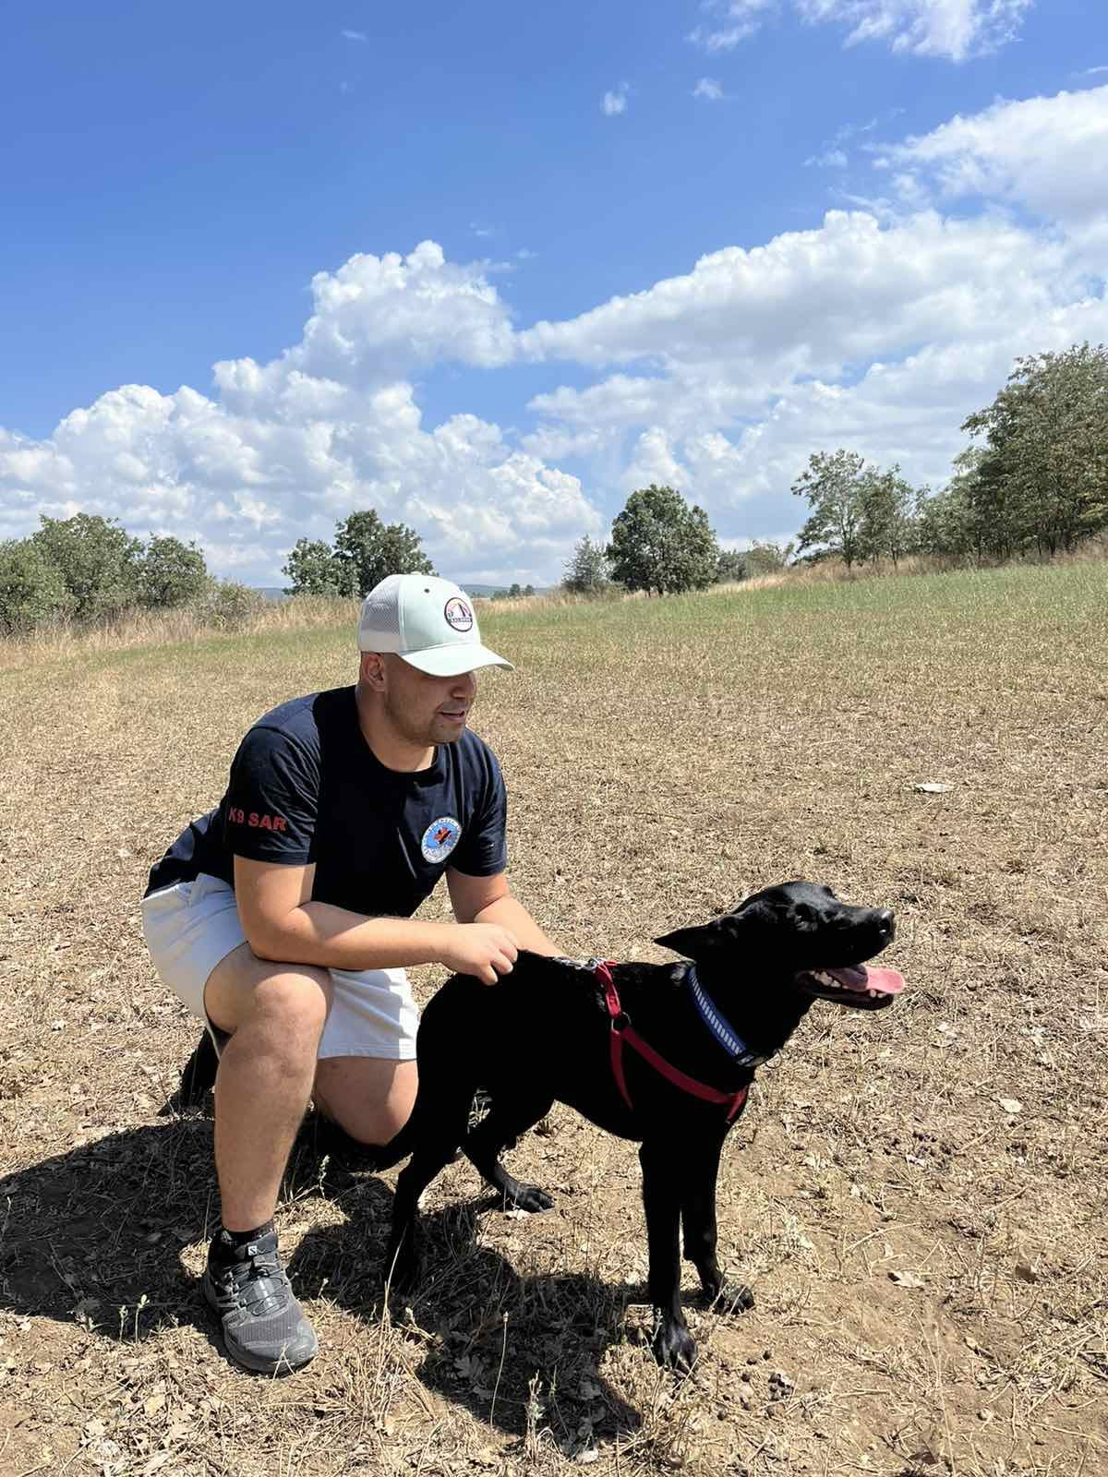
Vasilis and Bruno
Elvira and Savana
Thanasis and Junior
Volunteerism in Greece
Notes:
2. Limited Funding and Resources
Many volunteer organizations in Greece rely on donations or external funding, which is often inconsistent or insufficient. This financial insecurity limits their capacity to carry out long-term projects and provide proper support for volunteers.
Over-reliance on Volunteers: In some cases, essential services such as refugee support or environmental protection rely too heavily on volunteer labor due to a lack of state funding, which can strain volunteers both emotionally and physically.
3. Lack of Training and Professional Support
Many volunteers, particularly those involved in sensitive areas like refugee support or disaster relief, often lack the training and professional support necessary to deal with the complex challenges they encounter.
Inconsistent Volunteer Standards: The lack of standardized protocols for volunteer work means that volunteers may not always be prepared or qualified for the tasks they are assigned, which can result in ineffective aid or even harm.

Slide 13
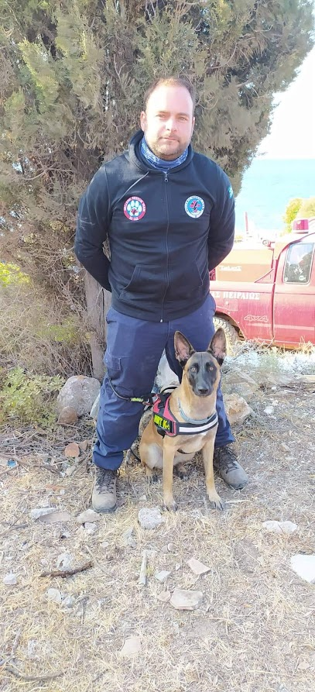
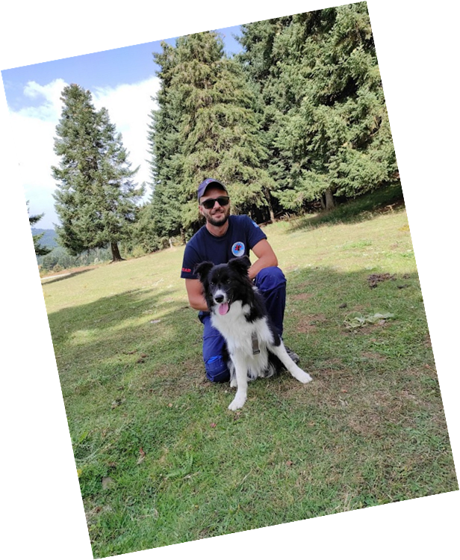
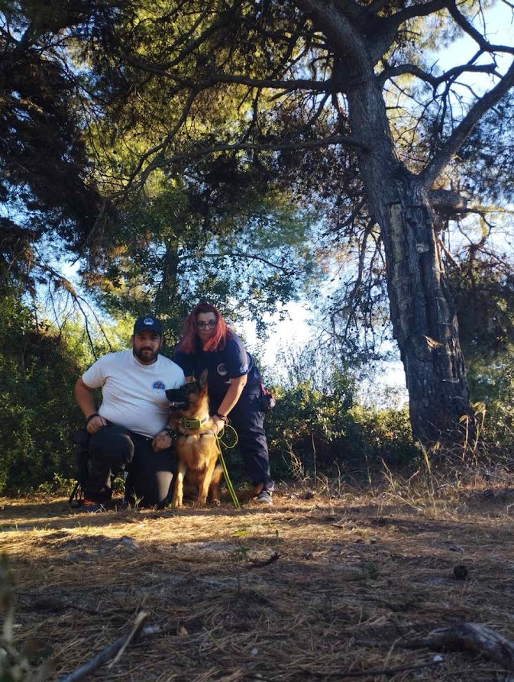
Yiannis-Dimitra and Asha
Thrasos and Map
Thanos and Speedy
Volunteerism in Greece
Notes:
5. Volunteer Retention Issues
Lack of Incentives: While many volunteers are motivated by altruism, the lack of formal recognition, support, or career incentives can make it difficult to retain volunteers in the long run.
6. Legal and Institutional Gaps
Unclear Legal Framework: There is no comprehensive legal framework that clearly defines the rights, duties, and protections of volunteers in Greece. This can lead to exploitation or unclear responsibilities for volunteers, particularly in high-pressure situations like refugee camps or disaster relief efforts.
Liability Issues: In some cases, the lack of clarity over liability can deter volunteers from engaging in certain activities due to fears of legal repercussions in case of accidents or disputes.

Slide 14
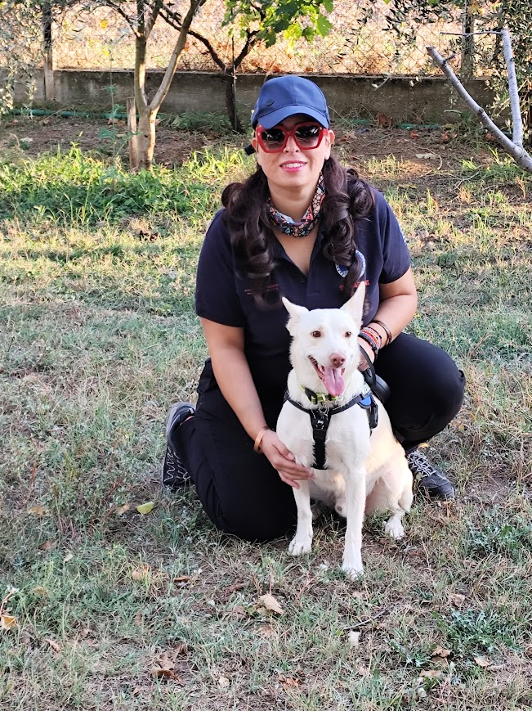
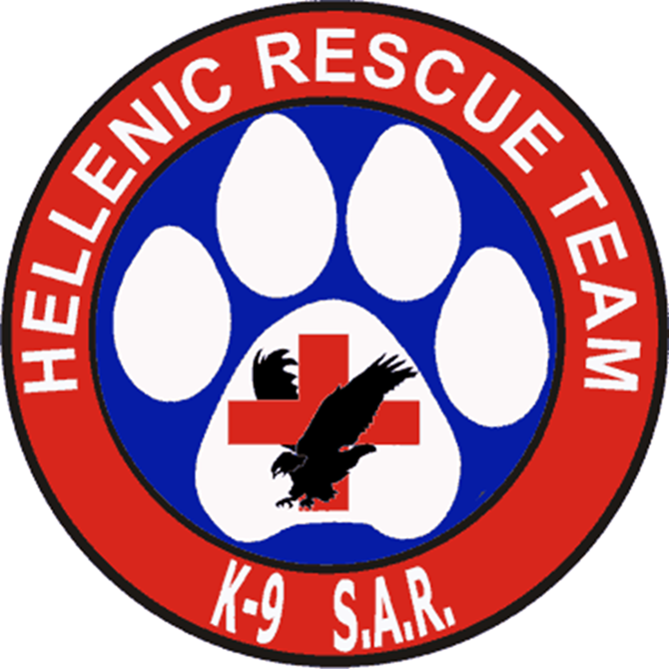
Katerina and Laertes
Thank you!
Volunteerism in Greece
Notes:
5. Volunteer Retention Issues
Lack of Incentives: While many volunteers are motivated by altruism, the lack of formal recognition, support, or career incentives can make it difficult to retain volunteers in the long run.
6. Legal and Institutional Gaps
Unclear Legal Framework: There is no comprehensive legal framework that clearly defines the rights, duties, and protections of volunteers in Greece. This can lead to exploitation or unclear responsibilities for volunteers, particularly in high-pressure situations like refugee camps or disaster relief efforts.
Liability Issues: In some cases, the lack of clarity over liability can deter volunteers from engaging in certain activities due to fears of legal repercussions in case of accidents or disputes.

